Slide 1
SEC 285 Final PROJECT
Professor Reginald Marshall
Takeyha Thompson-Green
November Session 2023

Slide 2
INTRODUCTION
Welcome to my SEC285 Fundamentals of Information System Security final project. In this compiled course project, I will be utilizing a Linux server, Kali, and Ubuntu throughout the project. This project will start with Asymmetric key encryption which will include encrypting my file with gpg and showing my file decryption process. Next, I will be doing a Nmap scan and showing my results. Later in my PowerPoint, I will be displaying my Bring Your Own Device (BYOD) Security Policy that I created which will also include my revision history. After the Bring Your Own Device (BYOD) Security Policy, I will be using a common-auth configuration file which will allow me to send an MFA code from Google. Lastly, I will be using vulnerability assessment tools which are Netcat, Wireshark, and Nessus to assess the vulnerability in the Linux Server.

Slide 3
Asymmetric Key Encryption

Slide 4
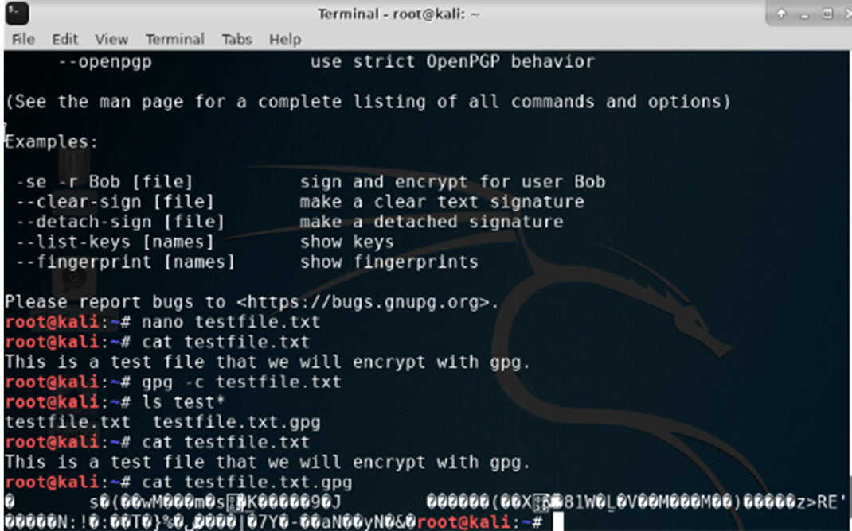
File Encryption
This screenshot should show the following :
Content of the plaintext file
Content of the encrypted file

Slide 5
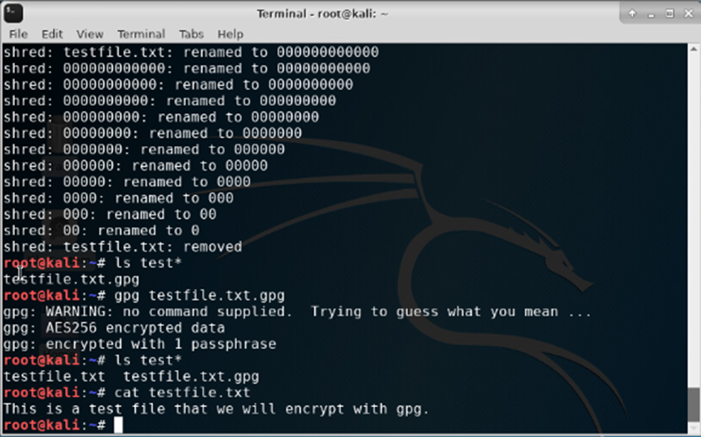
File Decryption
This screenshot should show the following.
The encrypted file being listed by itself
The decrypting process
Both the encrypted file and the original plaintext file being listed

Slide 6
Stateful Firewall

Slide 7
Question
What effect does the sudo iptables --policy INPUT DROP command have on the access to computing resources?
Answer here: This adds a rule in the policy section that pertains to incoming traffic that gets dropped.
References: Video Demonstration

Slide 8
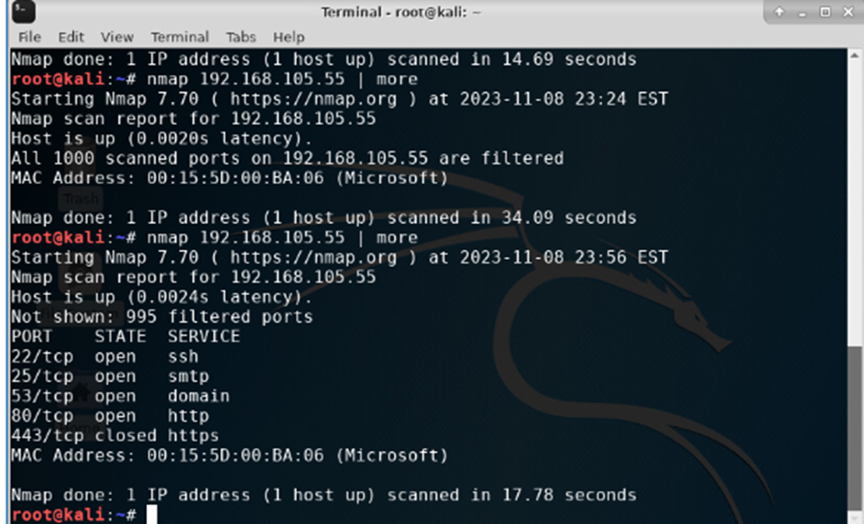
Nmap Scan
This screenshot should show the Nmap scan result of the Linux Server VM

Slide 9
Bring Your Own Device (BYOD) Security Policy

Slide 10
Overview:
In modern-day enterprises, companies have implemented the use of devices such as tablets, smartphones, and laptops. This has led businesses to increase communications from the employee to the employer and vice versa. This has given employees flexible communication options, especially in today's environment where employers are working remotely. Employees are now able to do work-related tasks such as work-related training, voice calls, and have access to company information. Not to mention present with the use of web-based platforms such as (Zoom, Webex, and Skype), they can review content and conduct meetings whether they are team-based or individual meetings. However, some risks are associated with these devices such as data security, standardized connectivity, and battery life.
https://www.mckinsey.com/~/media/McKinsey/dotcom/client_service/High Tech/PDFs/BYOD_means_so_long_to_company-issued_devices_March_2012.ashx
2. Purpose:
When BYOD you should always apply security measures simply because malicious attackers could gain access to the organization's information within a blink of an eye. Prioritizing your vulnerabilities based on risk and using technology that can automate vulnerabilities. It is important to do this because this will prevent the organization from data loss, facing a security breach, ransomware, and any other cyber attack

Slide 11
3. Scope:
The devices that can be utilized during working hours involve USB drives, smartphones, personal laptops/computers, and handheld tablets. Only work-related activity/content is allowed on these devices. Our local IT admin is responsible for issuing permissions on the company’s network.
4. Policy:
Importantly, all BYOD devices that will used are subjected to security assessments before receiving your permissions. The device must have the following which are: an updated anti-virus software, a firewall, and the last update of Windows 10/11, Linux, and Mac OS software update. Noncompliance vices will be required to follow a mediation, which your local IT department will be responsible for remediation.

Slide 12
5. Policy Compliance:
The InfoSec team will verify compliance with this policy through various methods, including but not limited to, periodic walk-throughs, video monitoring, intrusion detection tools, business tool reports, internal and external audits, and feedback to the policy owner. If an employee is found to have violated this policy may be subject to disciplinary actions up to 30 days of jail time to immediate termination of employment.
6. Related Standards, Policies, and Processes:
Protection of Personal Identifiable Information (PII)can be linked to this policy. Since you're able to BYOB, information security will be vital. You'll have access to information whether it's a client or your company's information. This prevents data breaches, identifies theft, and someone to gain access to your information. Therefore, protecting personal data is a must.

Slide 13
7. Definitions and Terms:
BYOD ( bring your own device )- this is when you bring your own personal technology. Whether it's a cellphone, tablet, or laptop.
Mobile devices - are portable computers such as cell phones and tablets that are usually made to be handheld.
CIA- this is a model for security systems that are made to protect policies for information security for an organization, which stands for confidentiality, integrity, and availability.
8. Revision History:
Date of change | Responsible | Summary of change
August 2019 | SANS policy team | Updated and converted to new format
November 2023 | Takeyha Thompson-Green | Completely updated, deleted, and revised a new policy

Slide 14
Multifactor Authentication (MFA)

Slide 15
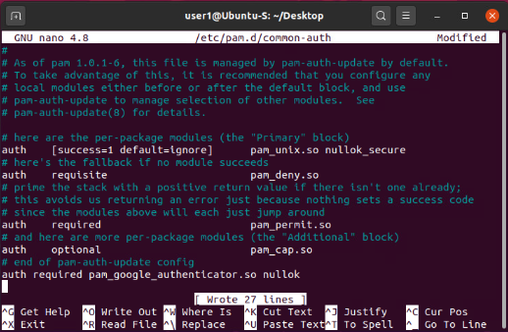
Common-auth Configuration File
This screenshot should show the entry that indicates the use of the Google Authenticator module.

Slide 16
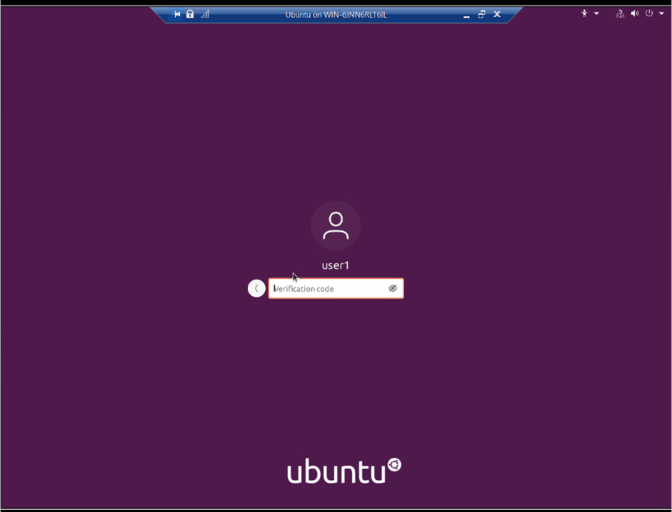
MFA Logon Screen
This screenshot should show the logon screen where a verification code is required.

Slide 17
Vulnerability Assessment

Slide 18
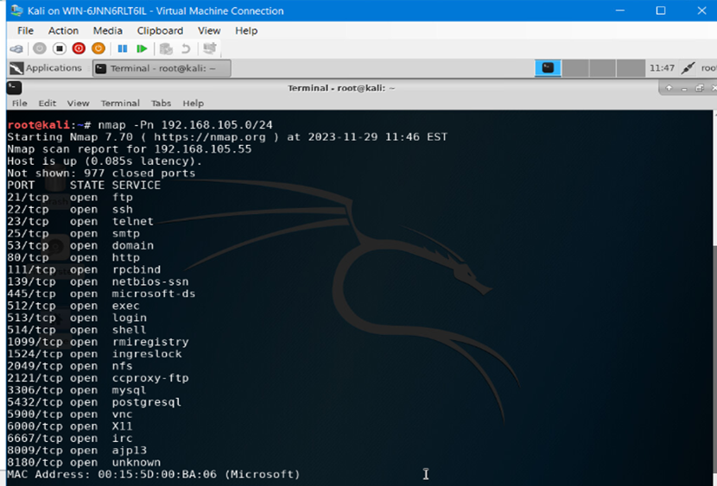
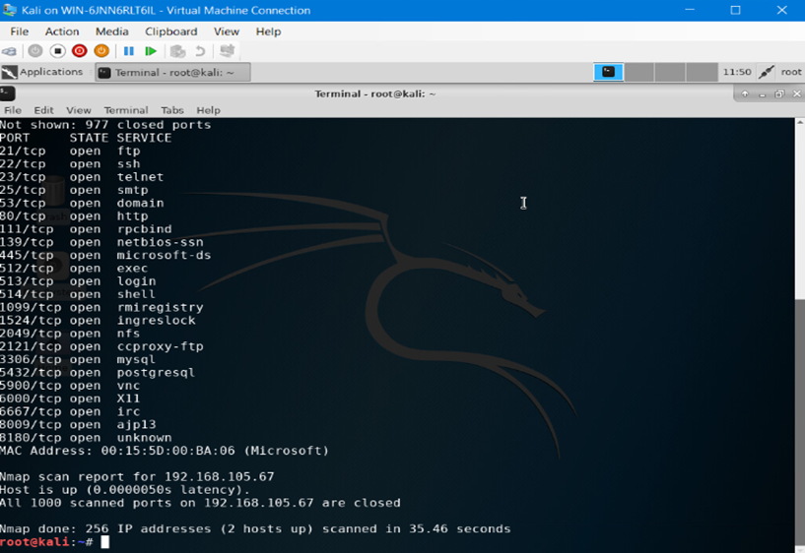
Nmap
This. screenshot should include the scan result showing both the Kali and Linux Server VMs

Slide 19
NetCat
This screenshot should include the scan result showing both the Kali and Linux Server VMs.

Slide 20
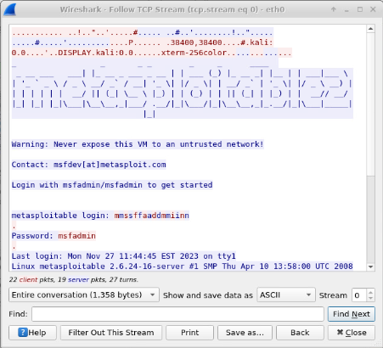
Wireshark
This screenshot should include the Wireshark—Follow TCP Steam window showing the Telnet username and password.

Slide 21
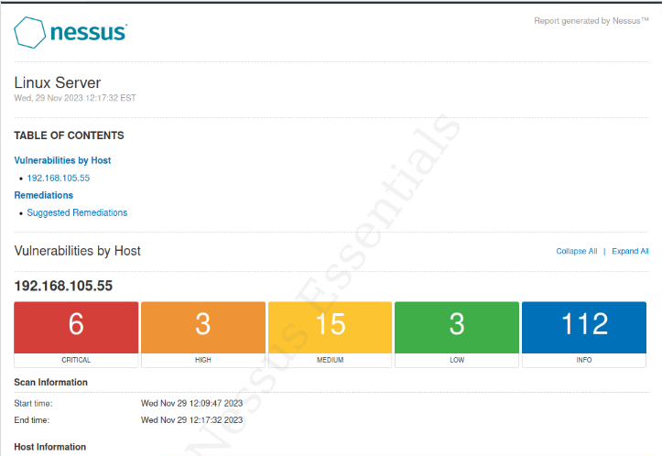
Nessus
This screenshot should include the high-level view of the Nessus vulnerability scan report (showing categories of vulnerability in different colors).

Slide 22
Career Slide
Created a BYOD device policy, this prepared me for my future career and helped me to understand how to write a security policy
I used asymmetric key encryption with the use of GPG in Kali, to encrypt files.
Used Linux to set up a stateful firewall, which was possible with the use of iptables
Used vulnerability assessment tools ( NetCat, Wireshark, and Nessus) to analyze any vulnerabilities to the Linux Server
=

Slide 23
Challenges
Some of the challenges that I faced were having to start over due to me missing a step when doing the Multifactor Authentication (MFA) process.
Severs were slow
When using the scan tool on Nessus the scan took about 12 mins, which ate up a lot of time.

Slide 24
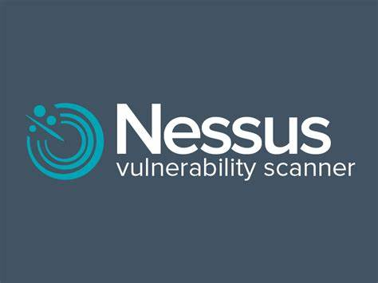
Conclusion
As I’m coming to the end of completing my SEC285 course, this compiled project has made me reflect on a lot. Some of the highlights were the Vulnerability Assessment which was one of my favorite parts of the project along with the Multifactor Authentication (MFA) segment. Another highlight was working with Nessus Vulnerability Scanner in Ubuntu. However, when it came to creating my own BYOD device policy wasn’t my favorite. Nonetheless, it helped me to understand how to write a policy and the components of a policy. This was my first time working in Kali, I liked working in this platform and look forward to working in Kali once again. Thank you for taking the time to view my project!

Slide 25
References
https://www.mckinsey.com/~/media/McKinsey/dotcom/client_service/High Tech/PDFs/BYOD_means_so_long_to_company-issued_devices_March_2012.ashx
Project Demonstration Videos 2-6

