Slide 1
NETW191 FINAL COURSE PROJECT
Professor Farooq Afzal
Takeyha Thompson-Green
September Session 2023

Slide 2
Introduction
Welcome to my NETW191 final course project this project covers the fundamentals of networking. Which is very important for my future career, however, it is also very important in the world of IoT. This project covers the design and not to mention the development process of building a network, which was created using Visio. It also includes SOHO router configurations, IP subnetting and loopback interfaces, multiple connectivity tests, network documentation, and SOHO wireless network security. Please enjoy this project because I enjoyed my time creating this project

Slide 3
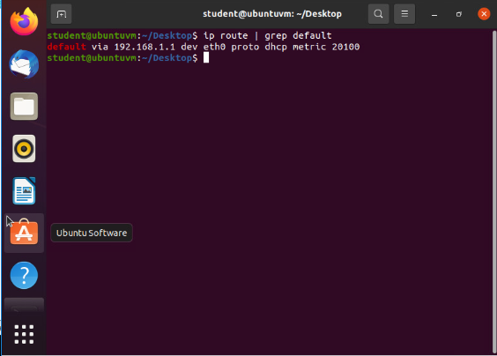
Preparation
This screenshot should include the terminal window that shows the default gateway IP address.

Slide 4
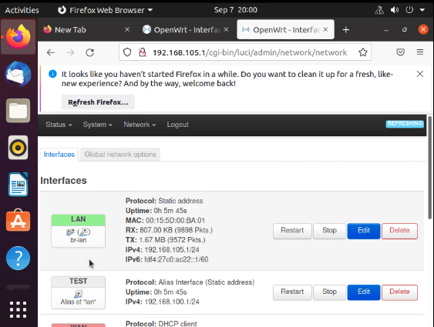
IPv4 Address Assignment
This screenshot should include the terminal window that shows the default gateway IP address.

Slide 5
CONNECTIVITY TEST

Slide 6
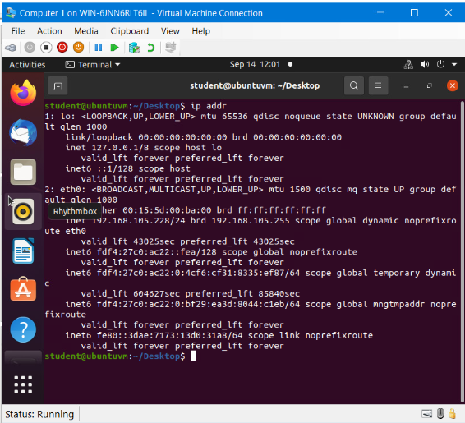
Dynamic IP Address Assignment This screenshot should show the IPv4 address of the Computer 1 VM

Slide 7
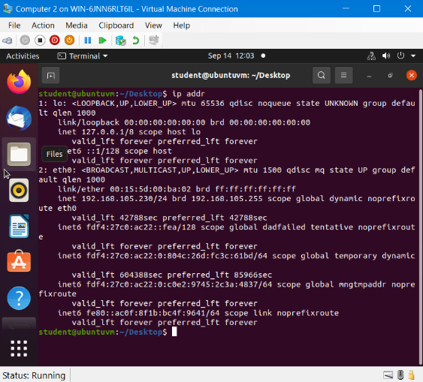
Dynamic IP Address Assignment This screenshot should show the IPv4 address of the Computer 2 VM

Slide 8
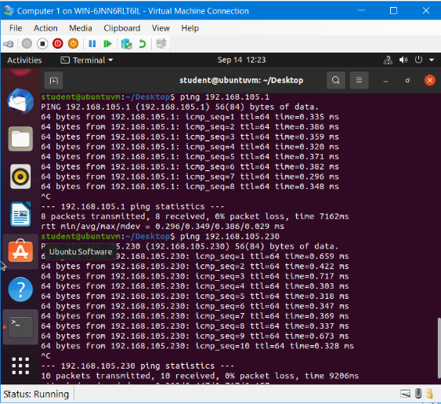
Connectivity Test
This screenshot should show the connectivity tests between the Computer 1 VM and the other two devices (i.e., the SOHO Router VM and Computer 2 VM).

Slide 9
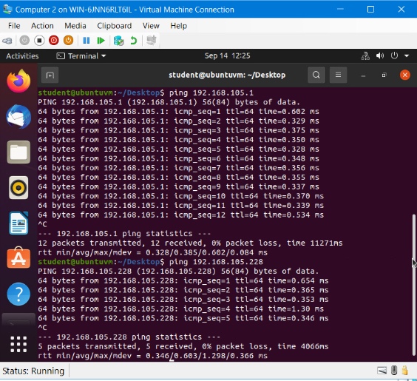
Connectivity Test
This screenshot should show the connectivity tests between the Computer 2 VM and the other two devices (i.e., the SOHO Router VM and Computer 1 VM).

Slide 10
IP SUBNETTING AND LOOPBACK INTERFACES

Slide 11
Subnetting Table
This table should include two /25 subnets, listing the subnet notation, network address, first usable host address, last usable host address, and broadcast address of each subnet.

Slide 12
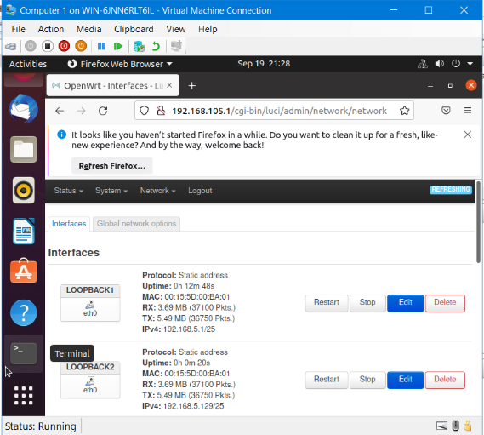
Loopback Interfaces
This screenshot should show both Loopback1 and Loopback2 interfaces and their correct IPv4 addresses.

Slide 13
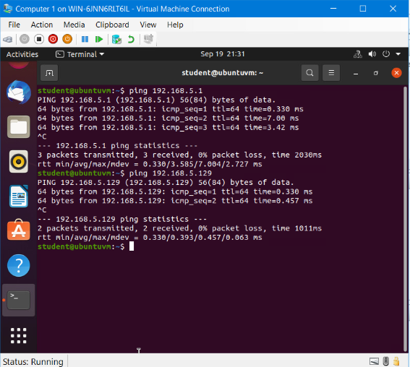
Connectivity Test
This screenshot should show two successful ping tests from the Computer 1 VM to the Loopback 1 and Loopback 2 interfaces.

Slide 14
Visio Network Diagram

Slide 15
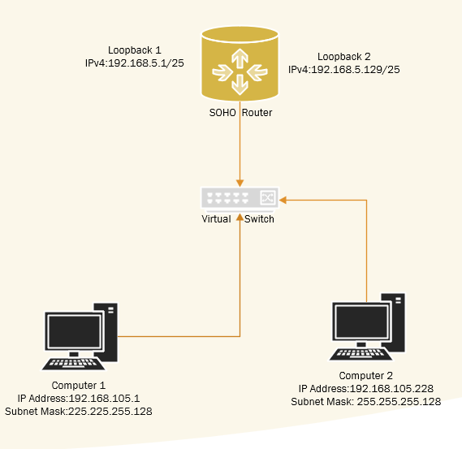
Microsoft Visio Network Diagram
This diagram should illustrate the interconnection of the Computer 1 VM, the Computer 2 VM, and the SOHO Router VM along with proper addressing and labeling.

Slide 16
SOHO Wireless Network Security

Slide 17
SOHO Wireless Network Security
1. What are the factory default username and password of a TP-Link router? Why is it important to change the default username and password of a SOHO router?
Answer: Default User Name - admin Default Password - admin
Due to security reasons, it provides security that prevents from anyone may be able to access your router.
2. To protect a SOHO wireless network with a small number of devices, which address management method provides more control, configuring the device IP addresses manually (static IP) or using a DHCP server (dynamic IP)? Why?
Answer: Static IP addresses because they don’t change over time like dynamic IP addresses that change periodically, you also have full control over your DNS settings, and you’re also able to whitelist IP addresses.
3. What does MAC filtering do? If needed, when would you use deny filtering rules, and when would you use allow filtering rules? What happens to devices that want to connect, if the “Allow the stations specified by any enabled entries in the list to access” function is enabled but there are no entries in the list?
Answer: Mac filtering allows you to control the wireless stations accessing the AP (access point, depending on the station’s MAC address. I would use the deny filter when I want to create a parent control that could restrict my son from connecting any devices to our network, I would use the allow filtering rules when I want to allow specific devices on my network. If there are any enabled entries on the list then no wireless stations will be able to access the AP.

Slide 18
SOHO Wireless Network Security
1. What wireless security settings are displayed on the Wireless Security page? Which one is recommended by the vendor? Why?
Answer: WPA/WPA2 – Personal, WPA/WPA2 – Enterprise and WEP
WPA/WPA2 with AES encryption is recommended by the vendor because it allows you to enable wireless security
2. Among the configurations you explored in this module, which one is a true security function? Why?
Answer: Mac Filtering because it allows you to choose who can connect to your network. This can prevent things like cyberattacks from happening especially if someone is on illegal sites or strangers connecting to your network.
3. What would you do to protect your wireless network at home? Why?
Answer: I would use Mac Filtering just because not add a little bit of security by getting rid of anyone that I would not want on my network. Especially if I gave them access to my network and didn’t want them to have access to my network any much longer.

Slide 19
References
1. Week 6 live session video
2. Static vs. Dynamic IP Address: Similarities and Differences | Fortinet

Slide 20
Challenges
Some of the challenges that I had during this project were :
Switching from Computer 1 & 2
Ubuntu crashing and lagging
Accidently closing the wrong screen
Forgetting that Ubuntu is case sensitive

Slide 21
Career slide
Understanding of Networking fundamentals
Basic understanding of SOHO router configurations
Network security protocols
Network documentation
Small network configuration
Routing Protocols
The difference between wireless security settings

Slide 22
CONCLUSION
Thank you for taking the time to view my project. I really enjoyed this project, especially when creating my Visio Network Diagram. Creating the diagram gave me the chance to be creative, it also illustrated the entire project. However, this project gave me hands-on experience that will benefit my future. I really hope you enjoyed it!

