Slide 1
CEIS101 Final PROJECT SMARTHOME AUTOMATION AND SECURITY SYSTEM
Presented by Takeyha Thompson-Green

Slide 2
Introduction
I developed a smart home automation and security system. First, I started off with using Tinkercad to build my prototype along with running a simulation. Later I started building the hardware with the components from the IoT Tech Core Kit and Arduino IDE to program. The smart home system has various devices that monitors the status of the home. This includes a door sensor, distance sensor, and automated lights.
The door sensor will check whether the door is open or closed.
The distance sensor will check to see for a possible home intruder .
The automated lights that turn on when it is dark.

Slide 3
Circuit Simulation Tinkercad

Slide 4
Circuit (screenshot)

Slide 5
Code (screenshot)

Slide 6
INVENTORY OF PARTS, CIRCUIT BUILDING AND DISPLAYING MESSAGES

Slide 7
Inventory of IoT Kit
UCTRONICS Kit
ESP32 (2)
LCD Modules (2)
Breadboards (3)
Mini Router
Patch Cable
Digital Multi Meter
USB to Micro USB (2)

Slide 8
Organization of Project (picture)
Arduino Mega 2560
Breadboard
Resistor 10kΩ
LEDs
Ultrasonic Sensor
Active Buzzer
Photoresistor
Wires
USB Type B cable

Slide 9
Circuit with red LED on (picture)

Slide 10
Serial Monitor(screenshot)

Slide 11
ADDING DOOR SENSOR TO SMARTHOME SYSTEM

Slide 12
Circuit of door closed with Green LED ON

Slide 13
Circuit of door open with Green LED OFF(picture)

Slide 14
Serial Monitor (screenshot)

Slide 15
Arduino Code (screenshot)

Slide 16
ADDING DISTANCE SENSOR TO SMART HOME SYSTEM AND CONDUCTING DATA ANALYSIS

Slide 17
Circuit with green LED on

Slide 18
Circuit with yellow LED on (picture)

Slide 19
Circuit with red LED on (picture)

Slide 20
Arduino Code (screenshot)

Slide 21
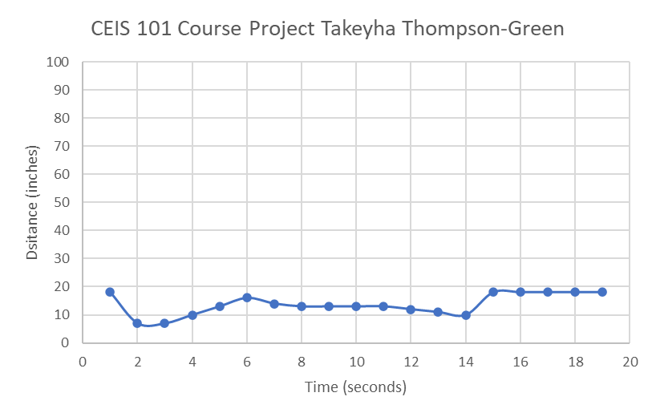
Plots of data (screenshot)

Slide 22
ADDed AUTOMATED LIGHT TO SMART HOME SECURITY SYStEM

Slide 23
Circuit with automated LED off (picture)

Slide 24
Circuit with automated LED on (picture)

Slide 25
Arduino Code (screenshot)

Slide 26
Serial Monitor (screenshot)

Slide 27
Challenges
The issues that occurred when building my smart home automation and security system were that :
I made a simple mistake by using the wrong resistor. Which caused me to take everything apart and rewire everything, unfortunately it still did not work. This caused me to do an inventory check on the parts that I needed.
I noticed that I had the wrong resistor, the lettering on the resistors was extremely hard to see so I ended up taking a pen and labeling my 10k resistors.
The other problem that I faced with Arduino IDE was that the serial monitor would run extremely fast. This caused me to keep unplugging the USB or keep running the code and trying to screenshot it as fast as I could.

Slide 28
Career Skills Acquired
Fundamental concept of IoT devices
Learning how to work with a breadboard
Prototyping systems
Programming and Coding with Arduino IDE and Tinkercad
Automation
Network Fundamentals

Slide 29
Conclusion
This project was not only fun, but a complete eye opener. It gave me basic knowledge of how to use Tinkercad. Which is a great resource that I used often throughout this project, to make sure all my wires and components were in the right place. I love that it was hands on and that I got familiar with my Arduino Mega 2650, breadboard, ESP32, along with the different components in my Uctronics kit. I liked working in Arduino IDE and seeing what I could do with plots of data. It led me to creating graphs from collected data used from the sensors. This gave me a basic idea of what IoT is about and ensured me that I was taking the right steps to success for my future classes .

