Slide 1
NETW 211 FINAL PROJECT
Professor Cung Nguyen
Takeyha Thompson-Green
November Session 2023

Slide 2
INTRODUCTION TO NETW211 FINAL COURSE PROJECT
This is my final project for my NETW211 Fundamentals of Cloud Computing course. It is a compiled project where I will be going over Virtual Instances in the first section. I will be deploying, connecting, and deleting a Virtual machine in Microsoft Azure. The next section will be called Azure VNet and Subnets. In this section, I'll create and deploy a VNet which will have 2 subnets in Microsoft Azure. Later I will verify the connectivity of the subnets using Command Prompt. Azure VM Security will be the next section, I will be creating a VM machine. Downloading a private key pair, connecting my VM with SSH, and adding my Allow_Ping rule which will later ping facebook.com. The last two sections of the PowerPoint are loud storage and cloud monitoring. In the cloud storage section, I will be creating a storage account. Upload a file, create blob snapshots, and enable blob versioning. Lastly, in the last section of this final course project cloud monitoring, I will be setting up my two rules which are "VM-restart and VM-deallocate, and I will also be restarting my VM to receive the alert coming from Azure to my email. I will also be stopping my VM and receiving an alert to alert me that my VM deallocation was activated. I hope you enjoy my project!

Slide 3
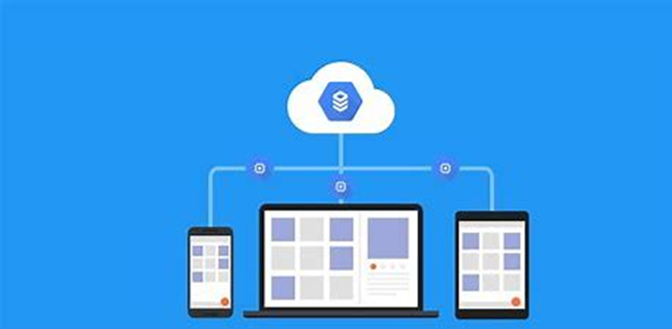
Virtual Machine (VM) Instances

Slide 4
Introduction to Virtual Machine (VM) Instances
I will be deploying a VM using the platform Azure, one of the first steps that I took was creating a Virtual Machine. Which included creating a new resource group, giving my virtual machine a name, changing my region to (US) East US, and selecting a security type. Next, I verified my VM size along with creating an administrator account. Next, it was time for the deployment process. Once that was completed, I connected to the Virtual machine using the Remote desk Protocol. I then downloaded the RDF file and logged into the virtual machine. Which then later I was able to connect successfully to the VM. Once, I was connected I was able to view the properties. The last steps that I did were to disconnect the VM and go back into Azure to delete the resources, VM, along with the resource group.

Slide 5
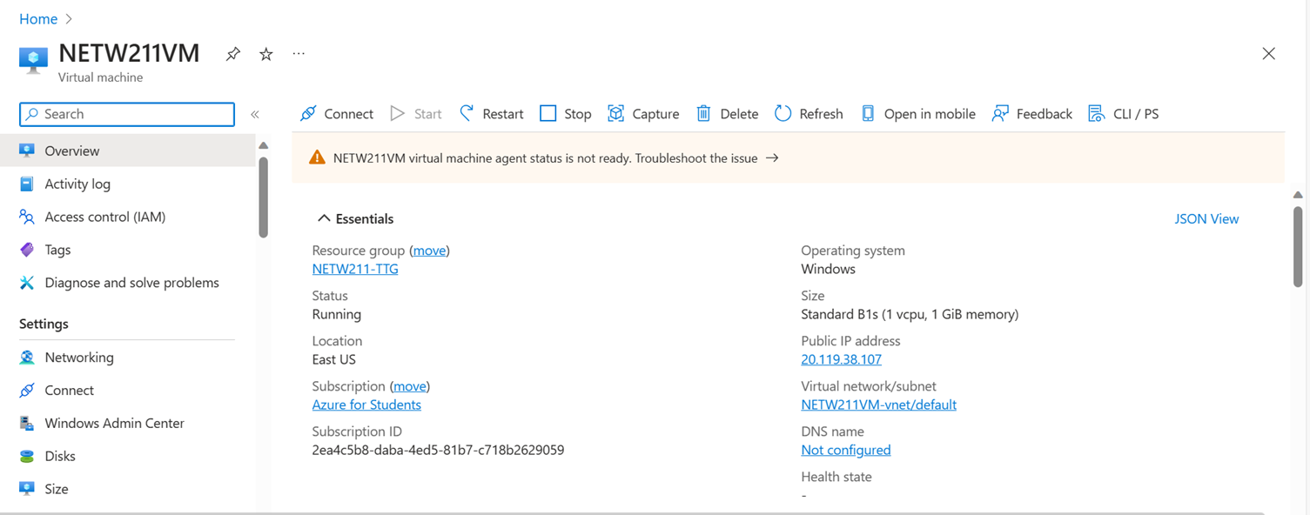
Deploying a VM in Azure
This screenshot should show the NETW211VM page with information such as the resource group name, subscription, public IP address, etc.
This screenshot should also show your DVU ID information in the top right corner of the Azure Portal.

Slide 6
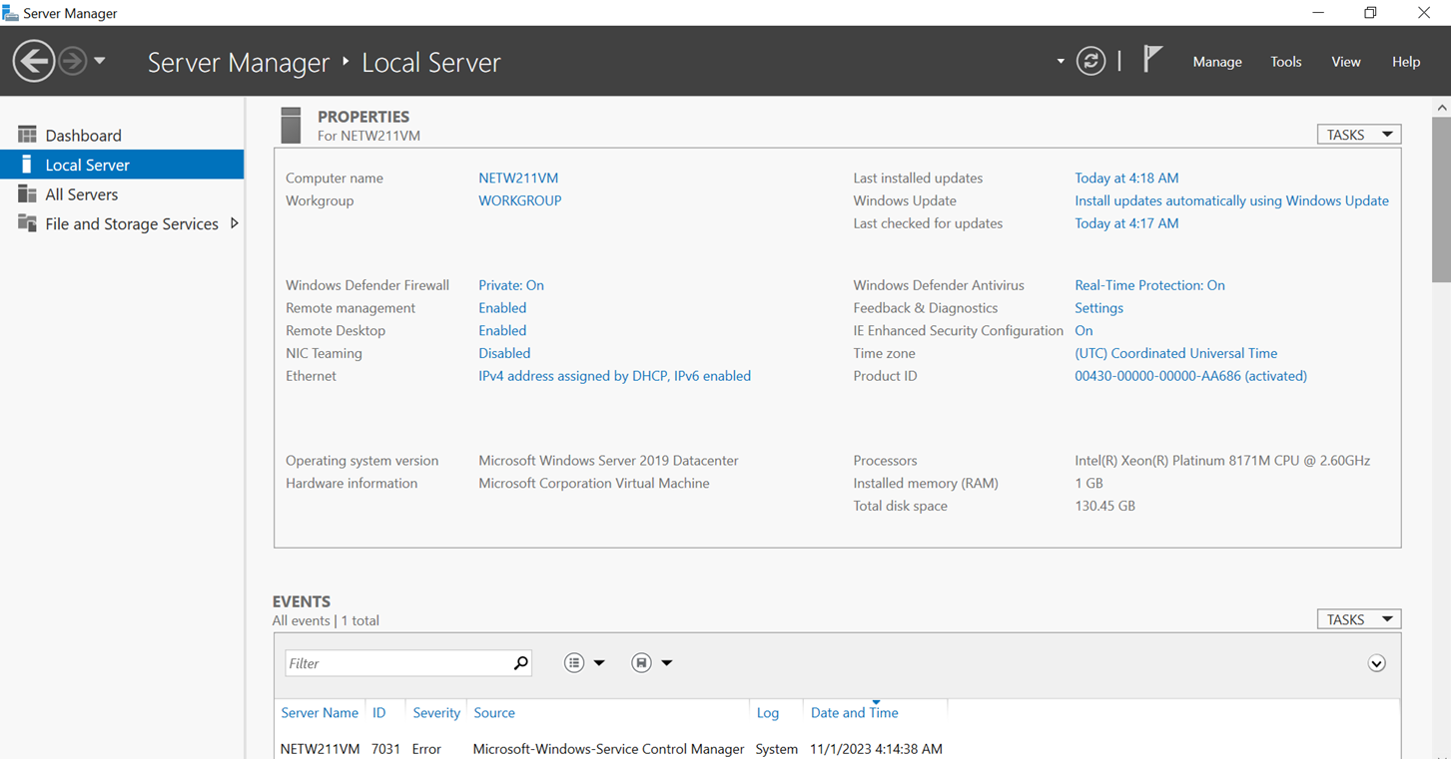
Connecting to the VM
This screenshot should show the PROPERTIES for NETW211VM page, including the computer name, operating system version, hardware information, etc.
This screenshot should also show the EVENTS section with the Date and Time information.

Slide 7
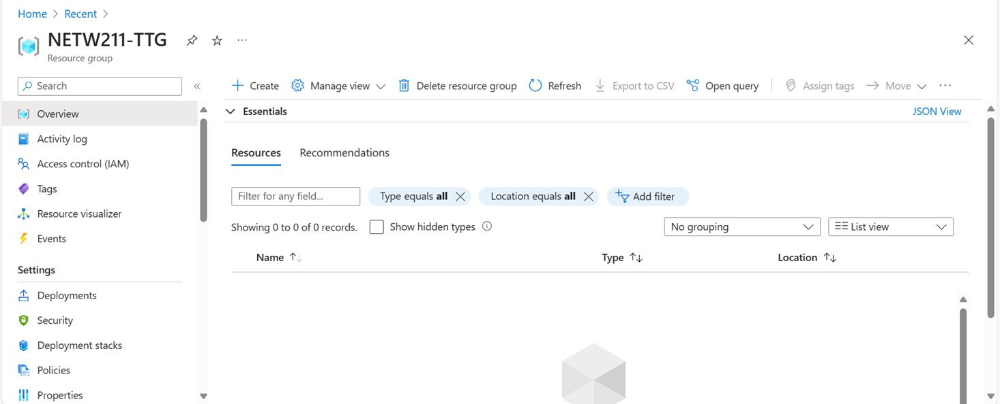
Deleting
the VM
This screenshot should show the NETW211-XX (Your Initials) Resource groups page, with the “No resources match your filters” message.
This screenshot should also show your DVU ID information in the top right corner of the Azure Portal.

Slide 8
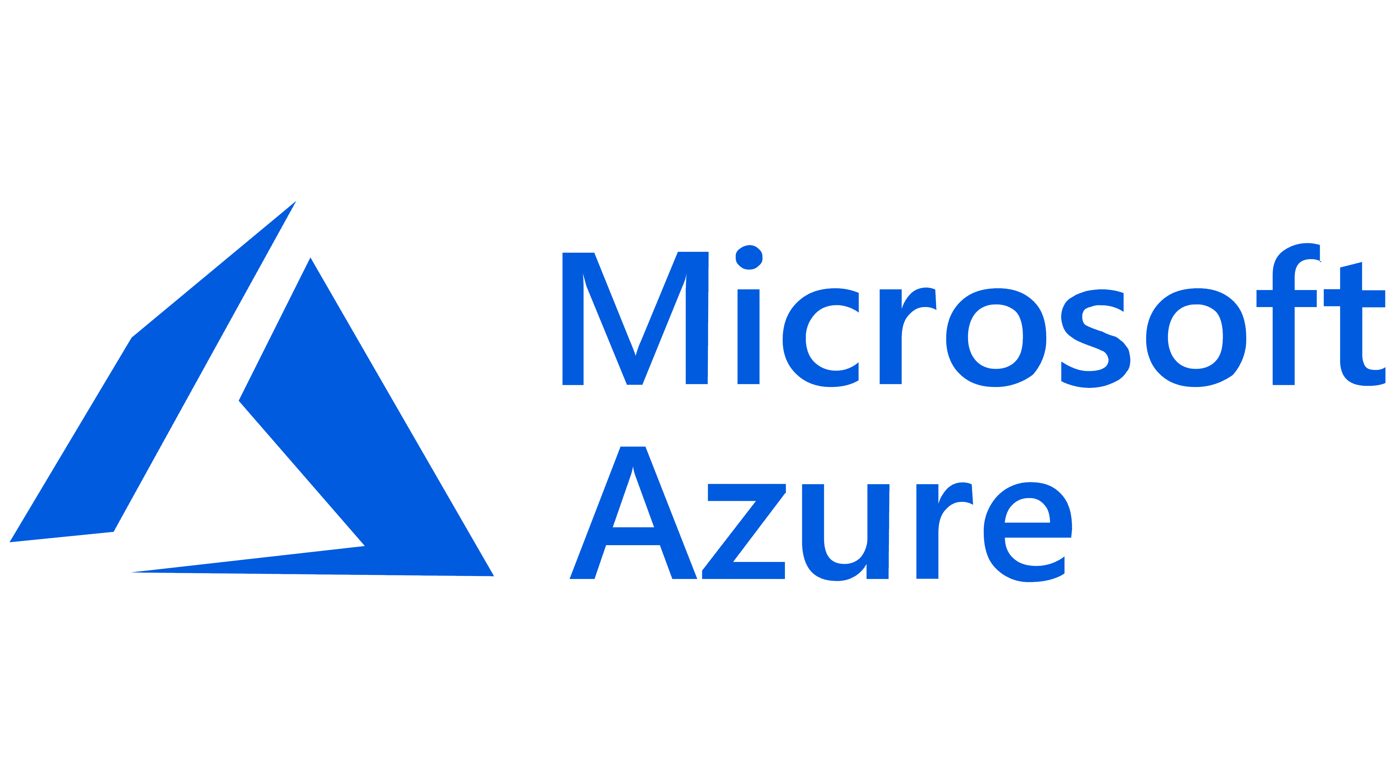
Conclusions
One of the things that I noticed when using Azure was that it was slow. Especially when it came to deploying, connecting, and deleting Azure. Which took up a lot of time, also when I was in the VM I noticed that it lagged a lot.

Slide 9
Azure VNet and Subnets

Slide 10
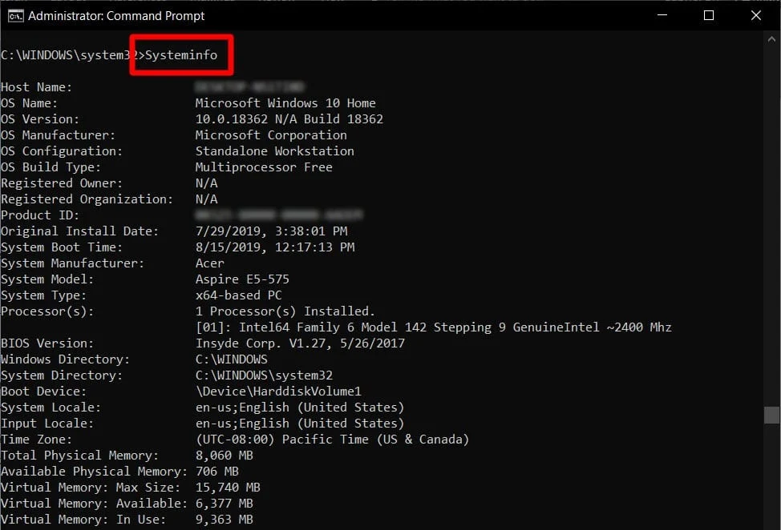
Introduction to Azure VNet and Subnets
I will be creating a VNet with two subnets, deploying the two subnets in Microsoft Azure, and verifying the connectivity of the two subnets using Command Prompt in the VM.

Slide 11
Creating a VNet with Two Subnets
1. With a /24 network prefix, how many usable IPv4 host addresses are there? [hint: you learned this in NETW191]
Answer here:
2⁸-2 = 256 -2 = 254
2. Given the answer above, why is the number of available IP addresses for Subnet0 (10.0.0.0/24) or Subnet1 (10.0.1.0/24) is 251 when you create an Azure VNet? [hint: where did the missing addresses go?]
Answer here: Yes. Azure reserves the first four addresses and the last address, for a total of five IP addresses within each subnet.
For example, the IP address range of 192.168.1.0/24 has the following reserved addresses:
192.168.1.0: Network address.
192.168.1.1: Reserved by Azure for the default gateway.
192.168.1.2, 192.168.1.3: Reserved by Azure to map the Azure DNS IP addresses to the virtual network space.
192.168.1.255: Network broadcast address.
1. IP Subnet Calculator, https://www.calculator.net/ip-subnet-calculator.html
2. Azure Virtual Network frequently asked questions, https://docs.microsoft.com/en-us/azure/virtual-network/virtual-networks-faq

Slide 12
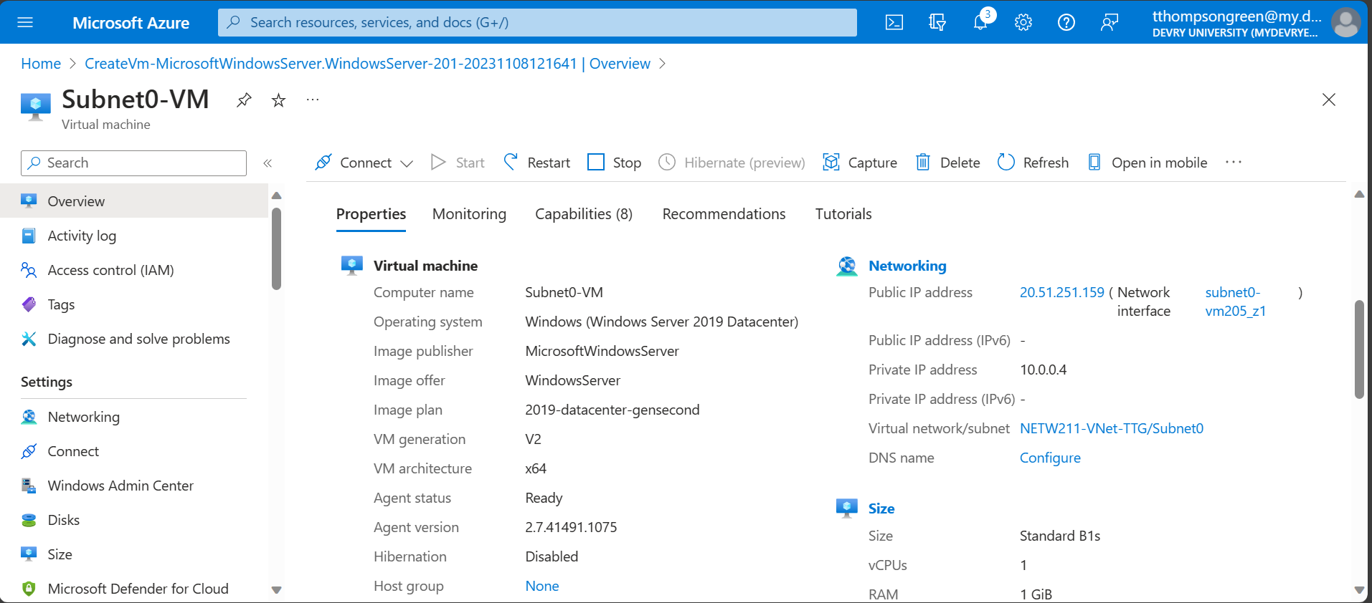
Deploying VMs into Subnets (1 of 3)
This screenshot should include the Properties section of the Subnet0-VM page, showing the networking and size information of the VM.
This screenshot should also show your DVU email in the top right corner of the Azure Portal.

Slide 13
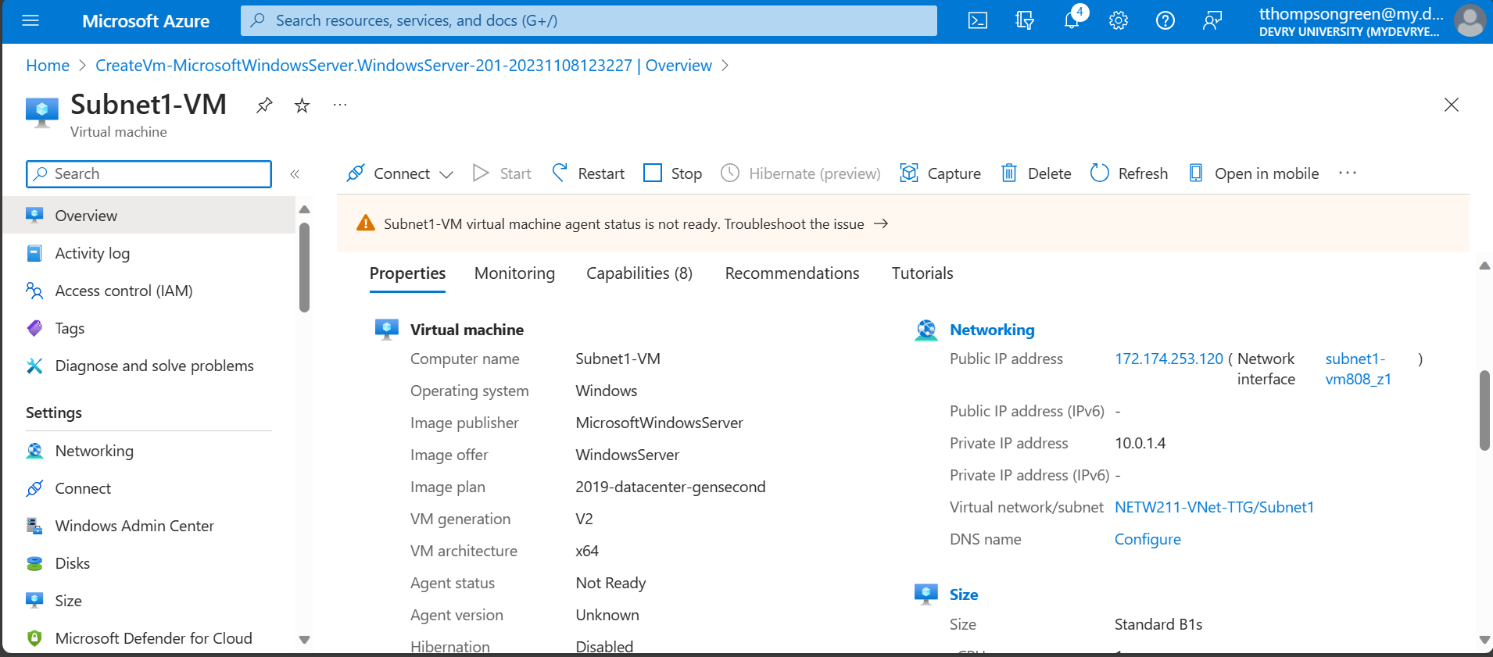
Deploying VMs into Subnets (2 of 3)
This screenshot should include the Properties section of the Subnet1-VM page, showing the networking and size information of the VM.
This screenshot should also show your DVU email in the top right corner of the Azure Portal.

Slide 14
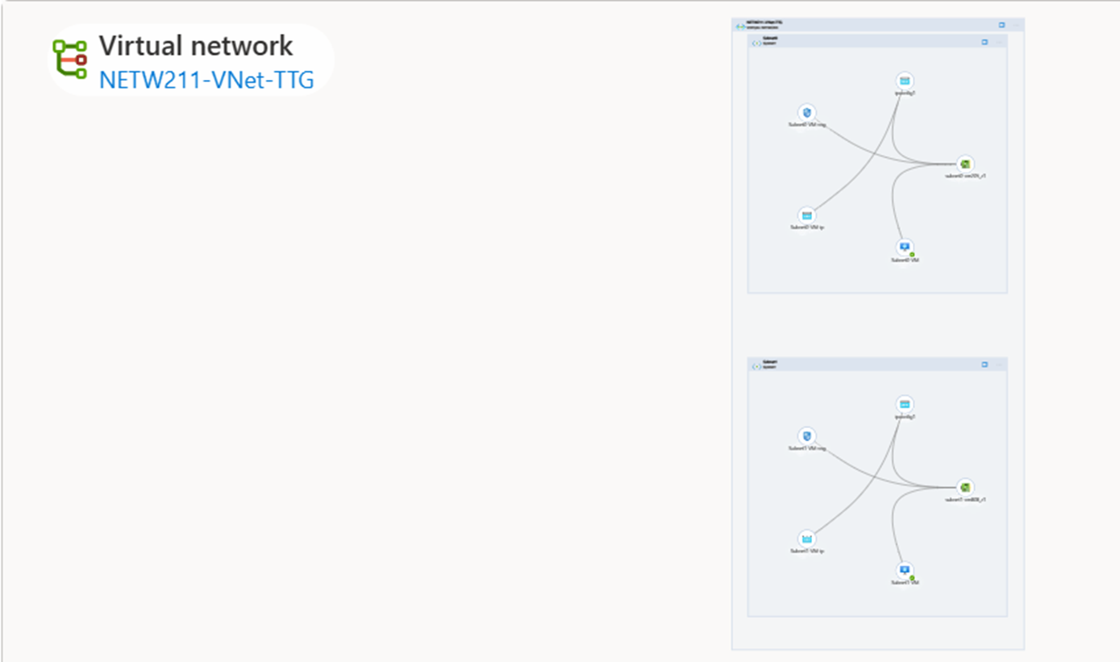
Deploying VMs into Subnets (3 of 3)
This screenshot should show the topology diagram of your VNet (NETW211-VNet-Your Initials) with two subnets (Subnet0 and Subnet1) and one VM in each subnet (Subnet0-VM and Subnet1-VM).
This screenshot should also show your DVU email in the top right corner of the Azure Portal.

Slide 15
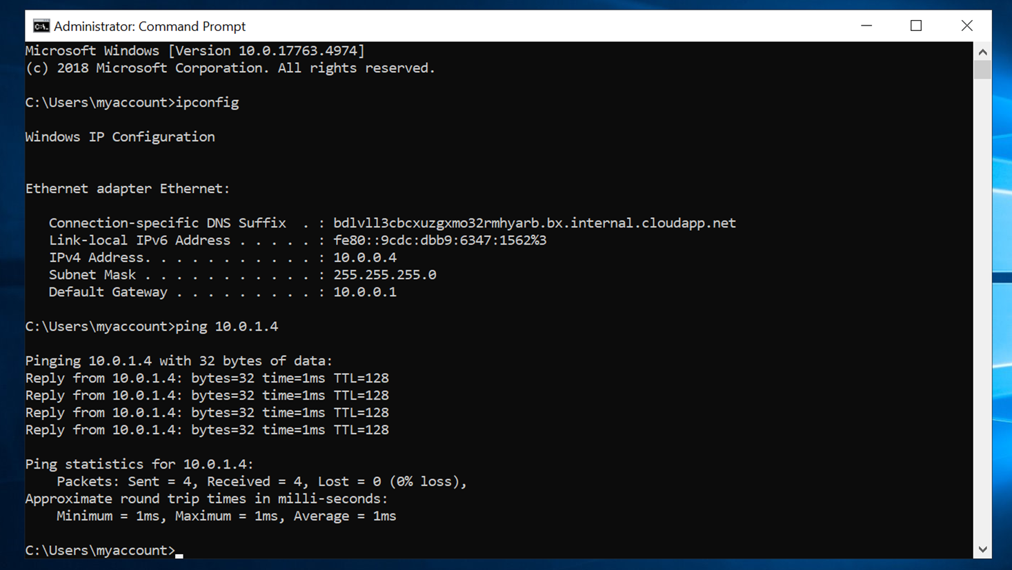
Verifying Connectivity between VMs (1 of 2)
This screenshot should show the ipconfig and ping x.x.x.x results in the command prompt window of Subnet0-VM.
This screenshot should also show the Date/Time information in the bottom right corner of your desktop.

Slide 16
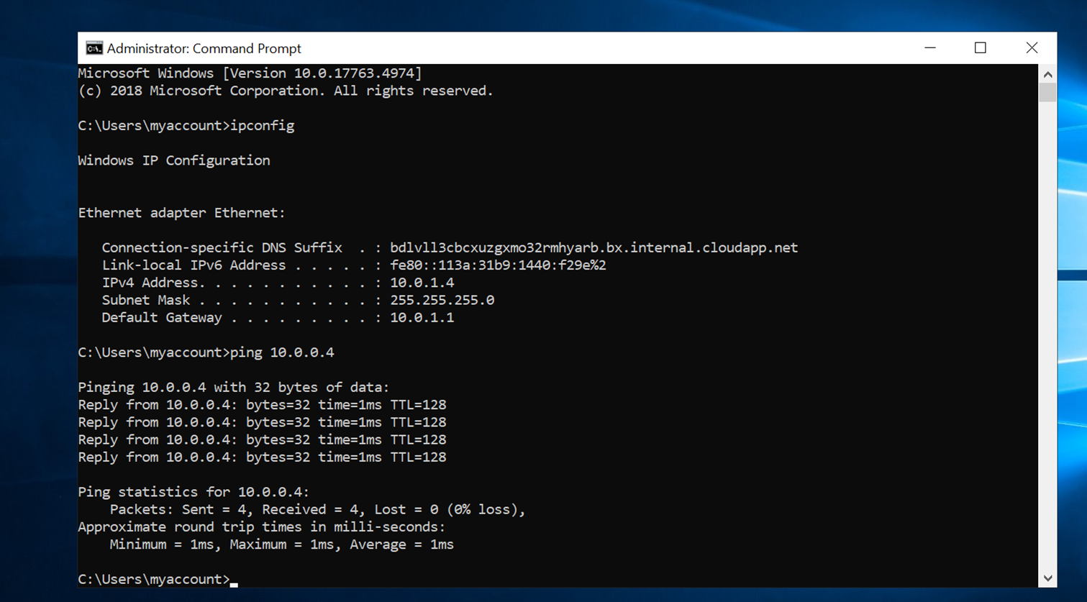
Verifying Connectivity between VMs (2 of 2)
This screenshot should show the ipconfig and ping x.x.x.x results in the command prompt window of Subnet1-VM.
This screenshot should also show the Date/Time information in the bottom right corner of your desktop.

Slide 17
Conclusions Overall, it was a quick and easy project. One difficulty that I had during the connectivity process was that the slides weren’t in order. I had to do the last part backward, not to mention minimizing the command prompt when executing commands in the Command prompt which can be easily confusing if you are not paying attention to the IPv4 addresses

Slide 18
Azure VM Security

Slide 19
During this portion of my project, I created a VM machine in Microsoft Azure. The most vital part of my deployment process was downloading the private key pair to my computer. Not to mention, documenting my public IP address which I needed later in this project. The next step was for me to connect my VM with SSH, once that was completed. I opened a command prompt and went to the directory that had my PIN file using the command dir *pen. Pasted in my command from SSH and included the entire extension. Entered a few commands, which included pinging facebook.com. I was also able to see my IP addresses with the command ip addr. The last step was configuring an NSG in Microsoft Azure. I created a security rule (Allow_Ping), opened a command prompt, and pinged the public IP address that I documented in earlier steps. Once this was done, I deleted the resource group that I created when deploying my VM.
Introduction to Azure VM Security

Slide 20
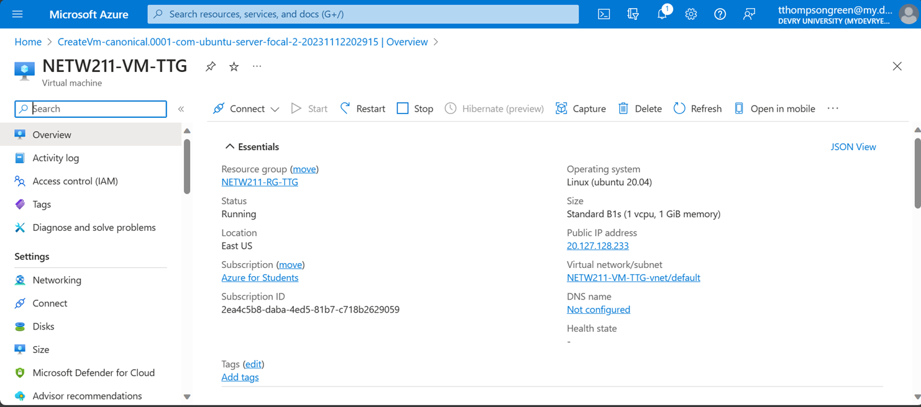
Launching a VM
This screenshot should show the NETW211-VM-Your Initials page, with information such as the resource group name, subscription, public IP address, etc.
This screenshot should also show your DVU email in the top right corner of the Azure Portal.

Slide 21
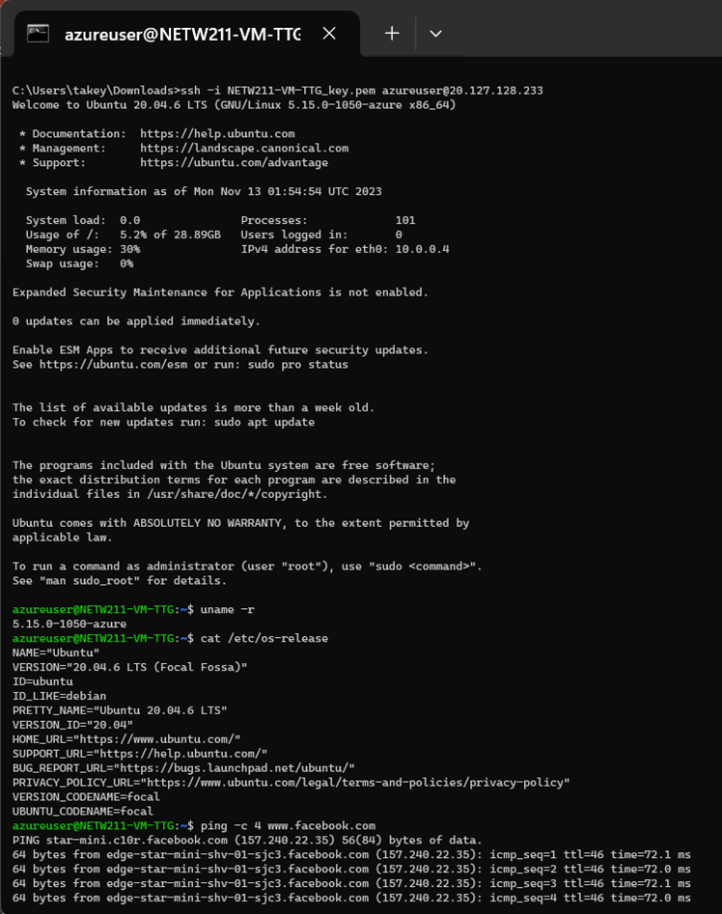
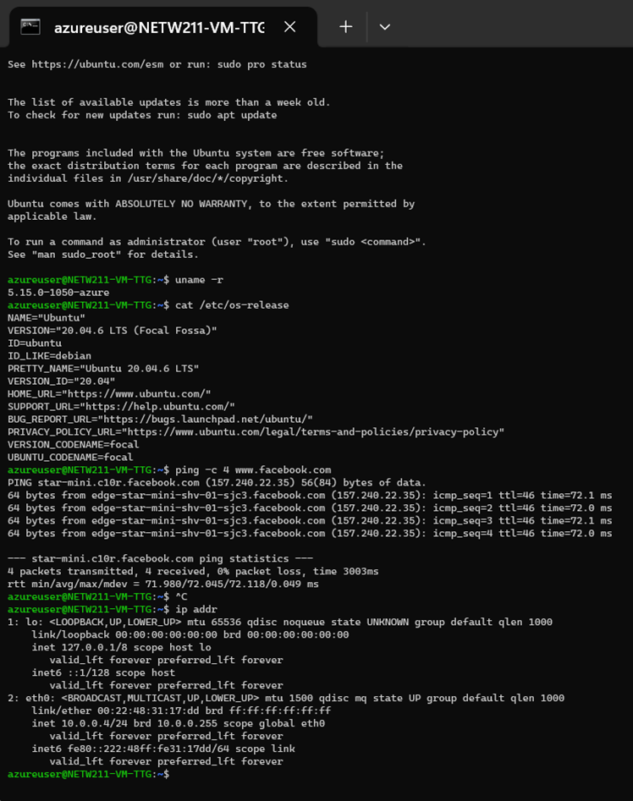
Connecting to the VM via SSH
This screenshot should include the azureuser@NETW211-VM-Your Initials window showing the IPv4 address of the VM in the Azure cloud.
Issue the date command in the same terminal window to include the system date and time in the screenshot.

Slide 22
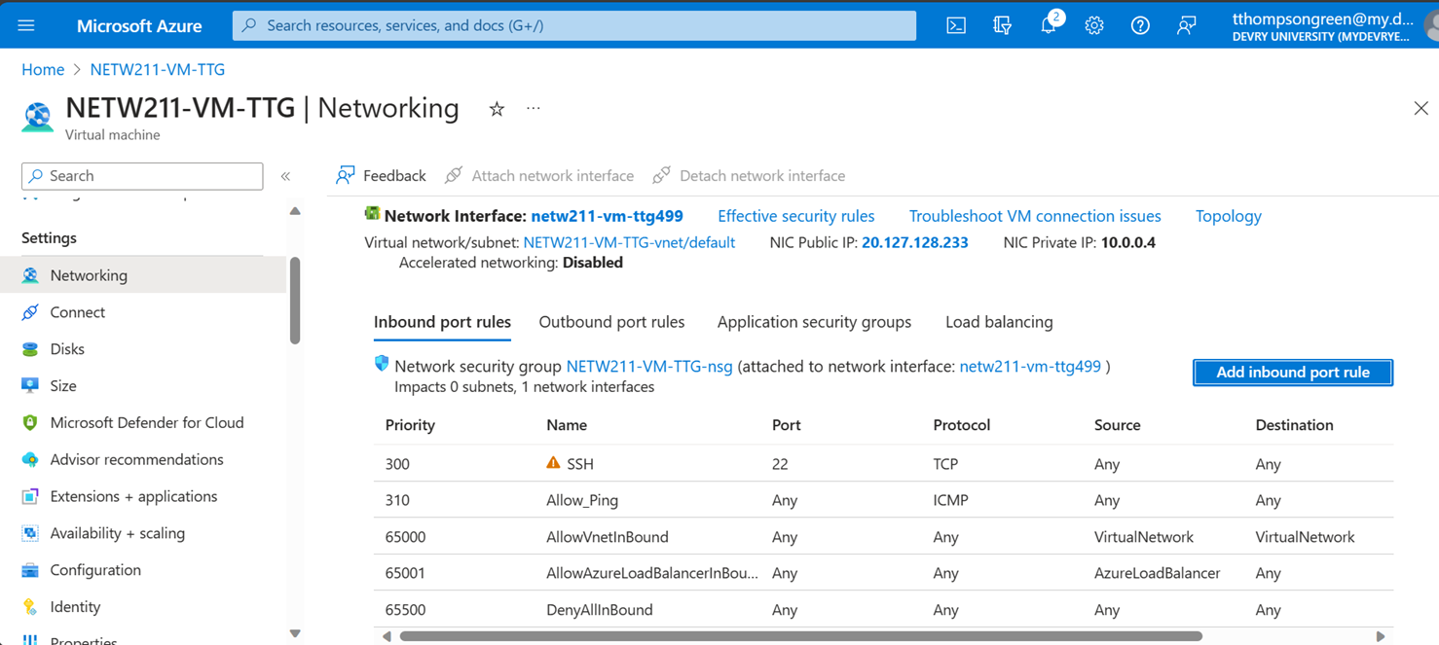
Configuring an NSG 1 of 2
This screenshot should show the Inbound port rules section with the newly added Allow_Ping rule.
This screenshot should also show your DVU email in the top right corner of the Azure Portal.

Slide 23
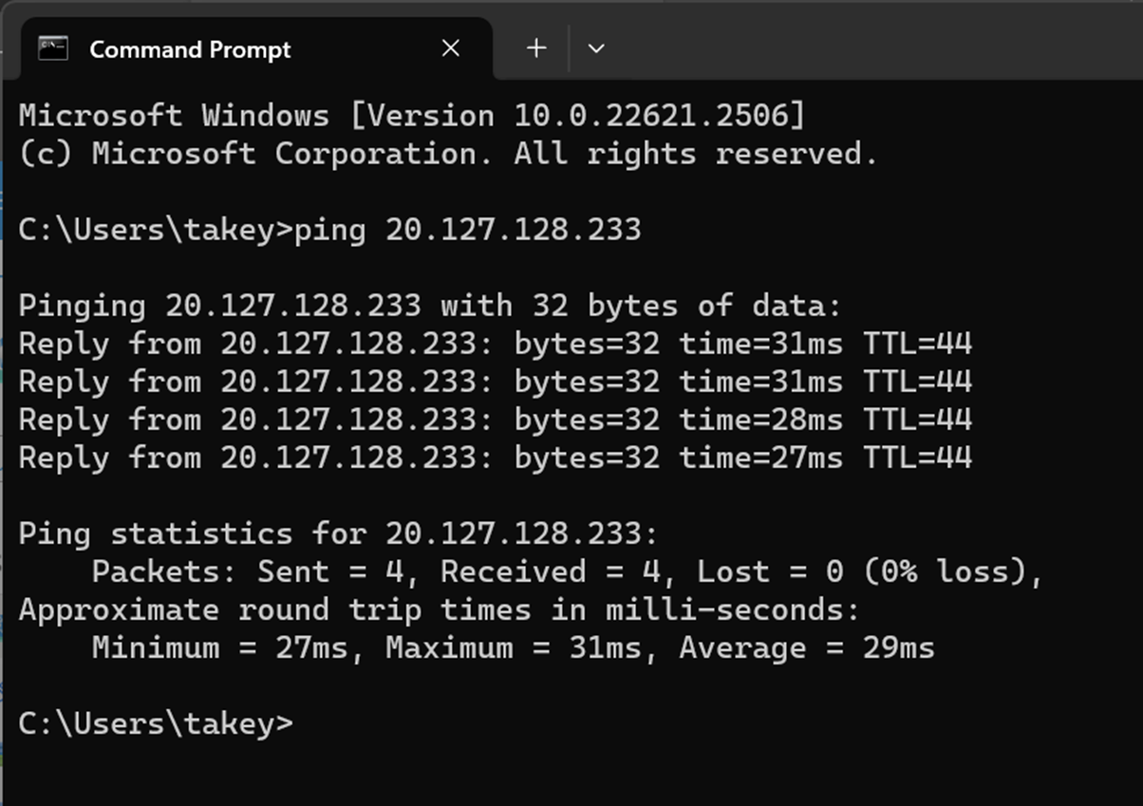
Configuring an NSG 2 of 2
This screenshot should show the successful ping result from your local computer to the VM in the Azure cloud.
Issue the date /t and time /t commands in the same command window to include the system date and time in the screenshot. Use the date command on a Mac computer.

Slide 24
Conclusions Overall, this was my favorite weekly project so far. I got to work with command prompt and learned a few new commands. Using the command (ping c -4 facebook.com) to ping facebook.com was very interesting to me. I was also able to add an inbound port rule that allowed me to ping my public address in the command prompt.

Slide 25
Cloud Storage

Slide 26
Introduction to Cloud Storage
I created a storage account which included creating a resource group, naming my storage account, and changing my redundancy to locally. Once the deployment process was complete, I then created my container to keep all my picture and text files in. I took a screenshot of my Azure page. Went to the container and uploaded the image. After that was successful, I double-clicked my image, once I was in overview, I copied the URL that was provided to a new tab. An error message popped up saying "Public access is not permitted on this storage account. So, I went back to change the permissions by going to my storage account and enabling the allow blob anonymous access. I saved it, went back to my container changed the access level to blob ( anonymous read access for blobs only ). I copied the new URL to show proof of the changes that I made, took a screenshot, and put it in the slide below. Once that was completed, I created a text file and saved it. Uploaded the text file to my container, went to the file, and clicked on edit to modify the original version. For the last part of the project, I went back to my storage account overview and looked for versioning which was under properties I had enabled. I clicked it enabled versioning for blobs and saved it. Went back to my container and uploaded my snapshot and I edited the file. I repeated the same step twice but this time this was my second revision. Lastly, I went back to my URL to show proof of my revision.

Slide 27
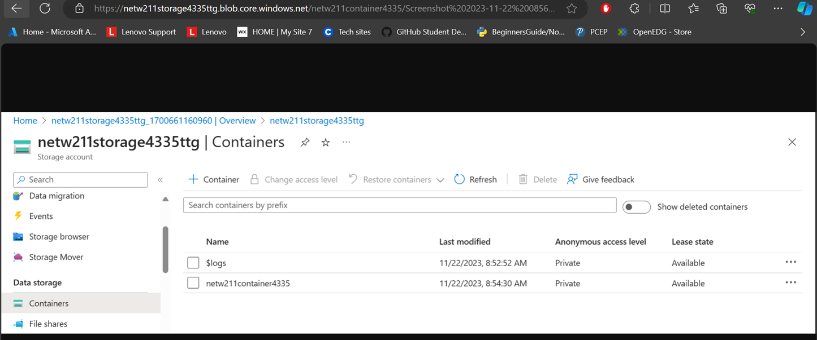
Uploading and Accessing a File
This screenshot should show the browser window with the image uploaded from your local computer and the URL on top of the window.
This screenshot should also show the Last modified property of the uploaded image

Slide 28
Creating Blob Snapshots 1 of 2
1. What does the access tier setting do? What are the Azure blob storage access tiers?
[hint: in the Azure portal, on the Upload blob page, under Advanced, click the? circle above the Access tier box.]
Answer here:
The access tier setting provides you with different access tiers so that you can store blob data, in the cheapest way depending on how it's being used. These are the Azure blob storage access tiers :
Hot tier - An online tier optimized for storing data that is accessed or modified frequently. The hot tier has the highest storage costs, but the lowest access costs.
Cool tier - An online tier optimized for storing data that is infrequently accessed or modified. Data in the cool tier should be stored for a minimum of 30 days. The cool tier has lower storage costs and higher access costs compared to the hot tier.
Cold tier - An online tier optimized for storing data that is rarely accessed or modified, but still requires fast retrieval. Data in the cold tier should be stored for a minimum of 90 days. The cold tier has lower storage costs and higher access costs compared to the cool tier.
Archive tier - An offline tier optimized for storing data that is rarely accessed, and that has flexible latency requirements, on the order of hours. Data in the archive tier should be stored for a minimum of 180 days.

Slide 29
Creating Blob Snapshots 2 of 2
This screenshot should show the browser window with the “This is the original version. –Your Initials” message and the URL on top of the window.

Slide 30
Enabling Blob Versioning
This screenshot should show the browser window with the “This is the first revised version. –Your Initials” message and the URL on top of the window.

Slide 31
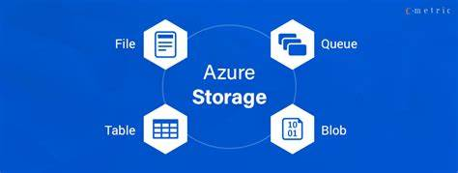
Conclusions Some of the highlights of this project were creating my storage account, changing permissions to my storage account, enabling versioning for blobs, editing my text files, and seeing the results. There weren’t any issues, I loved this hands-on project. It didn’t feel redundant, the only disadvantage is that if you don’t follow the steps correctly you won’t have the correct results. I almost missed the step to change my access level. However, what I learned during this project helped me to get a better understanding of the access tiers, and how containers work.

Slide 32
Cloud Monitoring

Slide 33
Introduction to Cloud Monitoring
I started this project by going to my Microsoft Azure environment, going to my resource providers, and registering with Microsoft. insights. The following steps that I took were, going to monitor alerts, action groups, and create. In this process, I created an action group along with notifications after was finished being set up. I had started to set up my alert rules, first I created a virtual machine, went back to resources, monitors and clicked on alerts, and finally created my alert rule. When creating my first alert rule (VM restart), I added the condition "restart virtual machine "I went back to the alert page to review the alert rule and created another alert rule which was “VM-deallocate”. The last step was to test the alerts, so I went back to my virtual machine and restarted my VM. Waiting on the email, Azure Monitor alert 'VM-Restart' was activated for 'NETW211-VM-TTG. I went back to my Virtual Machine overview page and stopped my virtual machine. After my virtual machine was successfully stopped, I received an email alerting me that my VM deallocate was activated.

Slide 34
Setting up an Action Group and Notifications
This screenshot should show the “VM-Status-Change” action group on the Manage Actions page.
This screenshot should also show your DVU email in the top right corner of the Azure Portal.

Slide 35
Setting up Alert Rules
This screenshot should show the Alert rules window showing the VM-Deallocate and VM-Restart rules.
This screenshot should also show your DVU email in the top right corner of the Azure Portal.

Slide 36
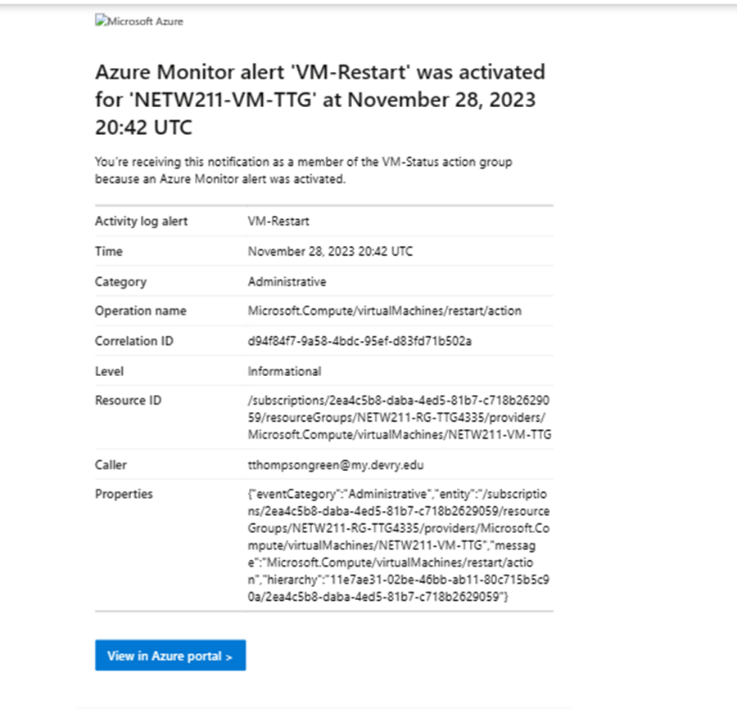
Testing Alerts 1 of 2
This screenshot should show the ‘VM-Restart’ was activated email message with the date and time of the alert.

Slide 37
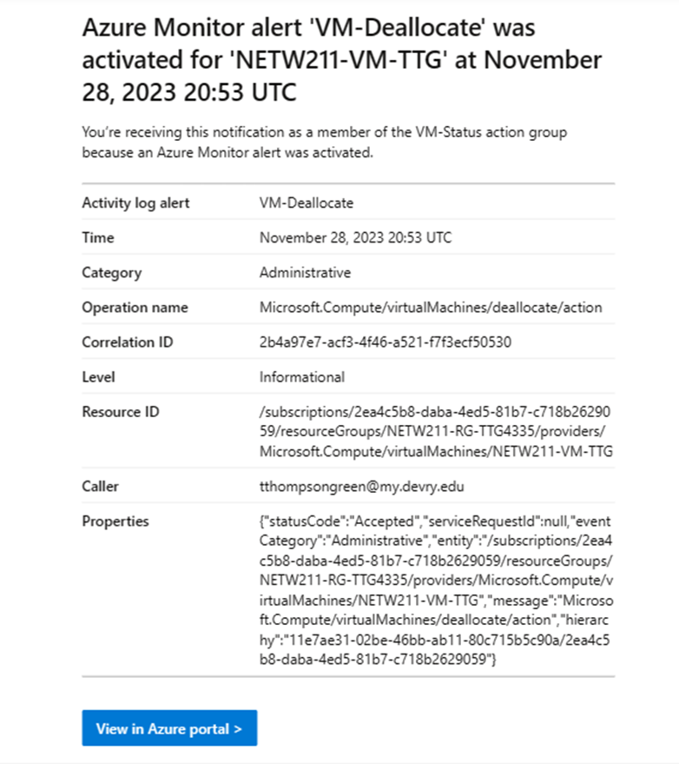
Testing Alerts 2 of 2
This screenshot should show the ‘VM-Deallocate’ was activated email message with the date and time of the alert.

Slide 38
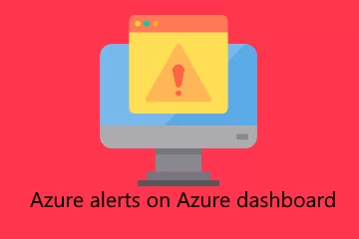
Conclusions
This project was very interesting, I created 2 alert rules during this project which were VM-restart and VM-deallocate. I also learned how to restart my VM and successfully stop my VM. One of the downsides of this project was that when it came to the testing part of this project, were that the notifications that were sent to my email took a while. The project itself was time-consuming, however, I still enjoyed it.

Slide 39
Career Slide
I learned the Fundamentals of Microsoft Azure :
Deploying VM in Azure, deleting Resource groups
using command prompt to verify connectivity with 2 different VMs
Deploying VMs into Subnet
Creating a security group
Understanding Azure’s blob storage access tiers
Creating containers, blob enabling, and versioning
Setting up rules, alerts, and testing alerts

Slide 40
Challenges
The Two challenges that I faced during this project were :
When testing the alerts in the Cloud monitoring portion of this project. It was very time-consuming. I also thought that deploying and deleting my resource group was also time-consuming at first. Some of the slides were also out of order.

Slide 41
References
1. Course Project demonstration videos
2. Hot, Cool, and Archive access tiers for blob data, https://docs.microsoft.com/en-us/azure/storage/blobs/access-tiers-overview
3. https://learn.microsoft.com/en-us/azure/storage/blobs/access-tiers-overview

Slide 42
Summary As my educational journey continues, I will say that I have learned so much from this NETW211 course so far. This was a class that I dreaded but ended up loving. I love the information that was introduced in this course, which started with me creating a virtual machine. This was a very small portion of this project. My favorite portion of this project was testing alerts in the cloud monitoring portion of the project. Even though the testing alerts did take a while to come through. I still found that portion of my project cool, I think that I will pursue the AZ-900: Microsoft Azure Fundamentals certification in the near future.

