Slide 1
SEC 290 Fundamentals of Infrastructure Security
Final Project
Professor Christina Bailey
Takeyha Thompson-Green

Slide 2
INTRODUCTION
Welcome to my SEC290 Final Course Project I will be :
Conducting a manual Vulnerability Analysis on a test VM along with showing the output of my meterpreter session
Along with analyzing activities such as common attacks, extracting data by using display filters, basic attack analysis, and basic protocol analysis.
Deep diving into manual Open SSL analysis in which I will be testing and creating an SSL/TLS file.
Conducting a Live Memory analysis
Creating and testing SNORT rules
Configuring IP tables in 6 different scenarios

Slide 3
Manual Vulnerability Analysis (on a test VM Network)

Slide 4
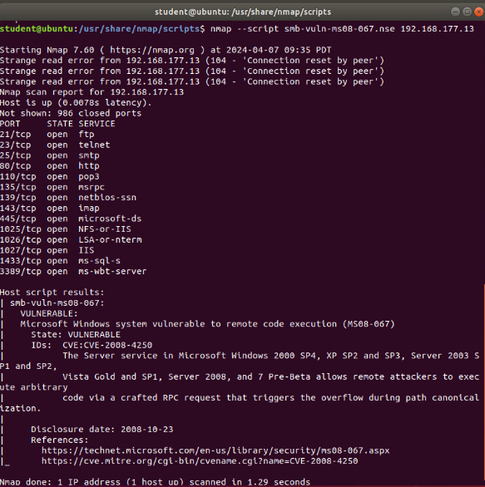
Microsoft Windows Bulletin MS08-067 vulnerability
Take a screenshot of the output in Part 3, Step 2.
It should show that a vulnerability exists in the test VM.

Slide 5
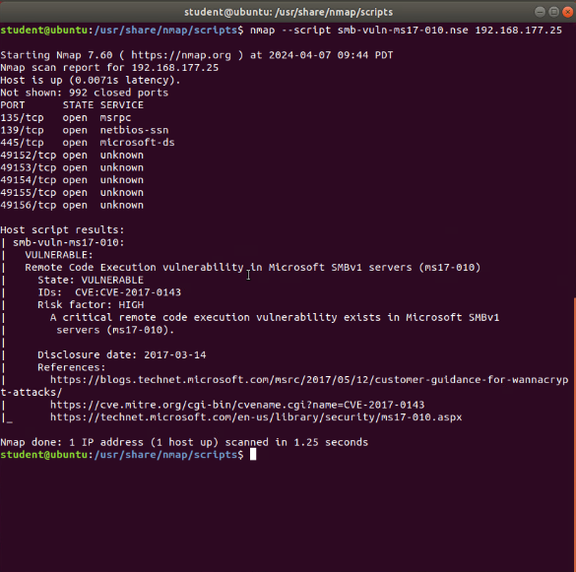
Microsoft Windows Bulletin MS17-010 vulnerability
Take a screenshot of the output of the Nmap command in Part 4.
It should show that a vulnerability exists on the test VM.

Slide 6
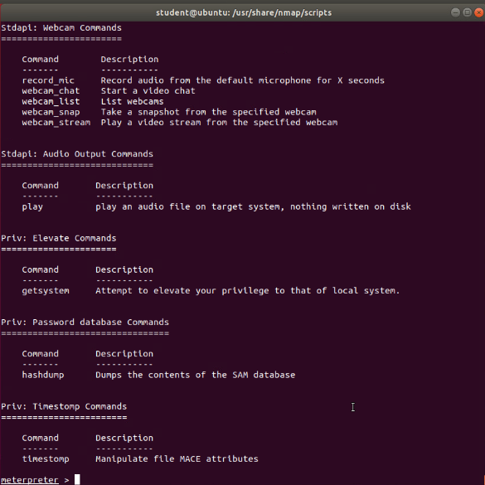
Meterpreter session command output
Take a screenshot of the output of the meterpreter session commands in Part 5, Step 19, or Step 20.

Slide 7
Intrusion Analysis using Wireshark

Slide 8
Basic attack analysis
1. Look at captures no. 20 and 22. (You can use the “Go” link at the top of the Wireshark screen to quickly go to a specific capture) Both packets are ICMP traffic but there are subtle differences between them. Compare the time-to-live and data field sizes in the two packets. What differences do you see?
The source IPs are different - Packet 20: 192.168.25.1, 22:192.168.25.50
The length messages are different – Packet 20: Length message (98), Packet 22: Length message (74)
The destination IPs are different- Packet 20: 192.168.25.50, Packet 22: 192.168.25.1
The time-to-live packages are different Packet- 20: Time-to-live =64,Packet 22: Time-to-live =128
2. Do a little Internet research to discover which operating systems use the specific values in their ping commands. What operating system generated the echo request in capture 20?
Windows OS was the operating system that was being used in echo request in Capture 20, which is due to the Time-to-live being = 128.
3 . Review packet no. 37 and beyond, what do you think is taking place here?
At number Packet 37 you can start to see TCP traffic, along with a pattern and flags that are being set.
4 . Look at capture 22846. What is suspicious about the flag settings in this packet?
Flags are being set on FIN, which means that there is an open connection.
5. What is the IP address of the host being targeted?
The IP of the host that is being targeted is 192.168.25.1.

Slide 9
Open SSL

Slide 10
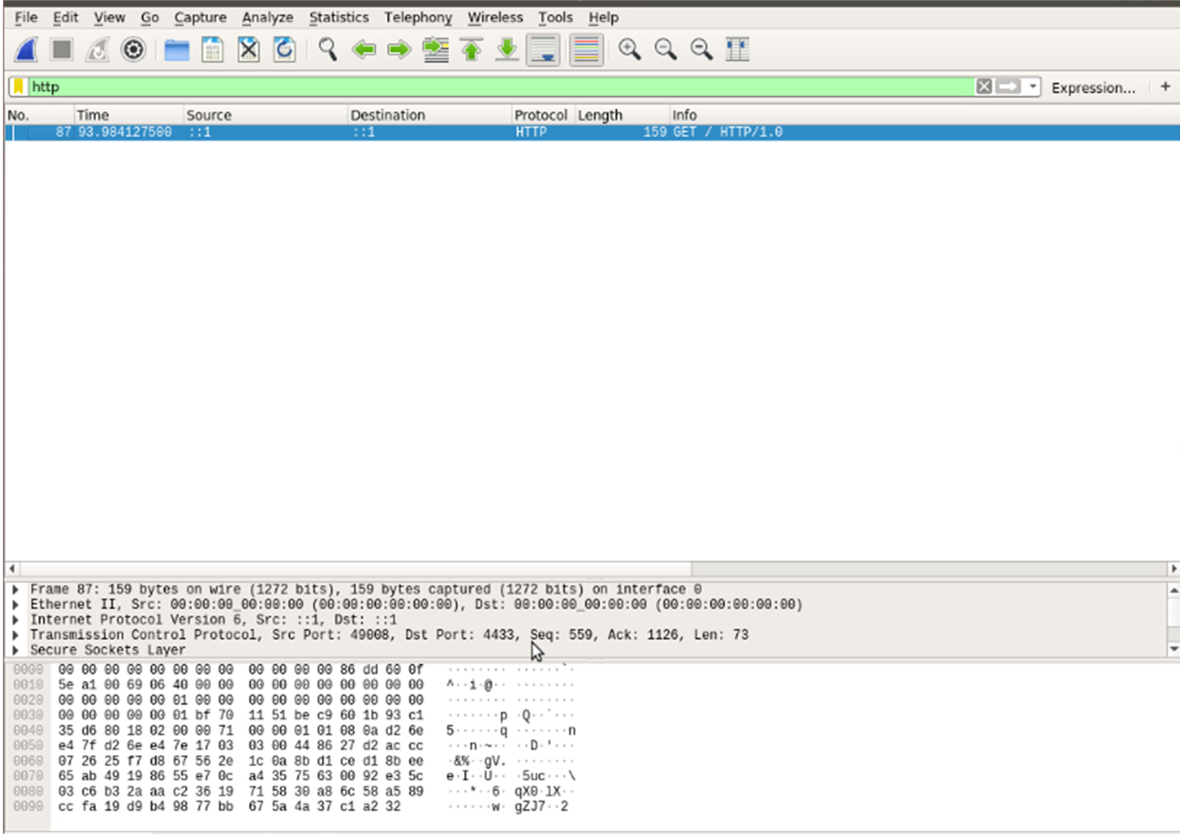
Creating and testing an SSL/TLS file
Take a screenshot of the output in Step 20.
It should show the GET request in the Info column.

Slide 11
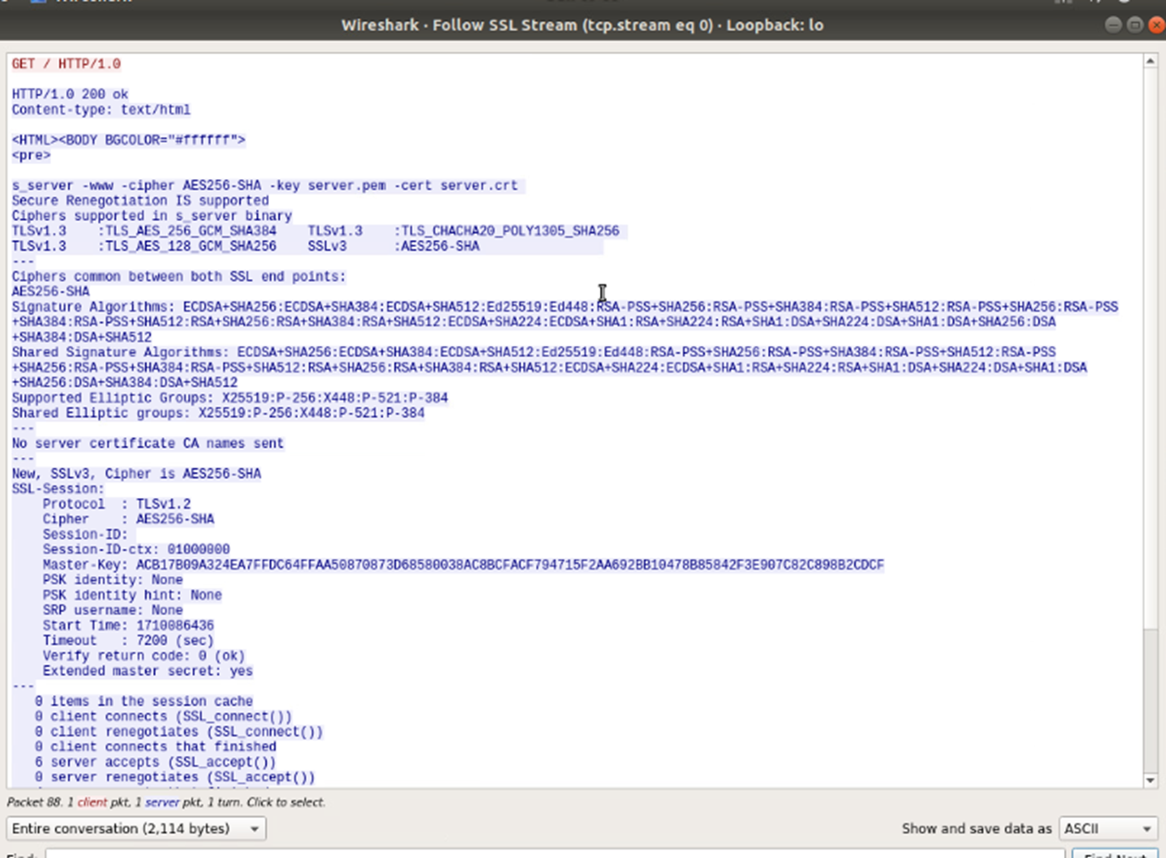
Creating and testing an SSL/TLS file cont’d
Take a screenshot of the output in Step 22.
It should show the decrypted SSL stream.

Slide 12
Snort

Slide 13
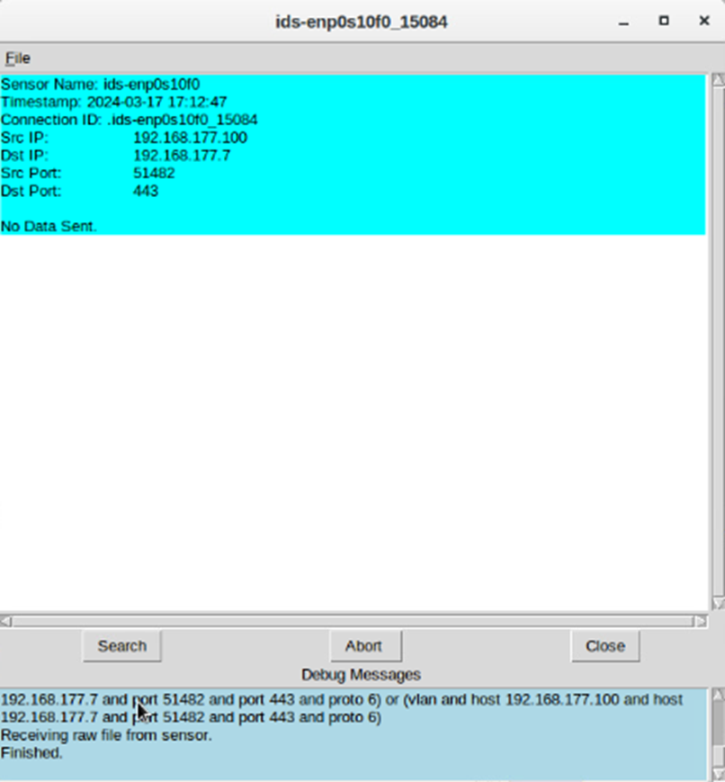
Testing Snort rules
Take a screenshot of the output in Part 1 Step 17.
It should show the transcript of the XMAS scan alert.

Slide 14
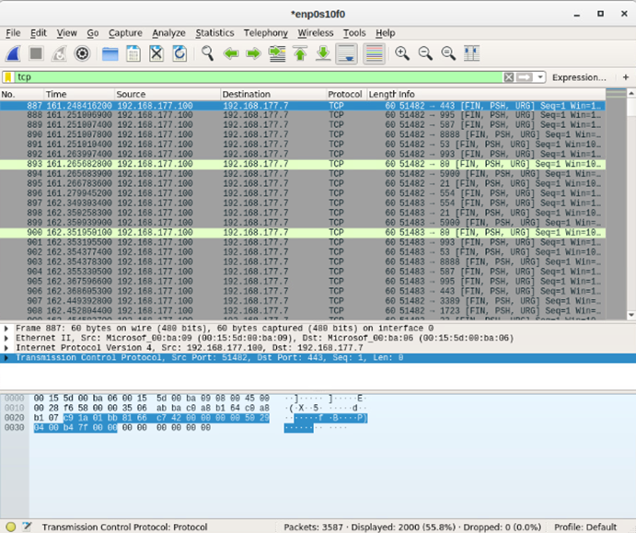
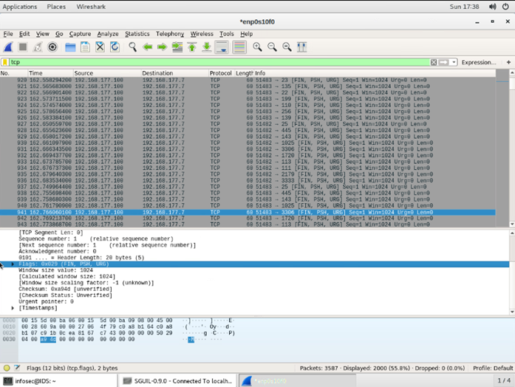
Testing Snort rules cont’d
Take a screenshot of the output in Part 1 Step 20.
It should show the TCP packets generated by the XMAS scan.

Slide 15
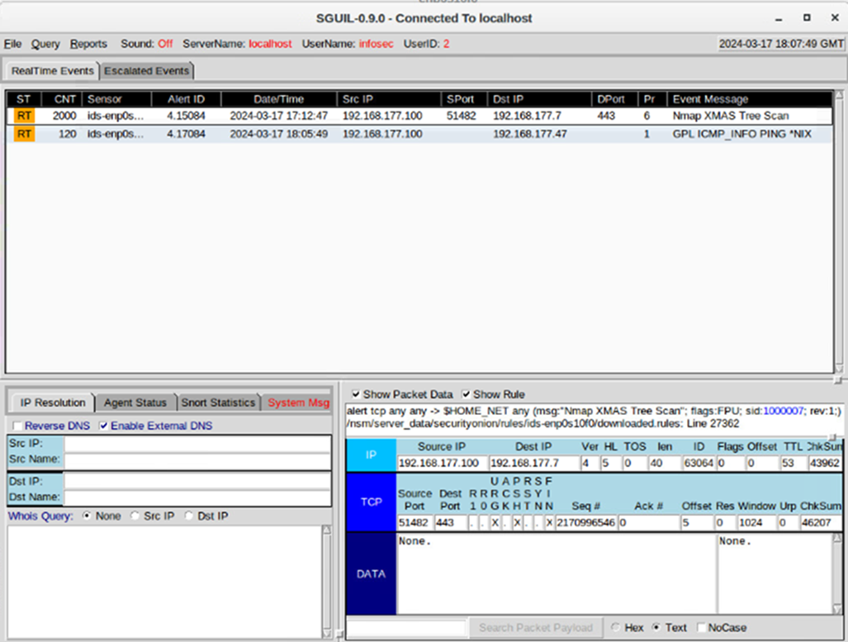
Creating Snort rules
Take a screenshot of the output in Part 2 Step 7.
It should show the ping activity alert.

Slide 16
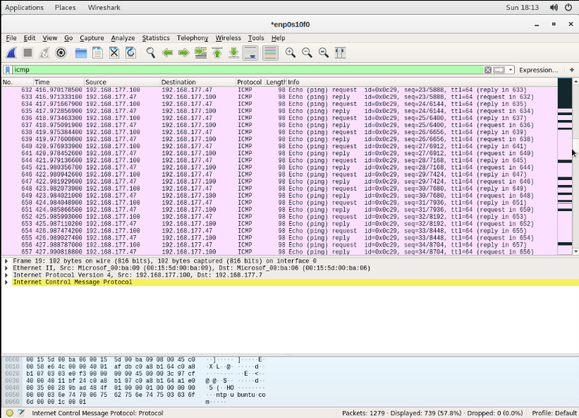
Creating Snort rules cont’d
Take a screenshot of the output in Part 2 Step 8.
It should show the ICMP packets generated by the ping activity.

Slide 17
Live Memory
Analysis

Slide 18
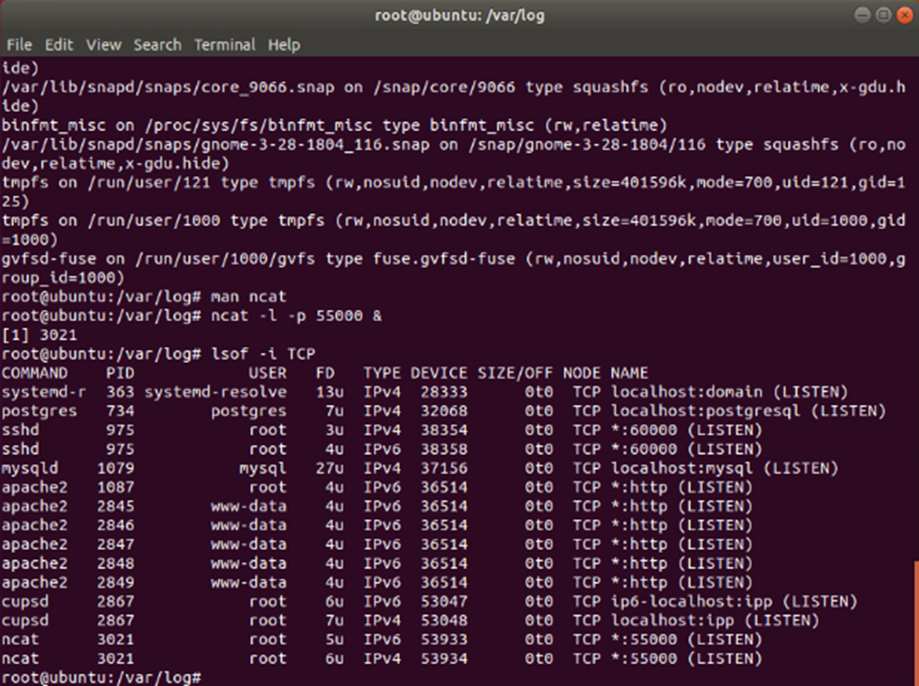
Linux Processes
Take a screenshot of the output in Part 1, Step 16.
It should show port 55000 open for both IPv4 and IPv6.

Slide 19
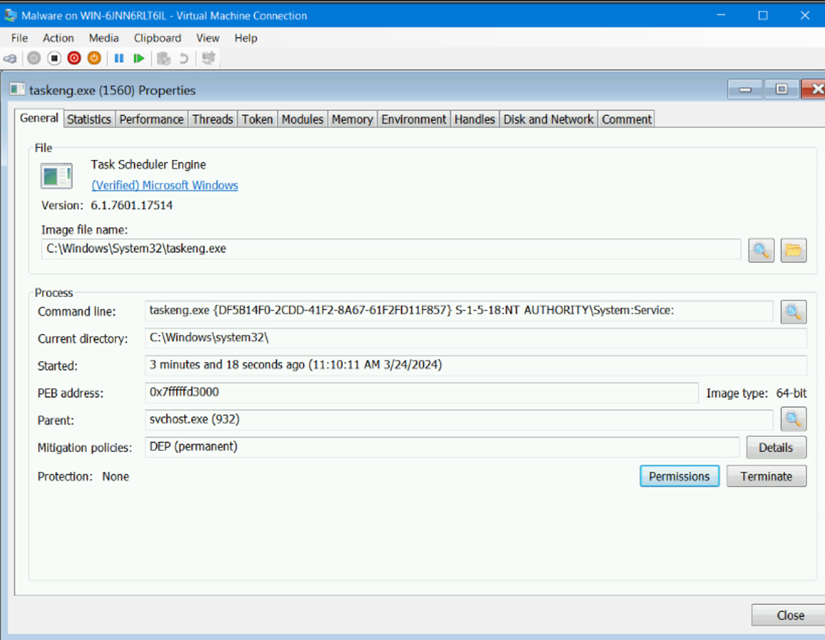
Process Hacker
Take a screenshot of the output in Part 2, Step 5.
It should show properties of a chosen process.

Slide 20
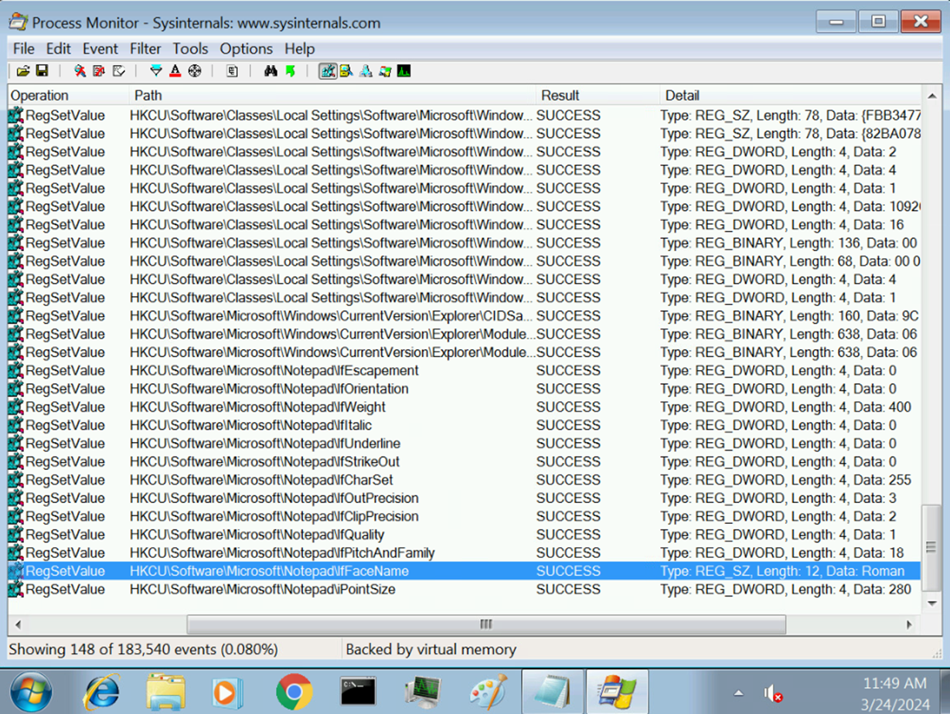
Process Monitor
Take a screenshot of the output in Part 3, Step 13.
It should show ifFaceName in the Path column and Data: Roman in the Detail column.

Slide 21
Firewall

Slide 22
Time-based Access
Take a screenshot of the output in Part 1 Step 21.
It should show the output of the DMZ Route Table.

Slide 23
Time-based Access
Take a screenshot of the output in Part 1 Step 26.
It should show a successful ping from the Ubuntu Web VM and the DMZ VM.

Slide 24
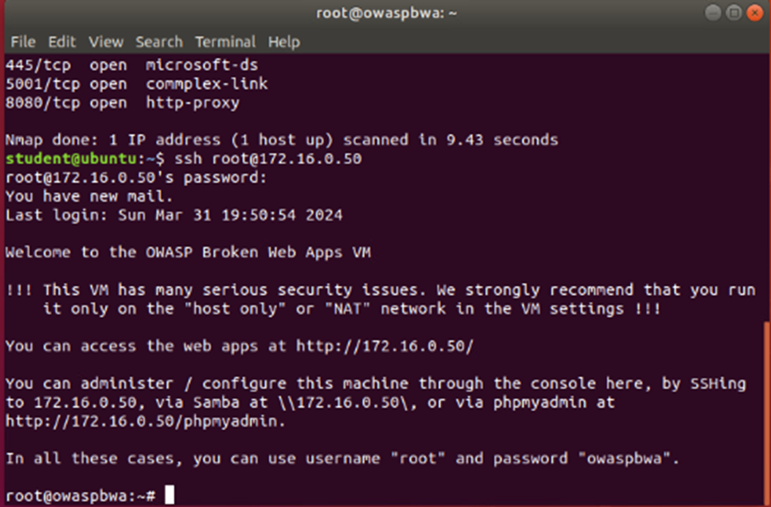
Time-based Access
Take a screenshot of the output in Part 1 Step 34.
It should show two time-based access rules in the FORWARD chain

Slide 25
CAREER SLIDE
In this course I have performed vulnerability scans and analyzed scan reports.
Identified security vulnerabilities.
Used SNORT (open-sourced IDS) along with creating rules and testing.
Along with using VM and software such as :
Ubuntu VM
Wireshark
Security Onion IDS
OWASP-BWA VM
Firewall VM
Learned about common attacks, and how to analyze them and filter them by using display filters to display data.
Process Hacker 2
DMZ Machine

Slide 26
CHALLENGES
OWASP-BWA and Firewall machine took a while to load
Nmap scans were time-consuming at times
I had to constantly log into Ubuntu VM when the screen wasn’t being used after a while

Slide 27
CONCLUSION
Overall, SEC290 was a very interesting course. I learned a lot being that this was my second Security course that I’ve taken so far. It was time-consuming towards the end of my project. Especially when working in the Firewall VM, DMZ machine, and Ubuntu. My favorite part of the course was learning about the SNORT rules. Not to mention working in Wireshark, learning about different flags.

Slide 28
References
Week 1-6 Video Demonstrations
2. Projects Week 1-6 InfoSec guides
3. Identify Operating System Using TTL Value And Ping – OSTechNix
4. How to identify the Operating System using PING Command - Yeah Hub

