Slide 1
NETW310 Wired, Optical, and Wireless Communications with Lab Final Course Project
Professor Nabeel Khan
Takeyha Thompson-Green
Sept Session 2024

Slide 2
Introduction
Welcome to my NETW310 Final Course project in which I will be covering various topics such as:
Communication System Basics Pgs. 3-7.
Baseband Signals and AM/FM Signals Pgs. 8-13.
Pulse Code Modulation (PCM) and Line Codes Pgs. 14-18.
Cables and Structured Cabling Pgs. 19-22.
Antenna Gain and Free Space Path Loss Pgs. 23-29.
Bit Error Rate of Fading Channels Pgs. 30-33.

Slide 3
Communication System Basics

Slide 4
Communication System Basics
In this part of the project, I learned what an oscilloscope is, and how to use a Spectrum Analyzer. Along with its capabilities, practicing simple RF calculations, and reviewing power measurements in Watts, and decibels.

Slide 5
Communication System Basics Questions
An oscilloscope has a screen that has a horizontal axis and a vertical axis that shows amplitude (in volts) and time (in seconds), respectively. It operates in what is called the time domain. A spectrum analyzer has a screen that has a horizontal axis and a vertical axis as well. What do these axes show? What are the units of these two? Which domain does a spectrum analyzer operate in?
Answer: A Spectrum Analyzer’s horizontal axis shows frequency, while its horizontal axis shows amplitude. The Spectrum Analyzer units for the horizontal axis are hertz, kilohertz, megahertz, or gigahertz. On the spectrum analyzer units for the vertical axis are watts, milli-watts, micro-watts, or their dB forms. A spectrum analyzer operates in the frequency domain.

Slide 6
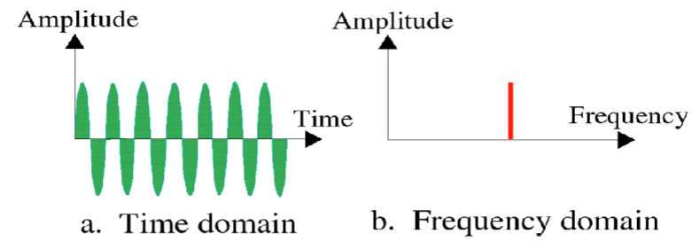
Communication System Basics Questions
2. Match the screen of the spectrum analyzer or the oscilloscope with the view of a sine wave shown below.
Which device shows : a. An Oscilloscope b. Spectrum Analyzer
What is the difference between the bandwidth that shows up on the screen of a spectrum analyzer and the channels that show up on the screen of a spectrum analyzer?
The difference is that the signal bandwidth that is displayed on the screen of a spectrum analyzer represents the range of frequencies of a signal. While the channel bandwidth that shows up on the screen of a spectrum analyzer represents the usable frequency range of a transmission system.

Slide 7
Communication System Basics Questions
In this section, I used the rule of 10s and 3s to calculate Basic RF Calculations:
1. Apply 3's rule to estimate what 16 mWs is in dBm:12 dBm 2. Apply 3's rule to estimate what 0.0625 mWs is in dBm:-12 dBm 3. Apply 10's rule to estimate what 10,000 mWs is in dBm: 40 dBm 4. Apply 10's rule to estimate what 0.0001 mWs is in dBm: -40 dBm 5. Apply 3's rule to estimate what 15 dBm is in mW: 32 mW 6. Apply 3's rule to estimate what -15 dBm is in mW: 0.03125 mW 7. Apply 10's rule to estimate what 50 dBm is in mW: 100,000 mW 8. Apply 10's rule to estimate what -50 dBm is in mW: 0.00001 mW
Challenge questions: Applying the 3's and 10's rules, what's 8 mW + 30 dBm in dBm? 39 dBm Applying the 3's and 10's rules, what's 8 mW + 30 dBm in mW? 8,000 mV

Slide 8
Baseband Signals and AM/FM Signals

Slide 9
Baseband Signals and AM/FM Signals
In this section of the project, I used the Multisim application to explore the capabilities of a spectrum analyzer and an oscilloscope for analyzing the time-domain and frequency-domain characteristics of a square wave signal. which includes using a spectrum analyzer to determine the frequency content of a square wave signal and explore the time-domain and frequency-domain characteristics of both AM and FM signals.

Slide 10
Baseband Signals
The screenshot to the left shows the spectrum analyzer displays the signal’s harmonic spectrum and its panel settings. Along with the signal voltage at each of the frequencies in the table in which I recorded.

Slide 11
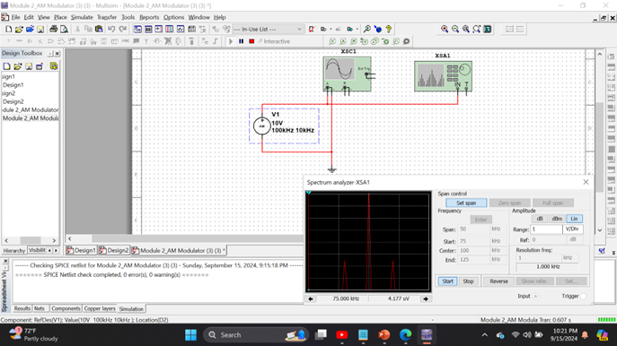
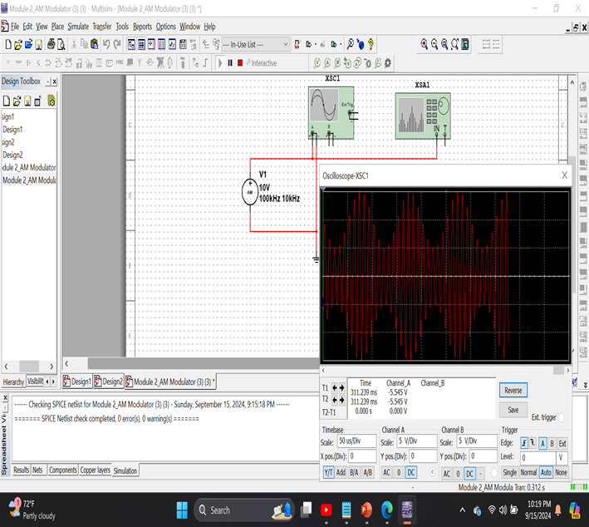
AM Signals
Oscilloscope screenshot here
Spectrum Analyzer screenshot here
Above is a screenshot of the Oscilloscope which includes the signal and the panel settings of the oscilloscope. Along with a screenshot of the Spectrum Analyzer that includes the signal and the panel setting of the analyzer.

Slide 12
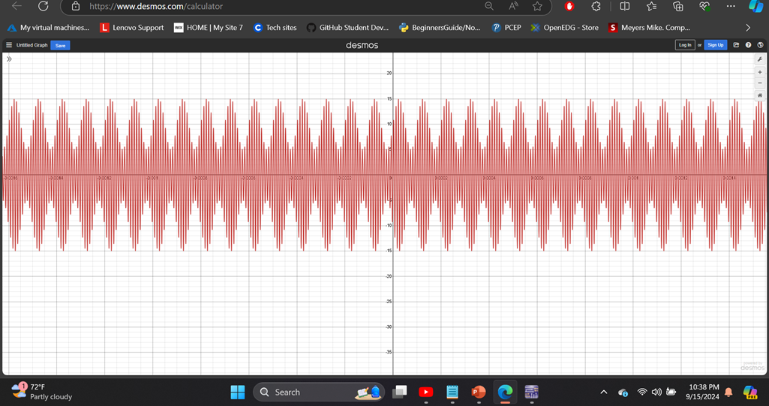
AM Signals Cont.
In this part, I developed equations for the carrier and modulating signals and plotted the equation for the composite modulated signal V_{AM .}
Equations here:
fc= 100000Hz
fi= 10000hz
y= 10 sin(2π100000x)+5sin(2π10000x)+(sin(2π100000x))
Plotted diagram screenshot, in which I used Desmos to plot the equation for the composite modulated signal V_{AM .}

Slide 13
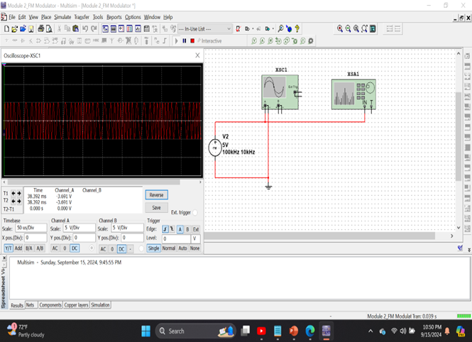
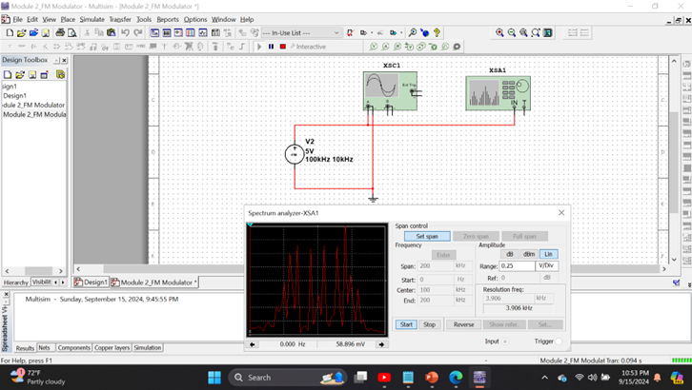
FM signals
This is a screenshot of the Oscilloscope that includes the signal and the panel settings of the oscilloscope. Also, a screenshot of the Spectrum Analyzer that includes the signal and the panel setting of the analyzer.
Oscilloscope Analyzer screenshot here
Spectrum Analyzer screenshot here
What’s the carrier frequency?
100kHz

Slide 14
Pulse Code Modulation (PCM) and Line Codes

Slide 15
Pulse Code Modulation (PCM) and Line Codes
In this section PCM and Line codes. I simulated a PCM system and compared the original input signal at the transmitter to the recovered signal at the receiver as well as plotted the power spectral densities of common line codes along with comparing their required frequency spectrum.

Slide 16
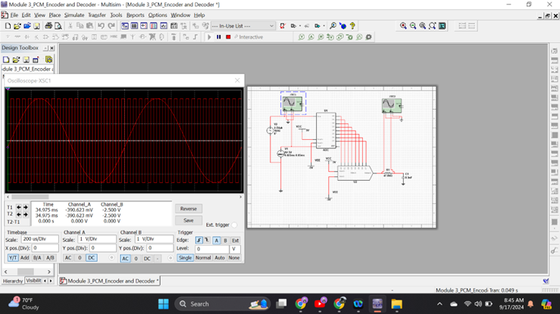
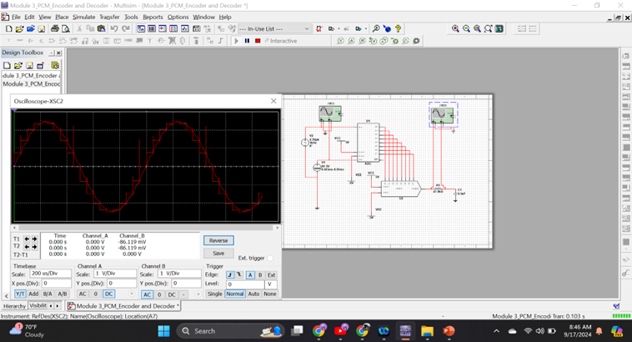
Pulse Code Modulation (PCM)
The first screenshot shows the Oscilloscope-XSC1 display with the analog input signal and sampling clock at the input to the ADC. The second screenshot shows the Oscilloscope-XSC2 display with the output of the DAC.

Slide 17
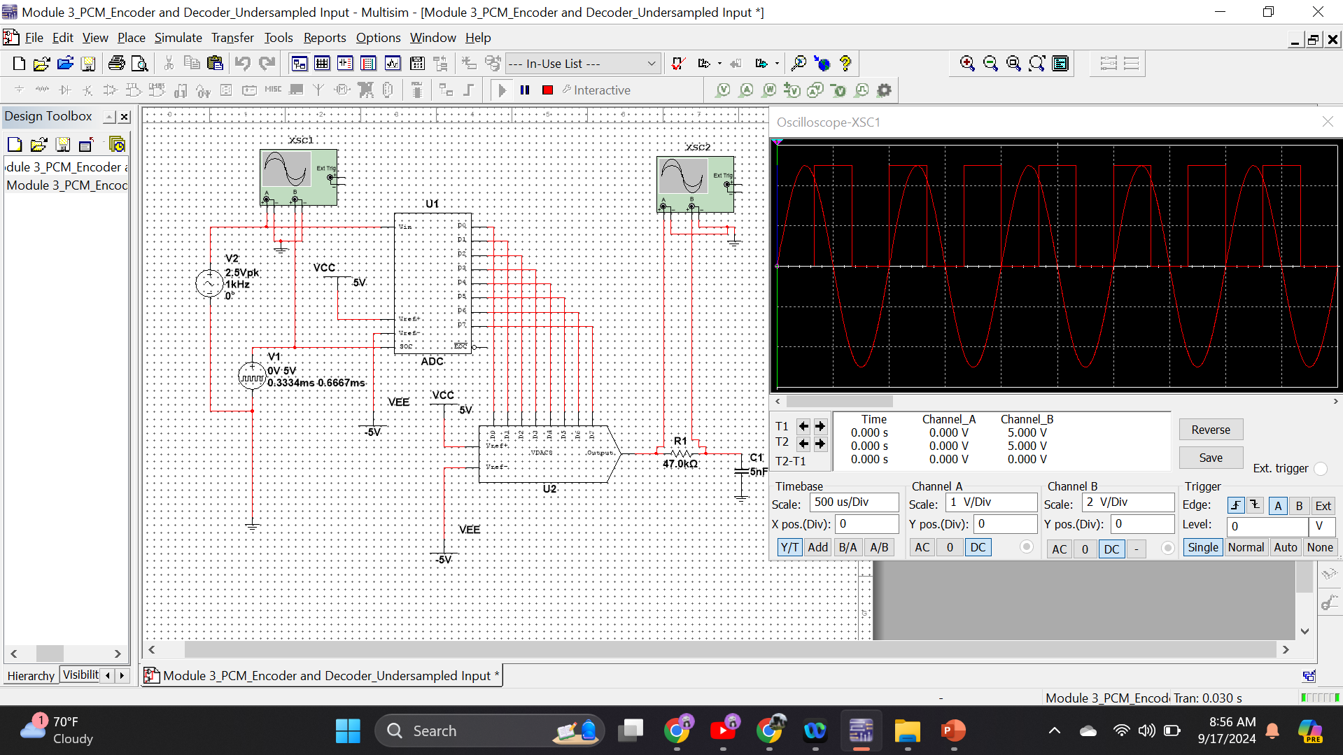
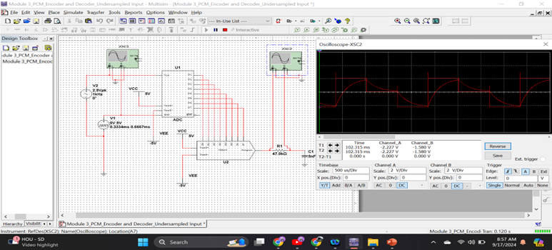
Pulse Code Modulation (PCM)
The first screenshot shows the Oscilloscope-XSC1 display with the analog input signal and sampling clock at the input to the ADC. The second screenshot shows the Oscilloscope-XSC2 display with the output of the DAC
What are the effects of increasing or decreasing the sampling rate?
Answer:
The effect of increasing the sample rate is that you can digitize the signal more rapidly. Which multiplies and produces more information.

Slide 18
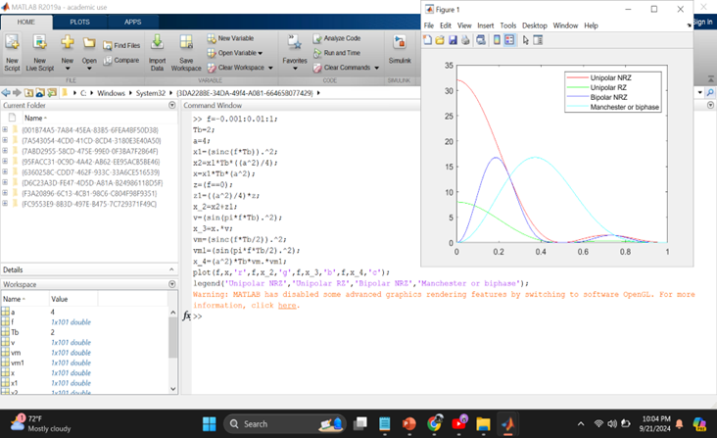
Line Codes
This screenshot shows the power spectral densities of four-line codes: NRZ-Polar, NRZ-Unipolar, NRZ-Bipolar, and Manchester-Polar.
MATLAB Diagram Here
Compare the NRZ-Bipolar and Manchester polar codes in the diagram.
Which one requires more bandwidth?
Answer:
The Manchester-Polar code requires more bandwidth.

Slide 19
Cables and Structured Cabling

Slide 20
Cables and Structured Cabling
In this section of Cable and Structured Cabling. I will be reviewing the current network cabling installation standards used in structured cabling systems for multimedia communications. Which I will reference the ANSI/TIA-568 and ISO/IEC 11801 structured cabling standards.

Slide 21
Questions
1. Why must the twisting in the individual wires be maintained in a UTP cable?
Answer:
Twisting in the individual wires is maintained in a UTP cable it helps to control signal degradation which is also due to electromagnetic interference. Not to mention it reduces crosstalk.
2. How many inches should UTP cable be separated from 110 volts electrical cable?
Answer:
A UTP cable should be 8-12 inches away from a 110-volt electric cable.
3. Horizontal cabling connects what areas to each other?
Answer:
Horizontal cabling connects work area telecommunications information outlets to the telecommunications information outlet.

Slide 22
Questions
4. What is a plenum-rated cable?
Answer: Plenum-rated cables are cables that run cables through a plenum space which are used for air circulation. These are special cables that are made with low-smoke-producing and fire-resistant materials.
5. What is a riser tube used for?
Answer: A Riser tube are vertical areas that are in a building that is used for communication cables, riser spaces are vertical areas in a building . Also are used for running utilities, including communication cables, which are between floors. Which is designed to be fire resistant and prevent fires from being spread between floors.
6. Is the grounding of equipment mostly a safety or a performance concern?
Answer: Grounding of equipment is mostly a safety concern versus a performance concern.

Slide 23
Antenna Gain and Free Space Path Loss

Slide 24
Antenna Gain and Free Space Path Loss
In this section, I will explore the characteristics of antenna gain and free space path loss. I will be analyzing the relationship between the signal frequency, antenna size, and antenna gain as well as analyzing the relationship between the signal frequency, distance, and free space path loss.

Slide 25
Antenna Gain
1. What is the maximum theoretical antenna gain of a common dish antenna at the 2.4 GHz band?
Answer:
The maximum theoretical antenna gain of a common dish antenna at the 2.4 GHz band is 22.379.
2. What is the maximum theoretical antenna gain of a common dish antenna at the 5 GHz band? Answer:
The maximum theoretical antenna gain of a common dish antenna at the 5 GHz band is 29.079.
3. Given the same sized reflector, which signals, high-frequency, or low-frequency, can be more efficiently focused by a common dish antenna (i.e., result in a higher antenna gain)?
Answer:
High frequency can be more efficiently focused by a common dish antenna.

Slide 26
Antenna Gain cont.
4. What is the maximum theoretical antenna gain of the dish antenna used in the VLA radio telescopes in New Mexico at the 5 GHz band?
Answer:
The maximum theoretical antenna gain of the dish antenna used in the VLA radio telescopes in New Mexico at the 5 GHz band is 63.059.
5. Given the same signal frequency, which dish antennas, large-sized or small-sized, are more efficient at focusing the signal (i.e., result in a higher antenna gain)?
Answer:
Larger-sized are more efficient at focusing the signal versus a small-sized dish antenna.

Slide 27
Free Space Path Loss
What is the free space path loss in dB at the 2.4 GHz band?
Answer: The free space path loss in dB at the 2.4 GHz band is -80.4.
2. What is the free space path loss in dB at the 5 GHz band?
Answer: The free space path loss in dB at the 5 GHz band is -87.2.
3. How does the free space path loss at a higher frequency (e.g., the 5 GHz band) compare with that at a lower frequency (e.g., the 2.4 GHz band)? Answer: It decreases with strength at a higher frequency versus a lower frequency.
4. What is the free space path loss in dB over 20 meters at the 2.4 GHz band?
Answer:
The free space path loss in dB over 20 meters at the 2.4 GHz band is -66.421.

Slide 28
Free Space Path Loss
5. What is the free space path loss in dB over 40 meters at the 2.4 GHz band?
Answer:
The free space path loss in dB over 40 meters at the 2.4 GHz band is -72.441.
6. What is the free space path loss in dB over 80 meters at the 2.4 GHz band?
Answer: The free space path loss in dB over 80 meters at the 2.4 GHz band is -78.462.
7. When the distance doubles, how does free space path loss in dB change approximately? [5 points]
Answer: It changes by approximately 6 dB.

Slide 29
Free Space Path Loss
8. Use a scientific calculator to calculate Delta $L_{fS}$ for D1 = 20 meters and D2 = 40 meters.
Delta $L_{fS }$= _-6.0205_
9. Is your calculation approximately the same as the result from Part 1 Step 2?
Answer: No, my calculations aren’t the same as Part 1 Step 2, only similar to its loss.

Slide 30
Bit Error Rate of Fading Channels

Slide 31
Bit Error Rate of Fading Channels
In this section, I will analyze and explore the BER performance of wireline and optical channels that use FSK, PSK, and DPSK. Along with BER performance of wireless channels that use PSK.

Slide 32
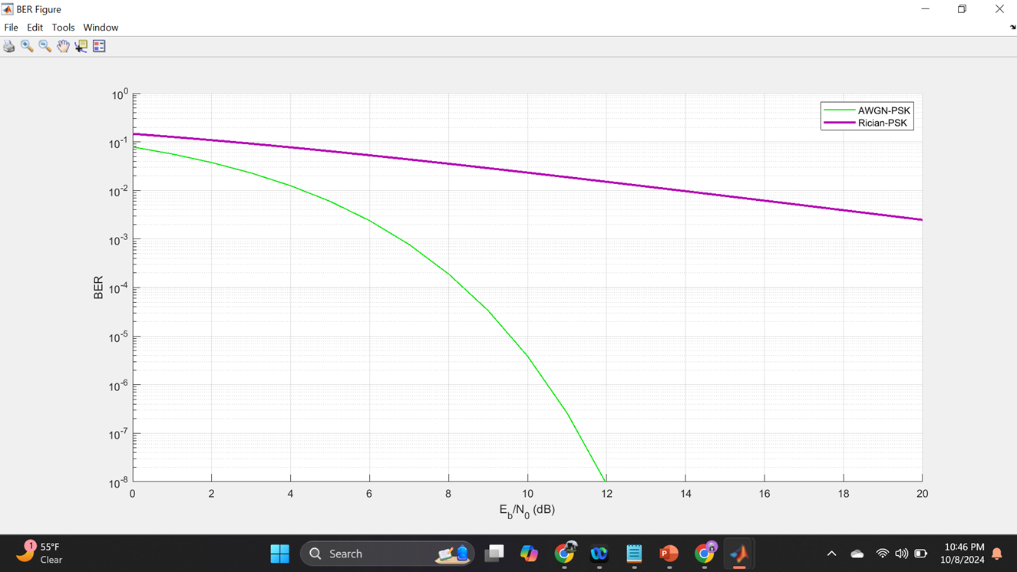
AWGN Channel and Rician Channel
This screenshot shows the bit rate error performance of both AWGN and Rician fading channels.

Slide 33
AWGN Channel and Rician Channel
Compare and contrast the BER performance of PSK over a noise limited (AWGN) transmission channel to the performance of PSK over a Rician channel at 5- and 10-dB Signal to Noise Ratio (E_{b}/N₀), respectively.
Is there a significant difference in BER performance of PSK between the AWGN channel and Rician channel?
Answer:
There’s a difference the BER rate for the AWGN channel is much more efficient than that for the Rician channel.

Slide 34
Challenges
Problems with accessing MATLAB and crashing constantly which prolonged my project at times.
Terminology was very excessive but very beneficial once learning

Slide 35
Career Skills
Learned the characteristics of wireline and wireless transmission media that make digital transmission possible.
Learned how to analyze baseband signals, along with AM/FM signals through simulation.
Along with Pulse Code Modulation (PCM), line codes, antenna gain, free space path loss, and fading channels.
Learned how to develop equations for the carrier and modulate signals and plot the equation.

Slide 36
Conclusion
Overall, I found this class challenging at times due to various things such as not having access to the technology that was needed to complete this project. Along with the amount of new terminology which was very important for this project to make sense. However, even though I found this class challenging I can say that I enjoy it somewhat and will hopefully use the tools and knowledge that was learned to benefit me in the future whether it is to further my education or in my future career,

Slide 37
References
https://youtu.be/VqoUS-ecw4Y?si=gezN56PC7qD8TDbb
Desmos.com
Engageli Week 3 Playback room
What is an Unshielded Twisted Pair (UTP)? - Definition from WhatIs.com (techtarget.com).
6W0001Z1_Stand_Ref_Guide2.qxd (anixter.com)
.The Ultimate Guide to Plenum, Riser, and LZSH Cables: Know the Difference (truecable.com)
Fundamentals of Grounding and Safety: Protecting People and Equipment - Technical Articles (control.com)
Can Ethernet Cable Run Next To Electrical? [Here's How] (cablesradar.com)
http://www.swisswireless.org/wlan_calc_en.htm

