Slide 1
CEIS114 Final Project Traffic controller
Professor Toshko Tzvetkov, May Session 2023
Takeyha Thompson-Green

Slide 2
INTRODUCTION
This project is a multiple-traffic control system that utilizes the ESP32 microcontroller, the internet, and a smart sensor. It also has an option for pedestrian crossing and emergency crossing for emergency personnel which is also controlled by using cloud services.

Slide 3
Preparation/ Inventory

Slide 4
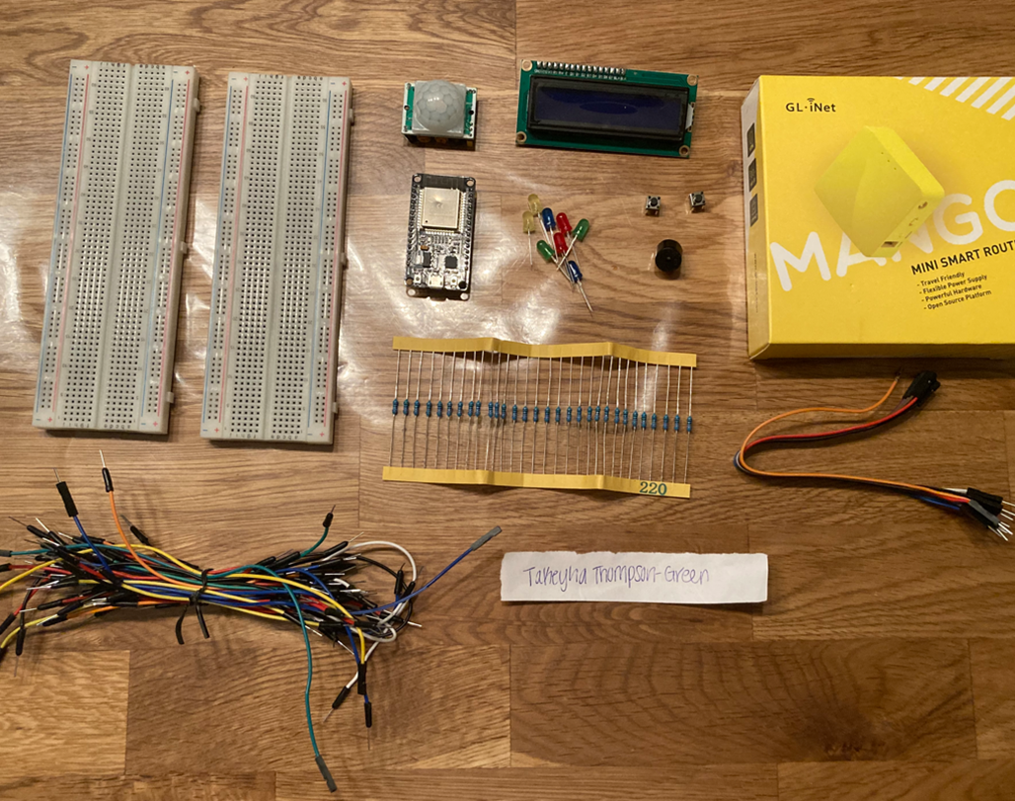
Inventory
ESP 32 Board
Colored LEDs: Red, Yellow, Green, and Blue
220 Ohm Resistors (optional)
Wires
Breadboard(s)
LCD Unit with I2C Adapter
Active Buzzer
Mini Router
Push Button(s)
PIR Motion Sensor

Slide 5
ESP32
Microcontroller mounted and powered
on.

Slide 6
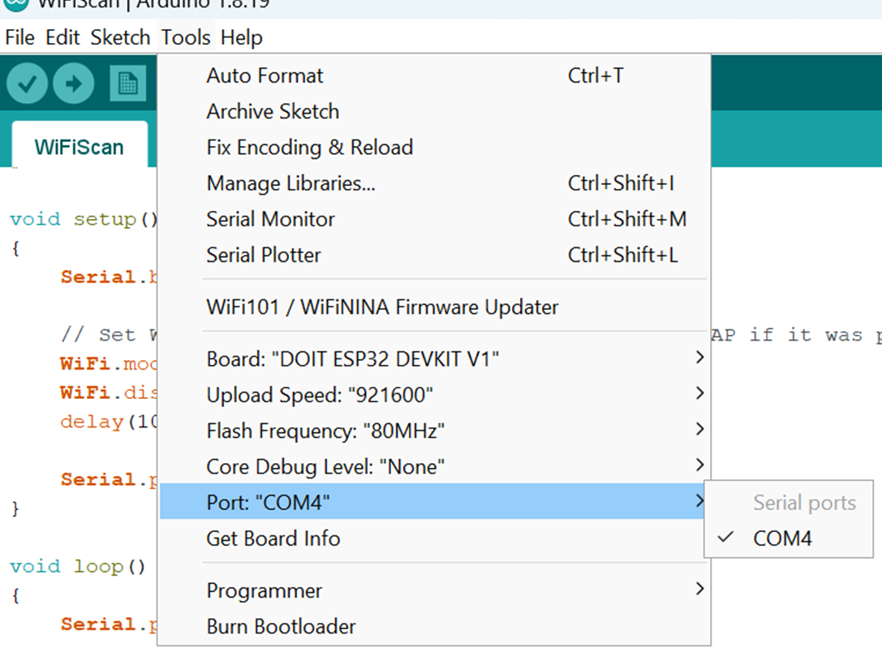
Installation of Arduino IDE
Screenshot of Arduino IDE with Port selected from Tools menu.

Slide 7
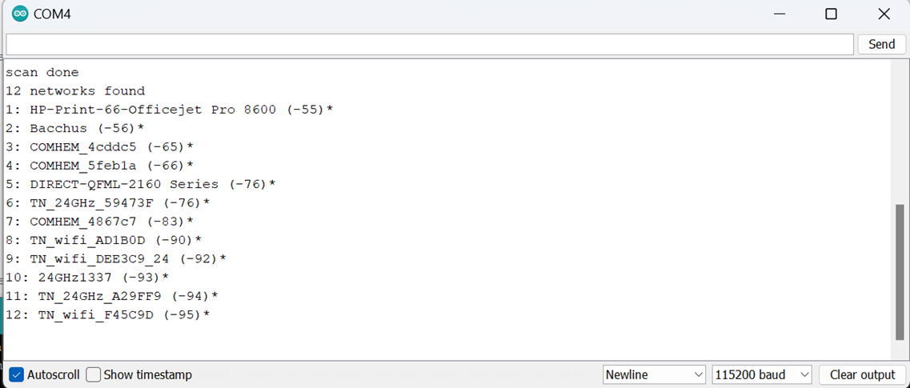
ESP32 Wi-Fi Scan
Screenshot of Serial Monitor in Arduino IDE showing the available networks

Slide 8
CREATING THE TRAFFIC CONTROLLER

Slide 9
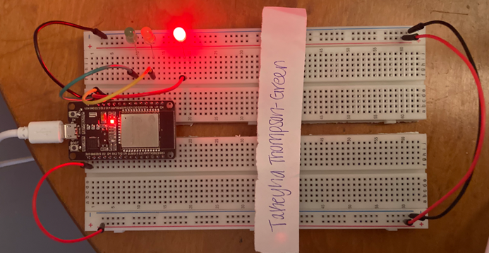
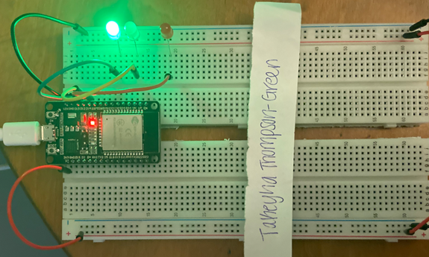
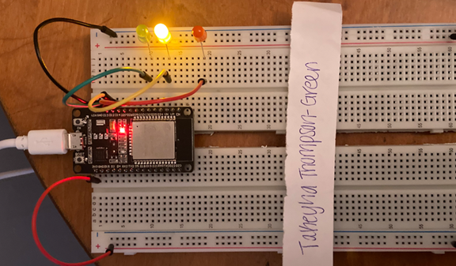
Picture of circuit with working LEDs
ESP 32 Board
Colored LEDs: Red, Yellow and Green
220 Ohm Resistors (optional)
Wires
Breadboard

Slide 10
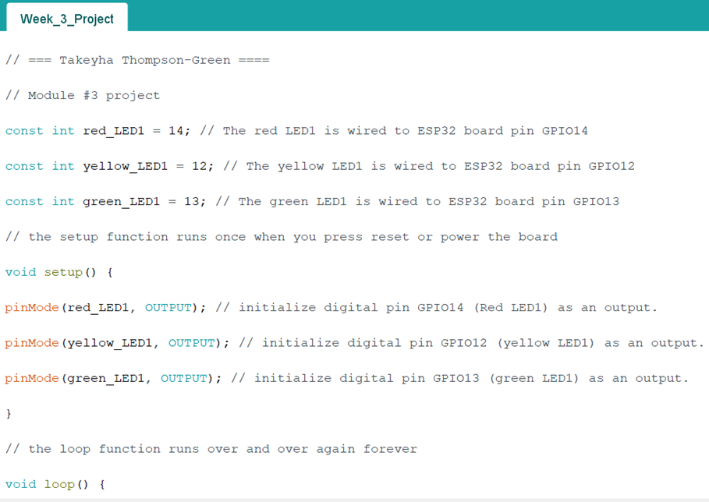
Screenshot of code in Arduino IDE
Screenshot of code in Arduino IDE showing my name in the comment

Slide 11
Creating a Multiple Traffic Light Controller

Slide 12
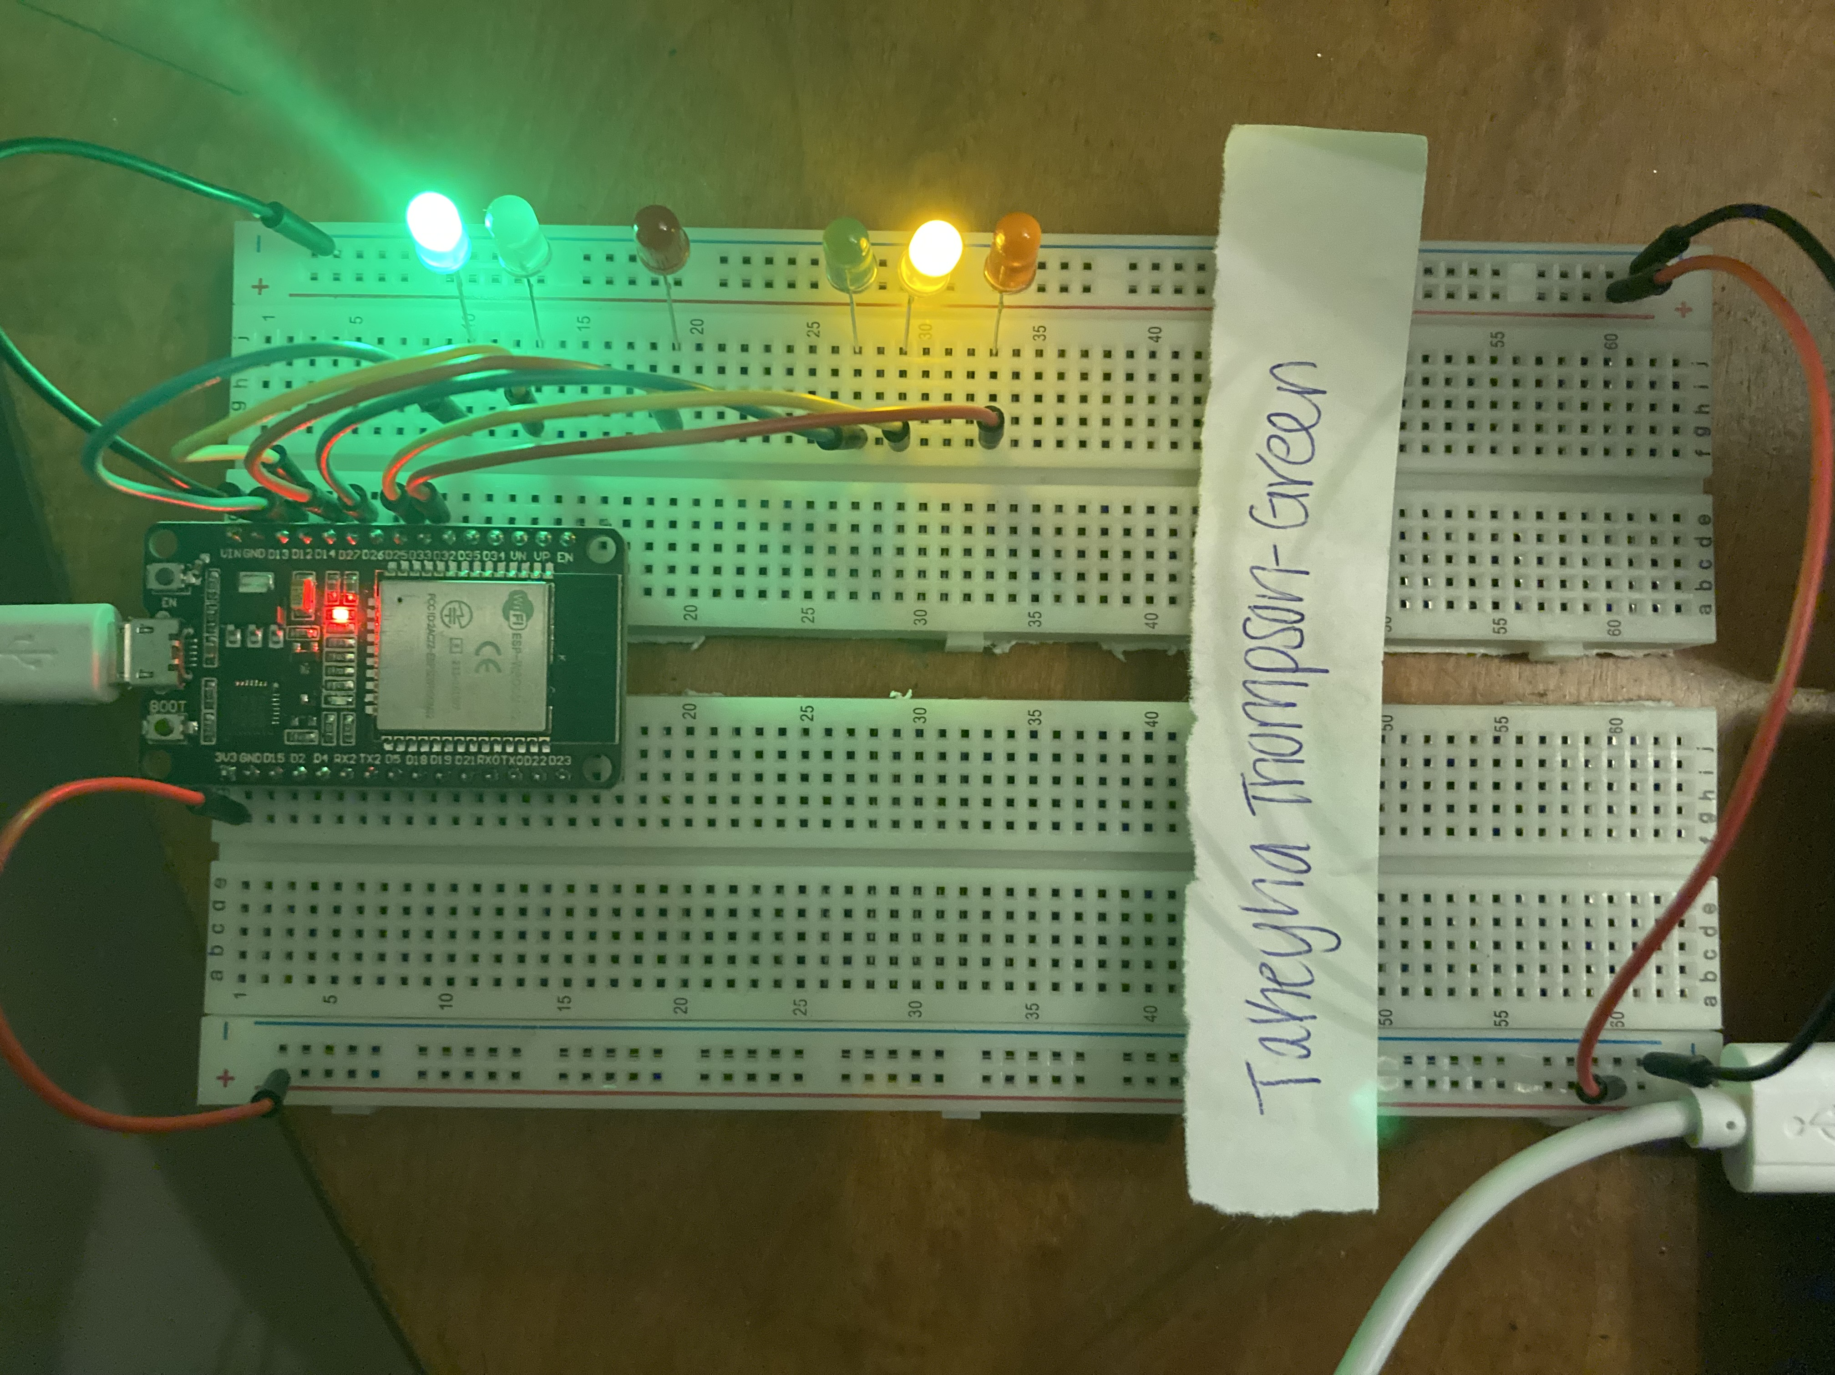
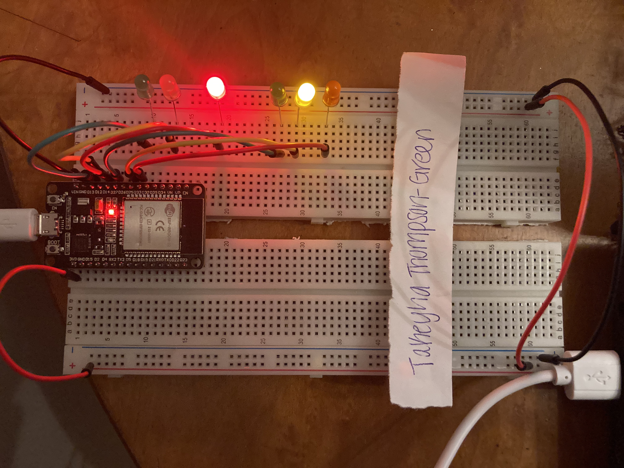
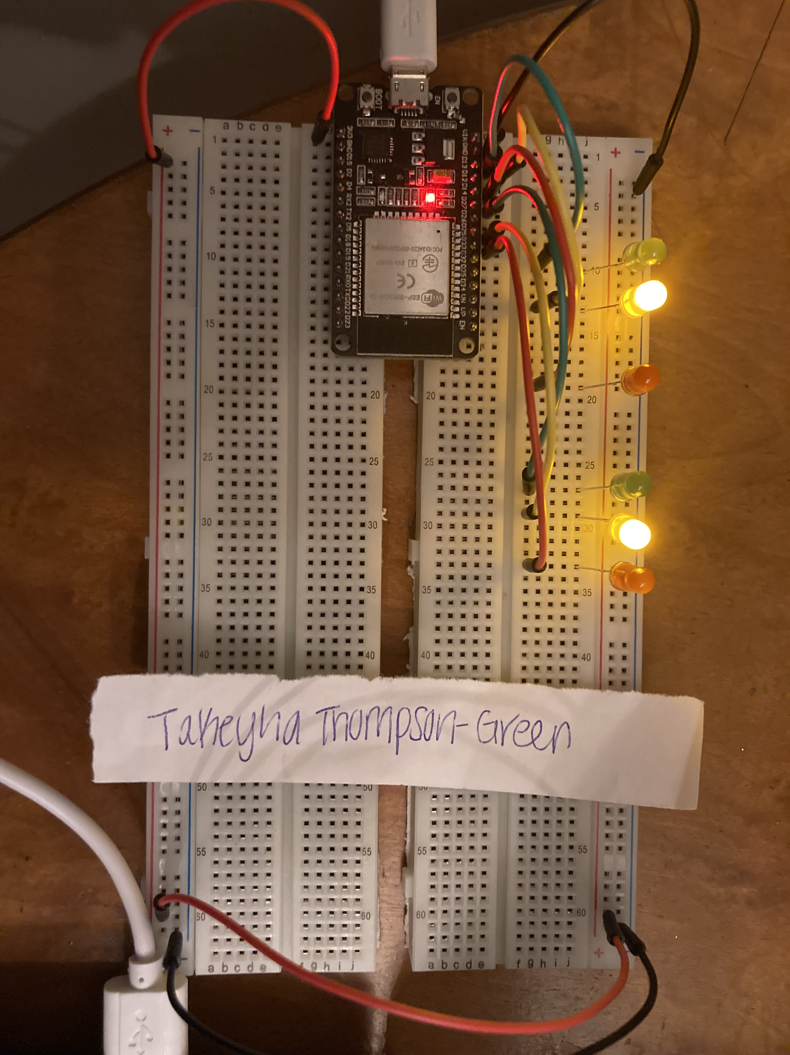
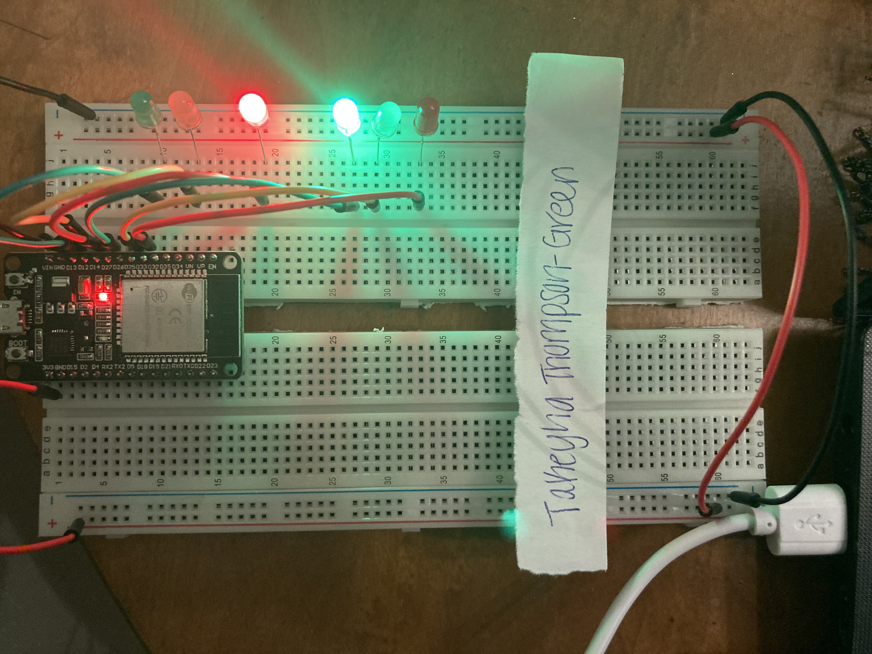
Picture of circuit with working LEDs
ESP 32 Board
Colored LEDs: Red, Yellow and Green (two sets)
220 Ohm Resistors (optional)
Wires
Breadboard

Slide 13
Screenshot of code in Arduino IDE
Screenshot of code in Arduino IDE showing my name in the comment

Slide 14
Creating a Multiple Traffic Light Controller with a Cross Walk and an Emergency Buzzer

Slide 15
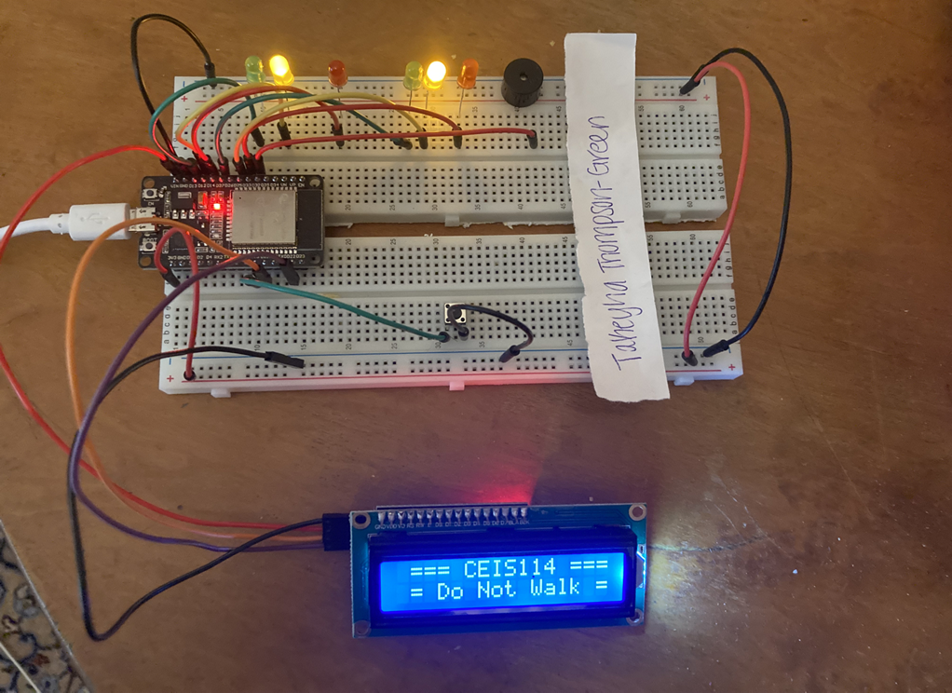
Picture of circuit with working LEDs and LCD display
ESP 32 Board
Colored LEDs: Red, Yellow and Green (two sets)
220 Ohm Resistors (optional)
Push Button
LCD Unit with Message Display
Wires
Breadboard

Slide 16
Screenshot of code in Arduino IDE
Screenshot of code in Arduino IDE showing my name in the comment

Slide 17
Screenshot of Serial Monitor in Arduino IDE
Screenshot of output in Serial Monitor

Slide 18
Creating a Multiple Traffic Light Controller with a Cross Walk and an Emergency Buzzer with secured IoT Control via Web

Slide 19
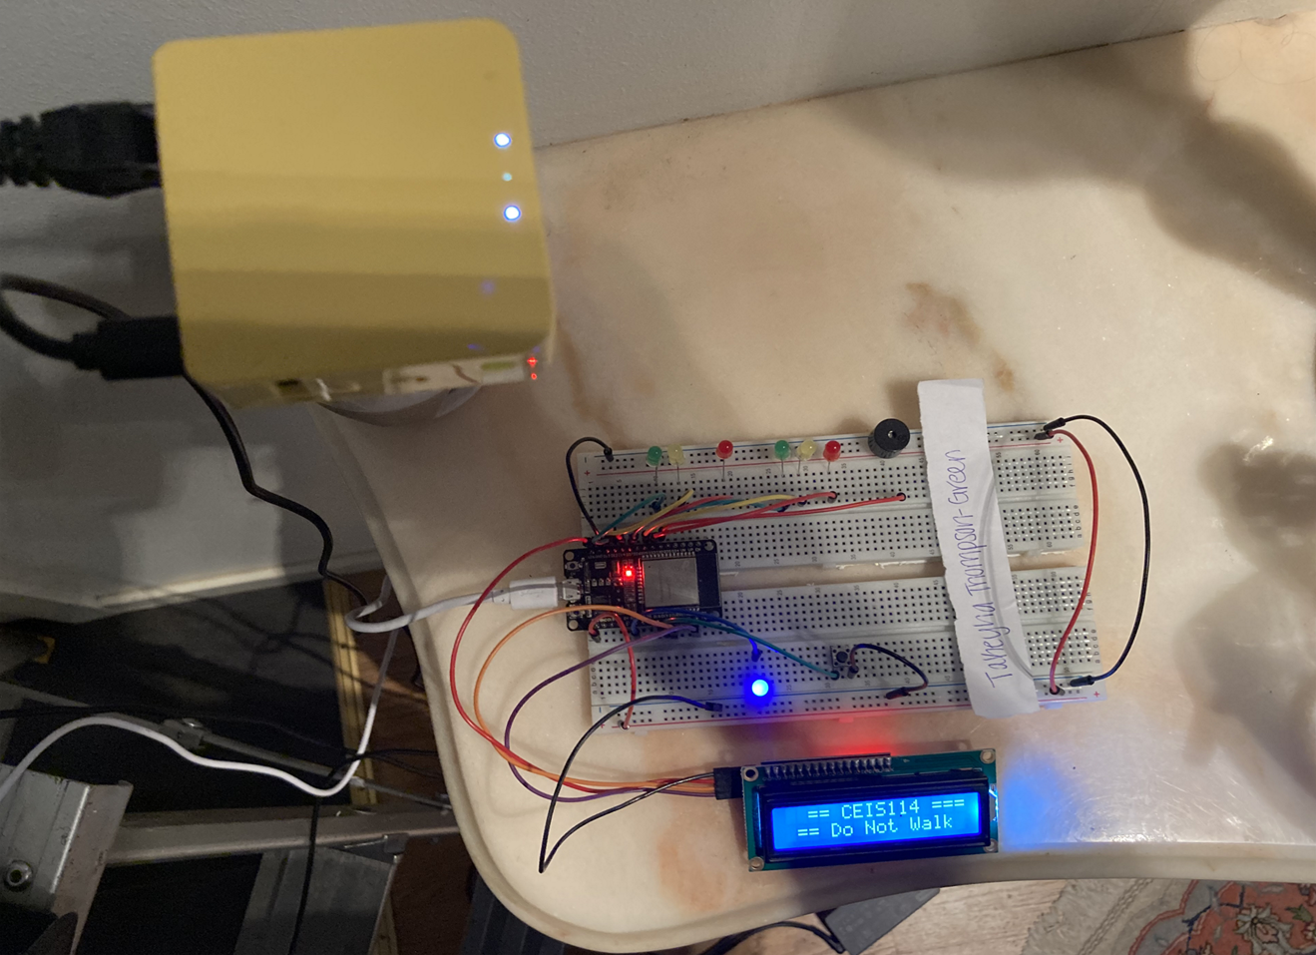
Screenshot of circuit with working LEDs and LCD display (Building/Operation)
ESP32 Board
Colored LEDs: Red, Yellow and Green (two sets)
One Blue LED – Emergency Light
220 Ohm Resistors (optional)
Push Button
LCD Unit
Buzzer
Wires
Breadboard

Slide 20
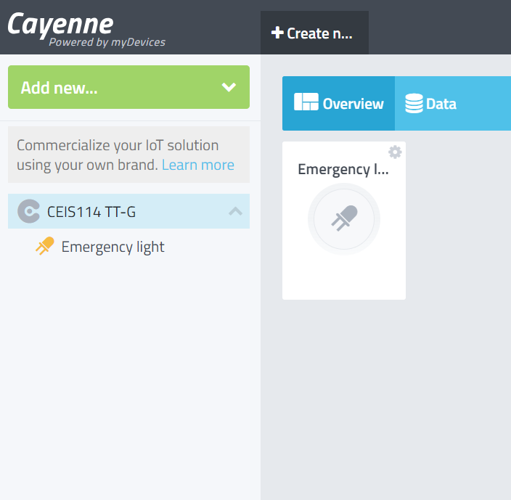
Screenshot of resources (Identification)
Resources needed to build a smart traffic controller.

Slide 21
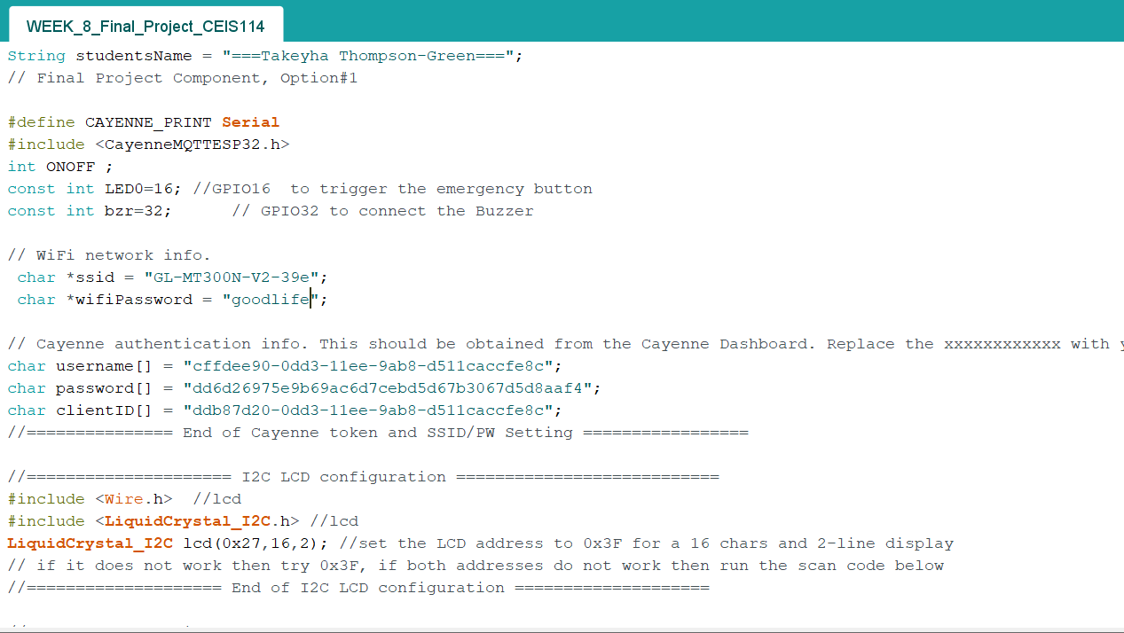
Screenshot of CODE in Arduino IDE (Testing)
Screenshot of code in Arduino IDE showing my name in the comment

Slide 22
Screenshot of Serial Monitor in Arduino IDE (Testing) Screenshot of output in Serial Monitor

Slide 23
Career SKILLS
Security Awareness
Programming on Arduino
AUTOMATION
BASIC FUNDAMENTALS OF IOT
NETWORKING
Team Building Skills

Slide 24
Challenges
Assembling my 2 breadboards together was a struggle, due to me cutting the tape that hold the rails together. I ended up cutting some of the tape off which made some of the rails pop off.
Wires popping out of breadboard ,which led me to constantly having push them in .
I had to either let my mini router hang or hold my mini router in my hand due it being place high up on the wall . I also struggled with setting up my mini router due to poor internet signal

Slide 25
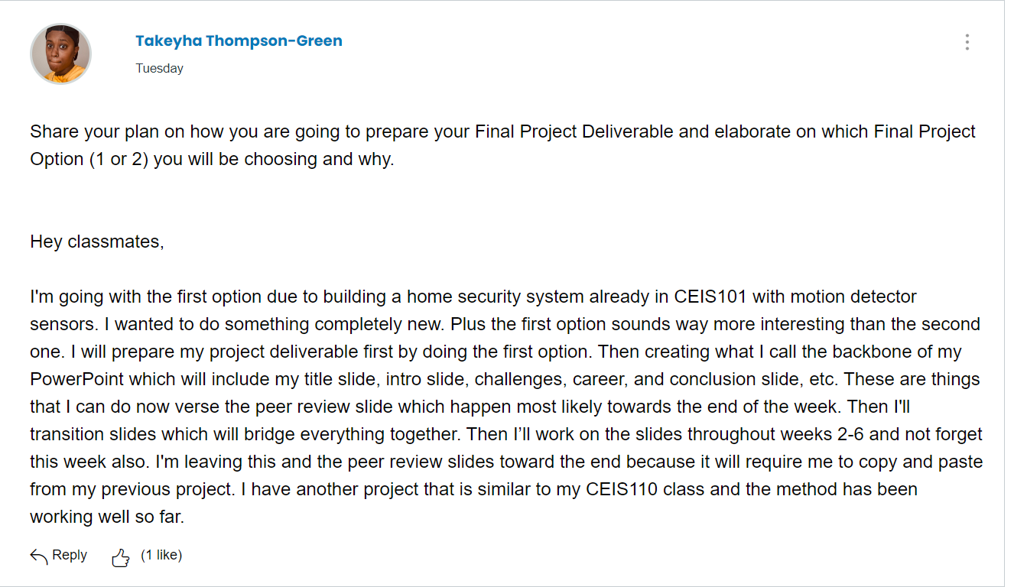
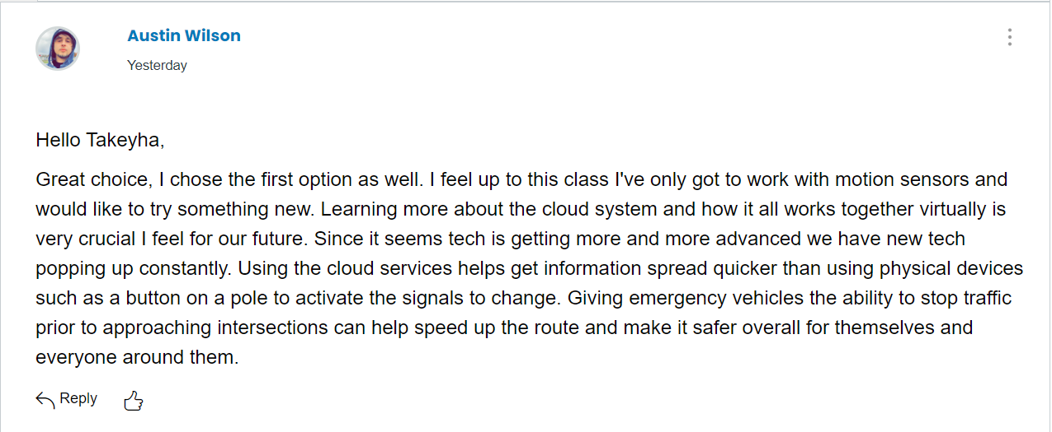
Peer REVIEW SLIDE
(RECIEVED)

Slide 26
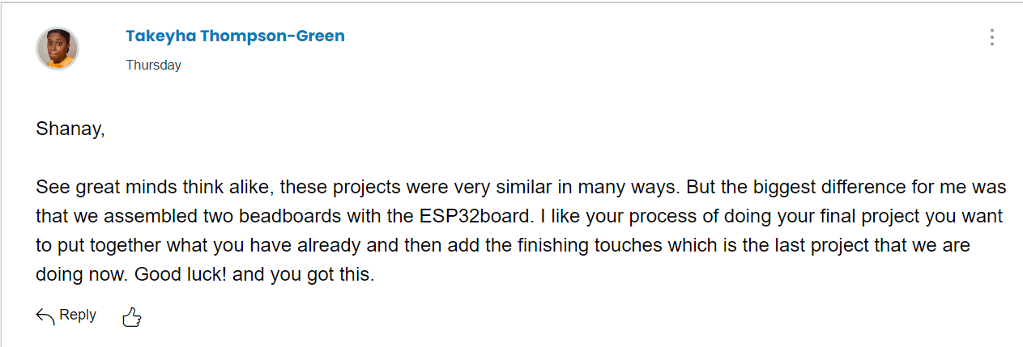
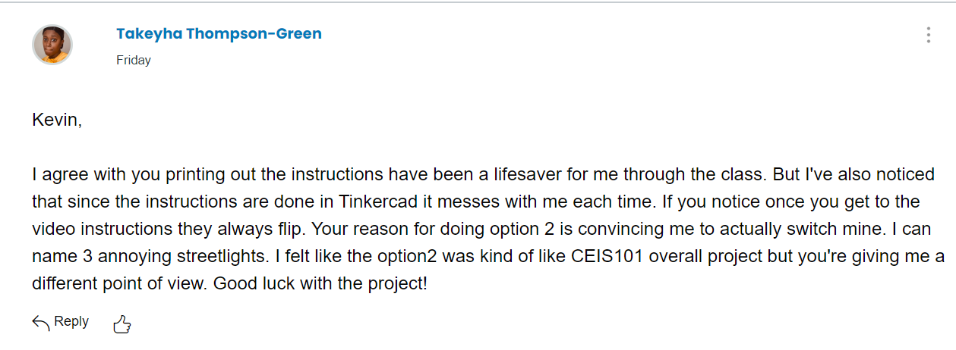
Peer REVIEW SLIDE
(GIVEN)

Slide 27
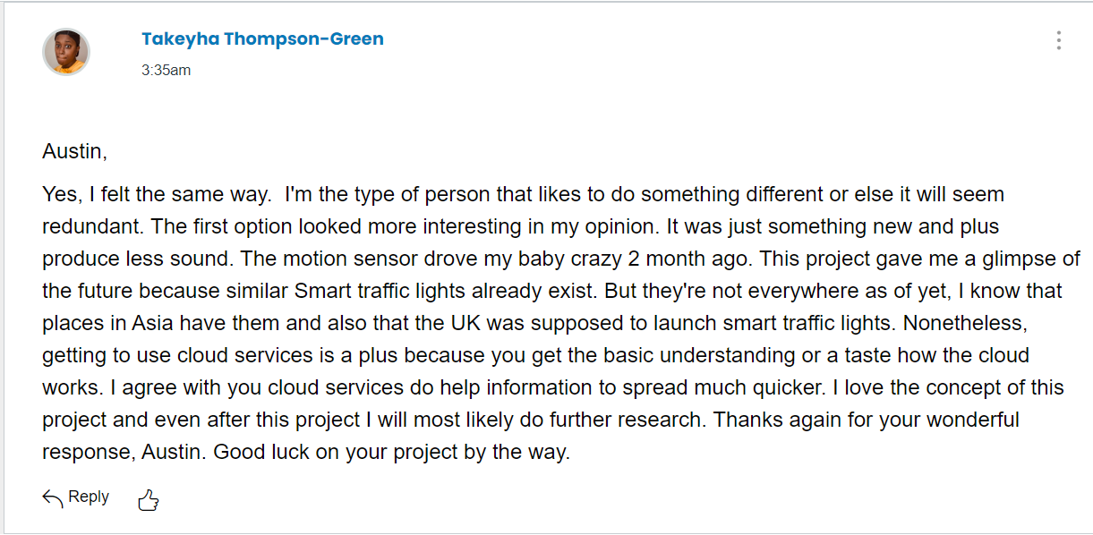
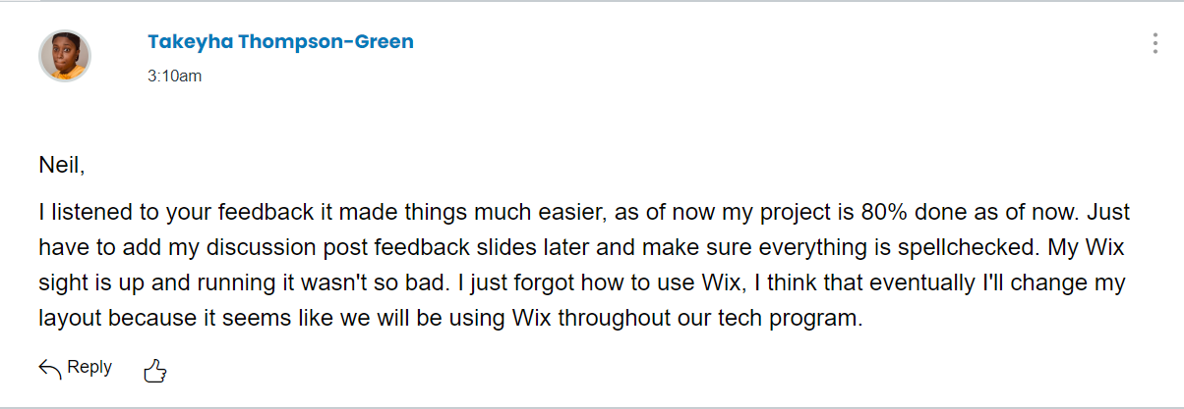
CONTINUED
PEER REVIEW SLIDE

Slide 28
Reflection on Feedback
I was very grateful for the feedback from both of my classmates, it was helpful when it came to this project .
01
What I used from Austin’s feedback was that it was ok , to what to do something different based on the previous class that we had before which was CEIS101. He also gave reasons of why he chose option 1 . Which were different from mine, but it gave me a different perspective of Option 1 . Not the forget the importance of getting the experience of working with the cloud .
02
What I used from Neil’s feedback was to go back to my CEIS101 project which was helpful and gave me inspiration for my layout .
03

Slide 29
CONCLUSION
This final project was very similar to my Home Security System in CEIS101. CEIS101, was a building block to CEIS114. I learned about the breadboard, wires, sensors, buzzers, and other different components. This class first introduced rearranging and assembling 2 breadboards to along with the ESP32. What else I found cool was that my controller used cloud service. The controller was able to give emergency personal, access to the traffic light control. Which doesn’t always happen in the real world, but this was nice to make because it could possibly save time, traffic, and someone’s life.

