Slide 1
CEIS150 PROGRAMMING WITH OBJECTS FINAL PROJECT
Professor Nabeel Baig, July Session 2023
Takeyha Thompson-Green

Slide 2
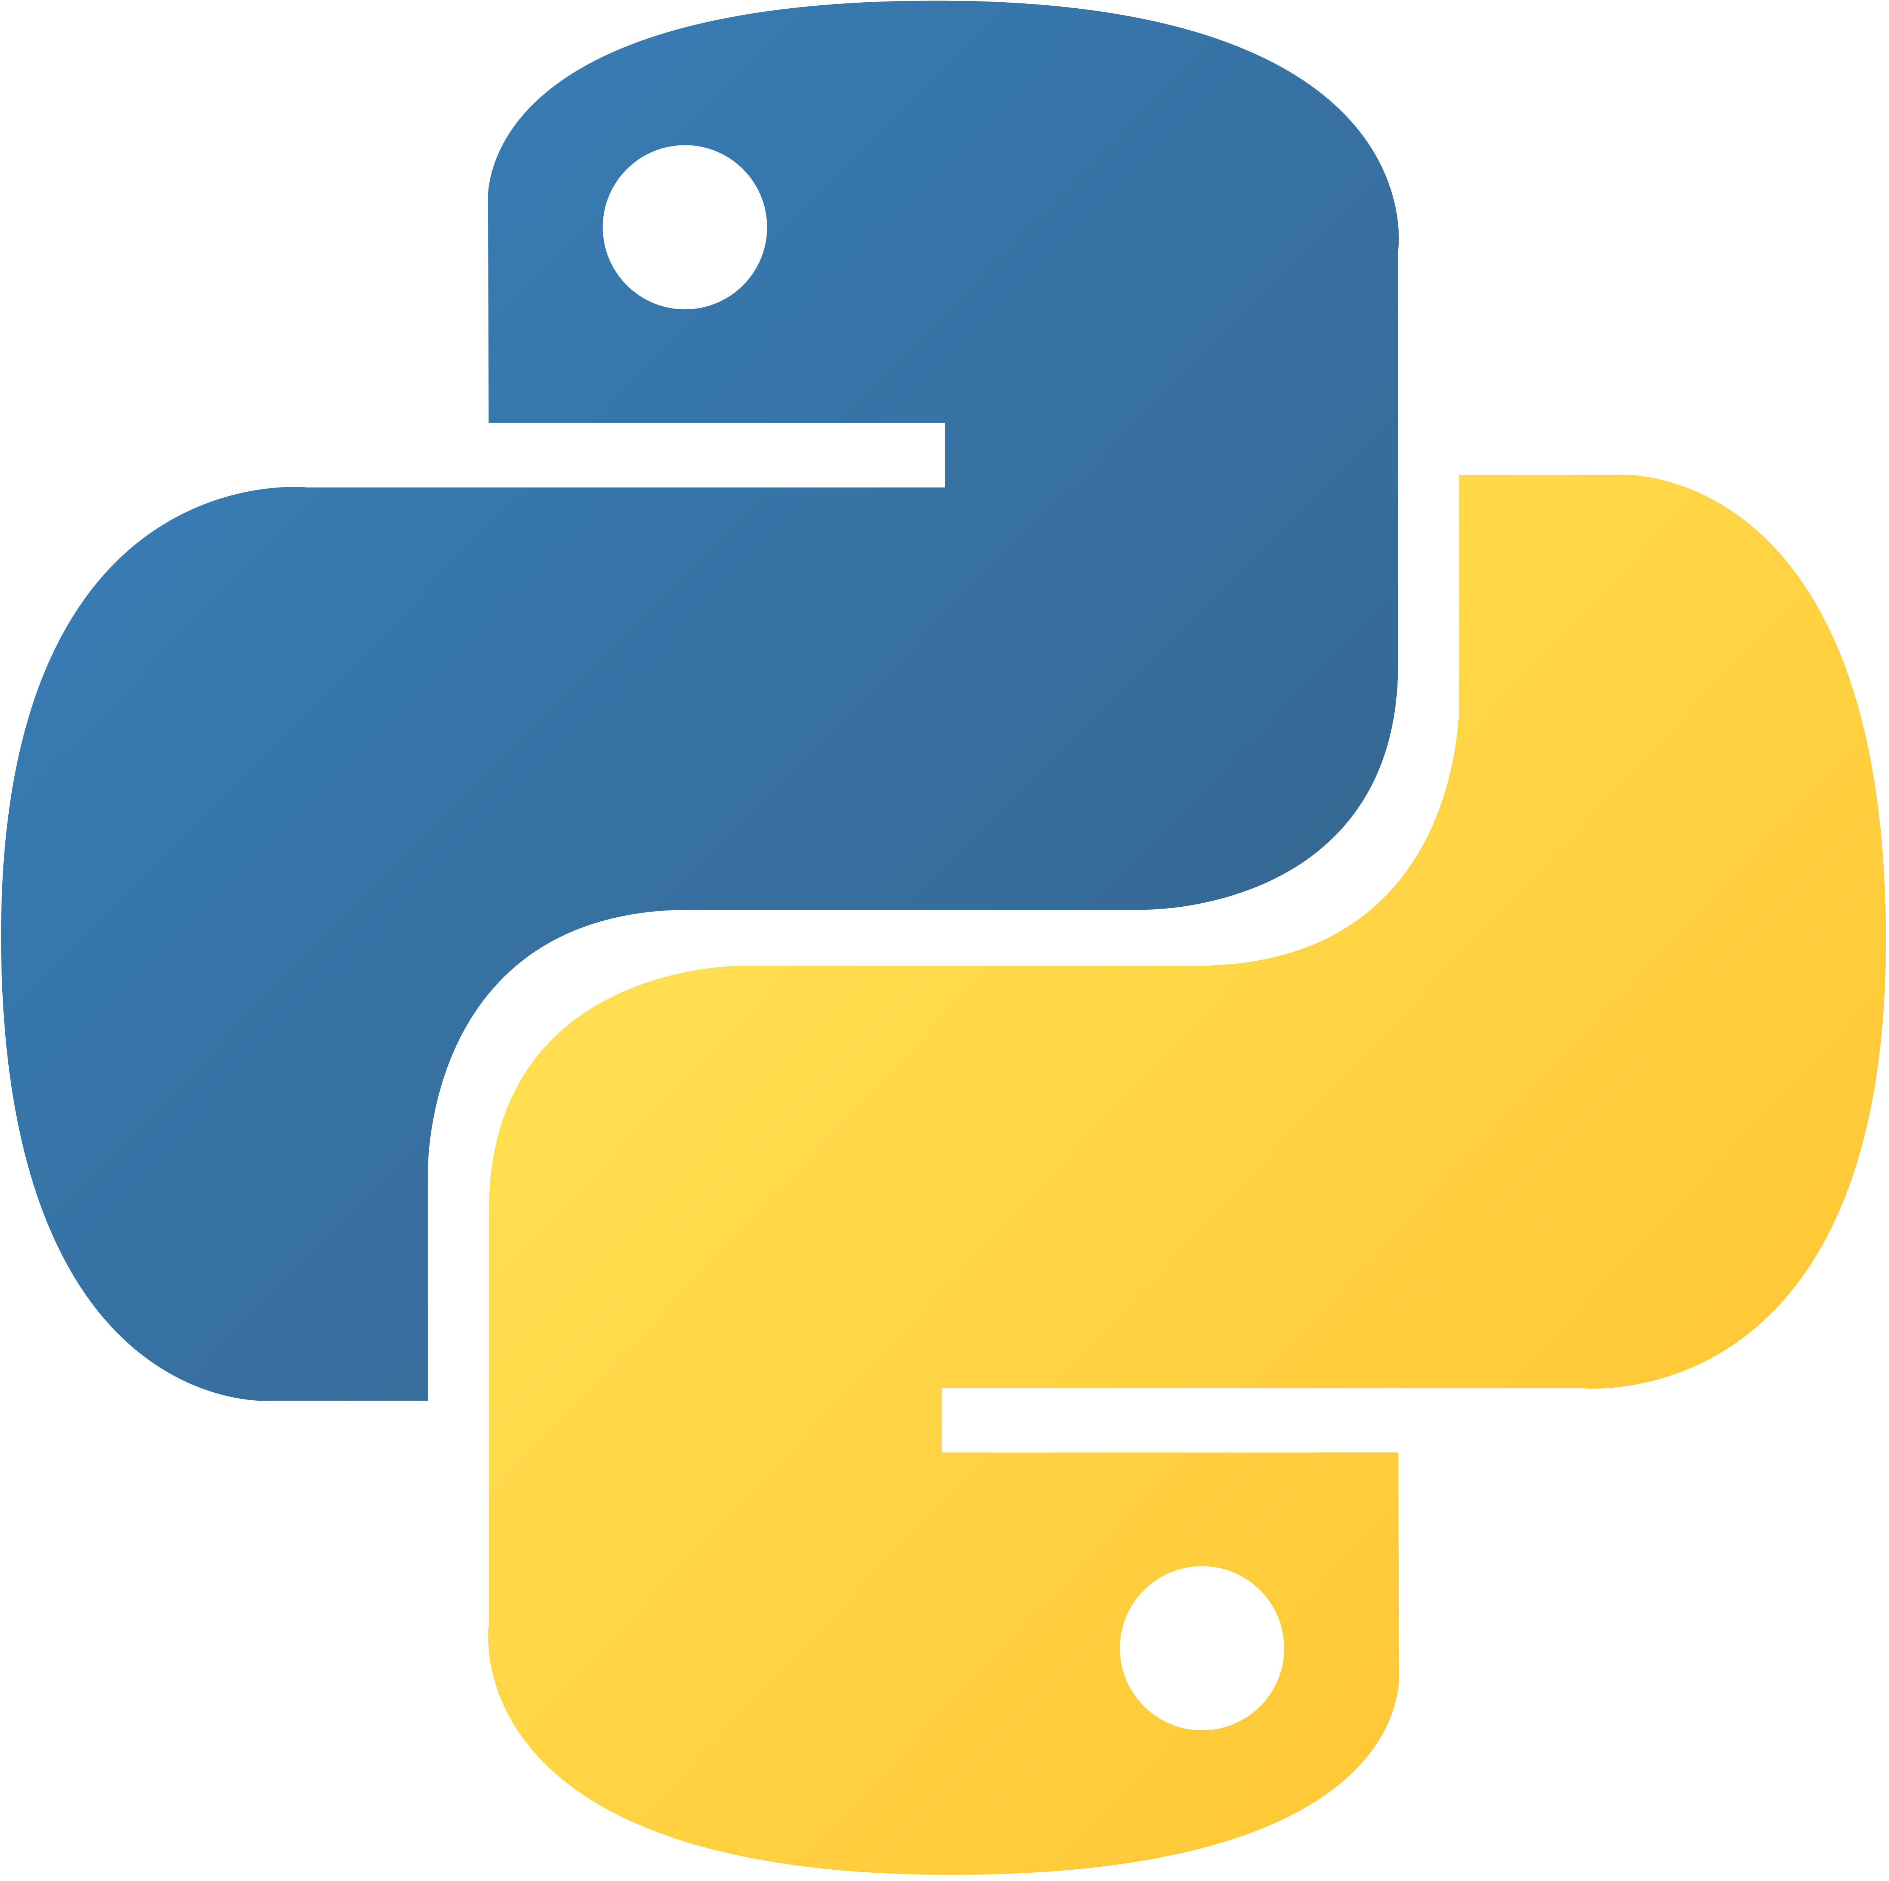
INTRODUCTION
Python has become one of the most popular programming languages thus far. In this compiled CEIS150 Programming with Objects course project, I will be utilizing Python IDE to develop a stock tracking application. This will involve me creating a diagram and creating charts with the use of Python libraries. I will also be processing historical stock data, and profit loss reports, using my saved data that will be generated from Yahoo Finance. In the end, I will create a GUI that shows my stocks, the history of my stock, and the summary of my data.

Slide 3
CLASS DIAGRAMS CLASS CODING UNIT TESTING

Slide 4
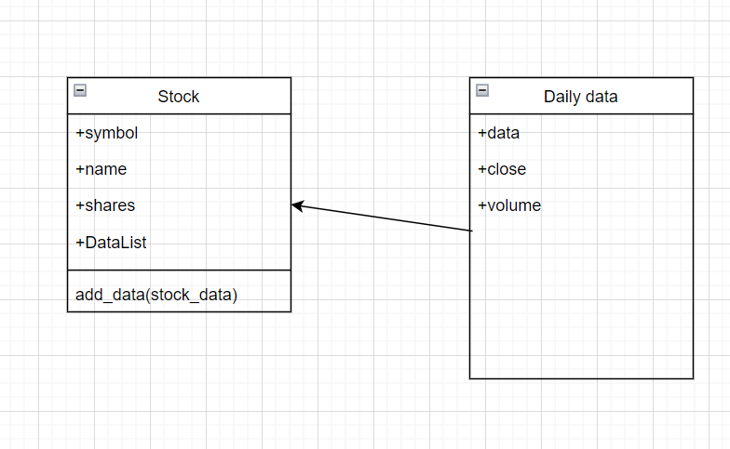
Class Diagram
Paste your Visio Class Diagram

Slide 5
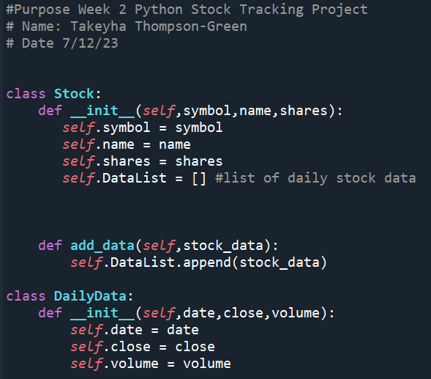
Class Code Screen Shot of your stock_class.py file

Slide 6
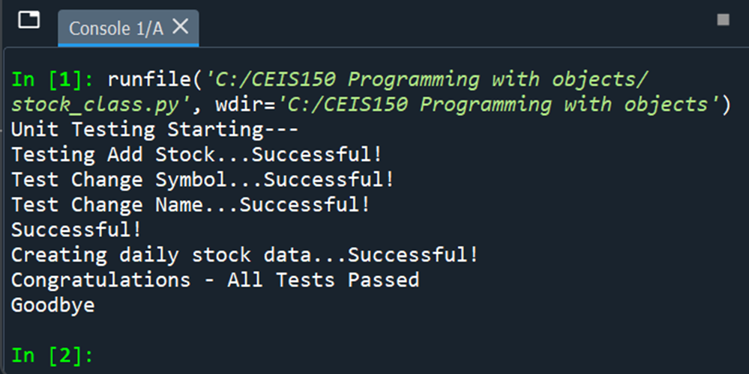
Unit Test
Screen Shot of your successful unit test

Slide 7
TEXT-BASED USER INTERFACE SUMMARY REPORT

Slide 8
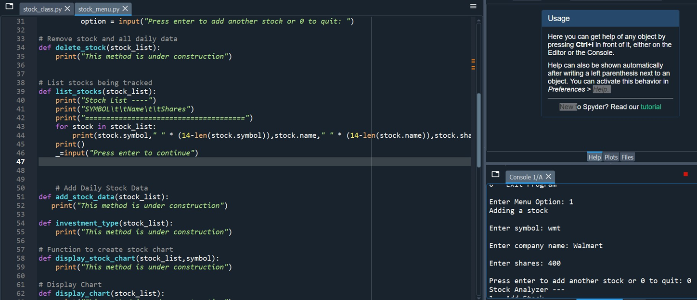
Adding a Stock
Paste a screen shot of your working Stock program.

Slide 9
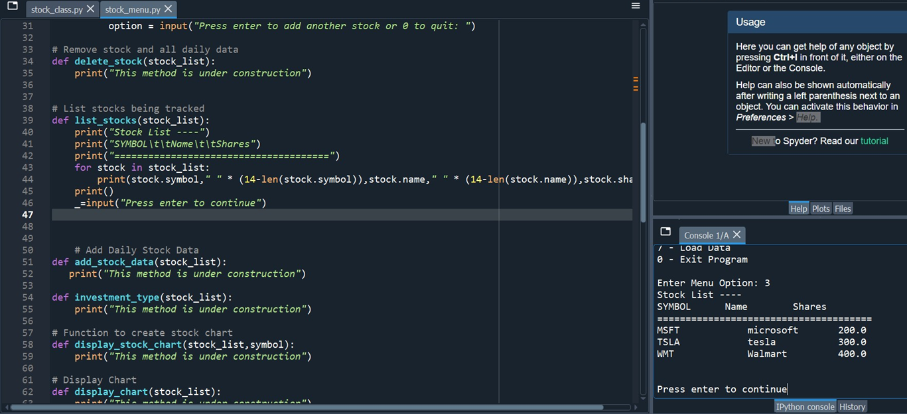
Listing 3 Stocks
Paste a screenshot of your working Stock program

Slide 10
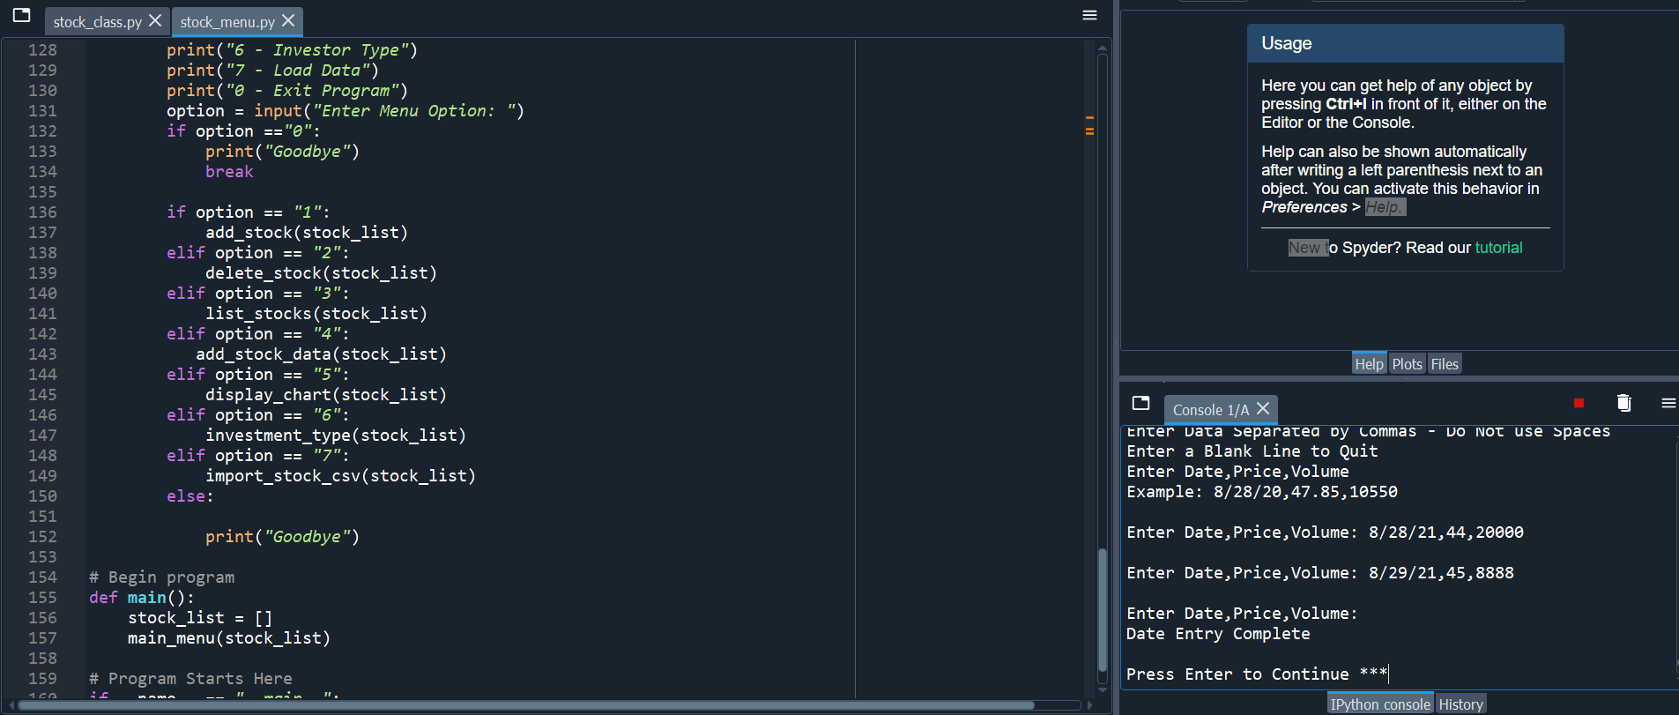
Daily Data
Paste a screenshot of your working Stock program.

Slide 11
INHERITANCE
SUMMARY REPORT

Slide 12
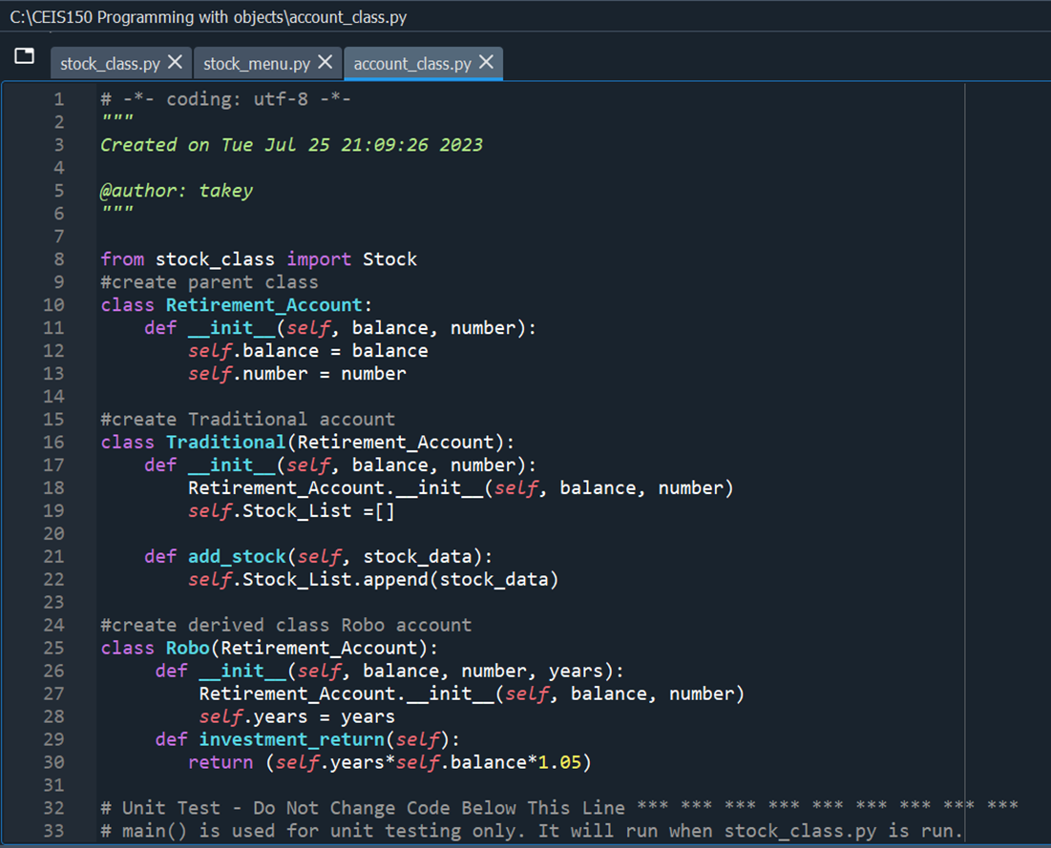
Inherited classes
Paste a screenshot of your classes

Slide 13
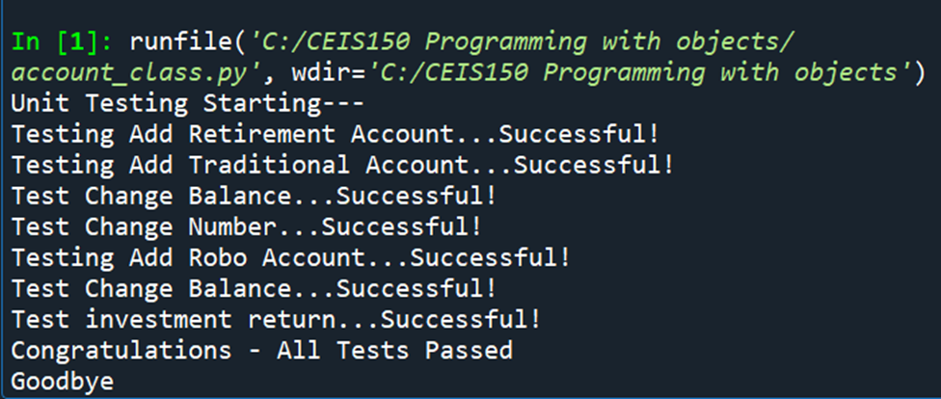
Unit tests
Paste a screenshot of your unit tests successfully completed

Slide 14
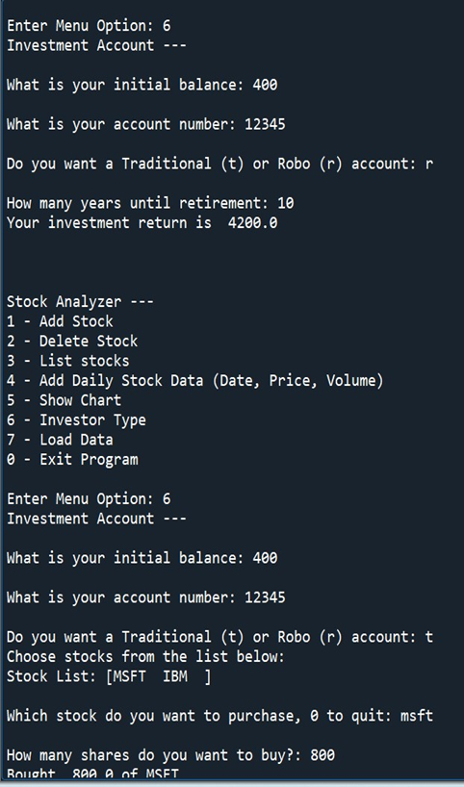
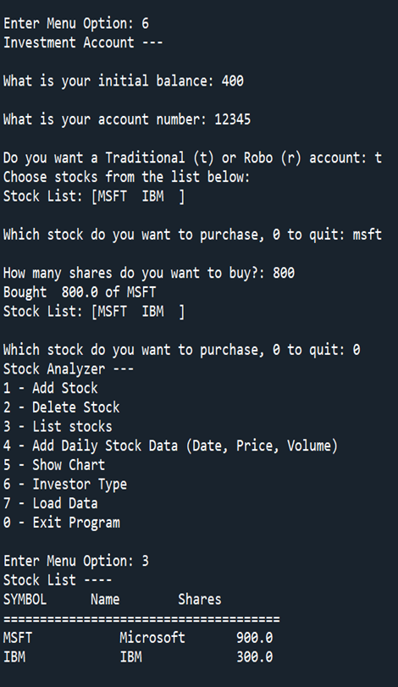
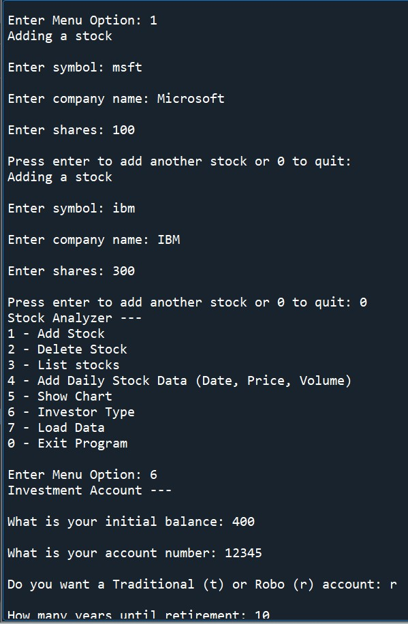
Stock menu program
Paste a screenshot of your classes in the main program

Slide 15
CREATING A CHART

Slide 16
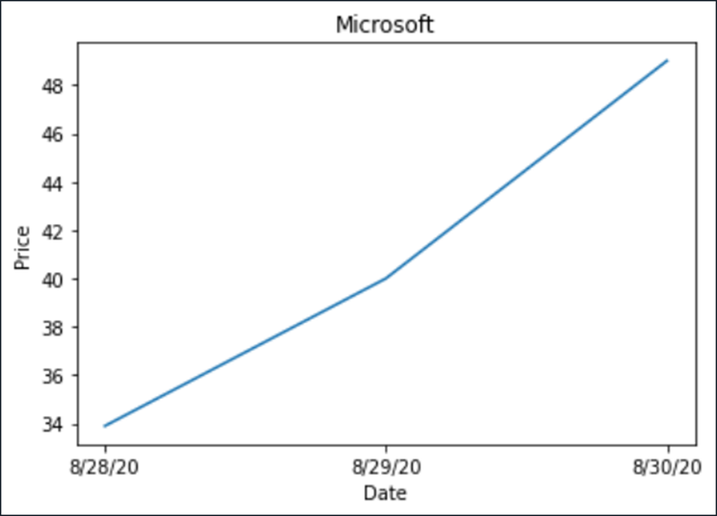
Chart
Paste a screenshot of your stock chart.

Slide 17
LOADING DATA

Slide 18
File
Paste a screenshot of the file downloaded from Yahoo Finance

Slide 19
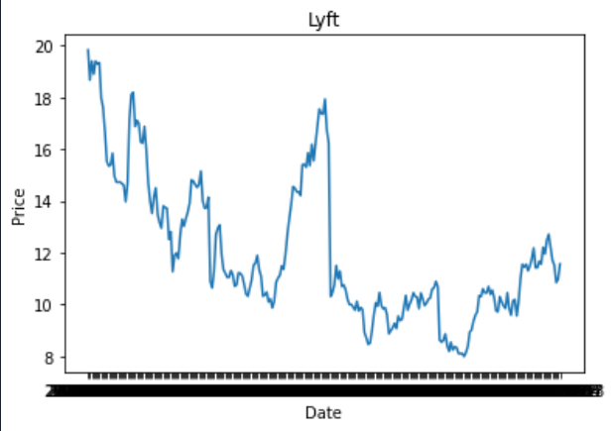
Importing data
Screenshot of the historical data import

Slide 20
GUI

Slide 21
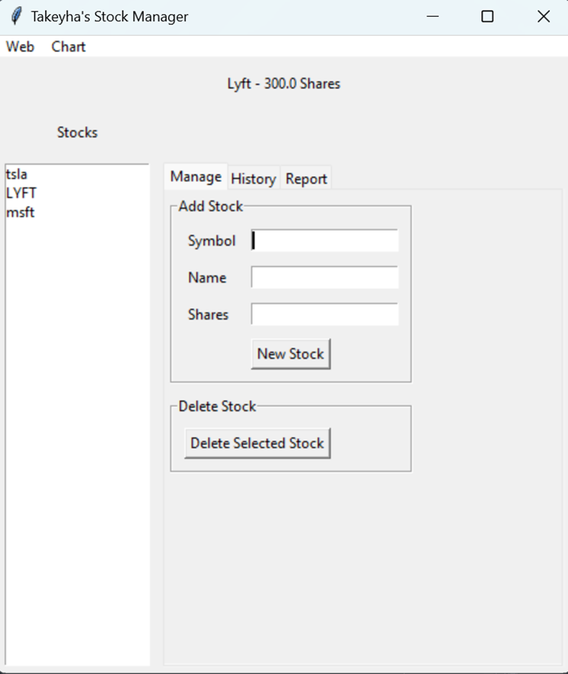
Stocks in GUI
Paste a screenshot of your GUI working

Slide 22
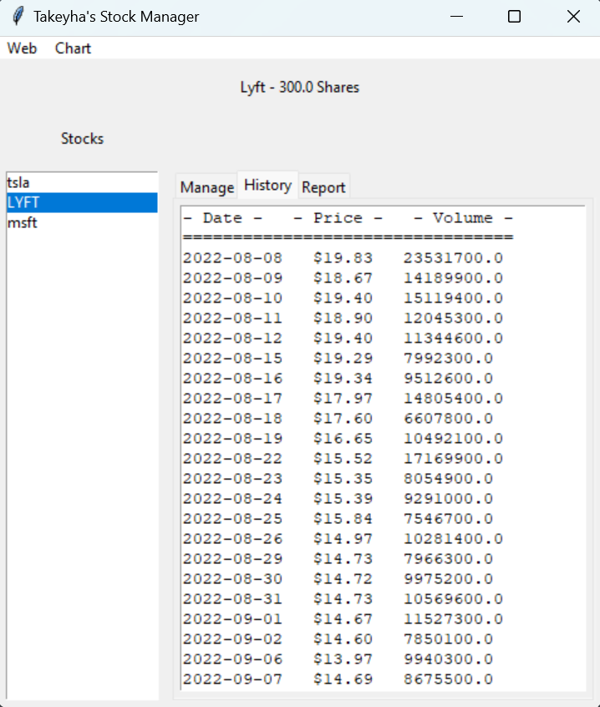
History Tab
Paste a screenshot of your History tab with import working.

Slide 23
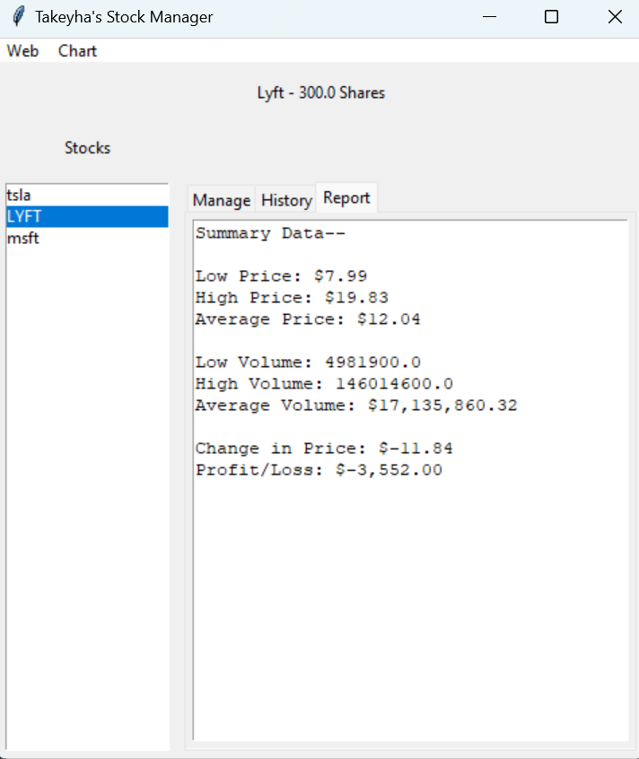
Report Complete
Paste a screenshot of your Report tab

Slide 24
Career Skills
Gained experience with creating applications in Python IDE
Creating charts with the use of Python libraries
Writing object-oriented code
Utilizing libraries to develop a GUI
Writing code in Python IDE
Creating a class diagram
Creating a menu-driven user interface

Slide 25
Challenges
Python IDE crashing
Having to reread and rewrite code due to errors
At the beginning of my project, proper indentation was an issue
Had some issues at first with forgetting to enter in 0 to exit the stock manager program.

Slide 26
Conclusion
After successfully completing this final course project, it has given me a better understanding of how to track stocks in Python. It was a little challenging towards the end but rewarding to see the end result. It gave me a better perspective of what Python has to offer after utilizing its libraries, creating charts, and importing/loading data. This has led me in the right direction and given me a little taste of programming. I hope you enjoy this project!

