Slide 1
CEIS106
FINAL COURSE PROJECT
Professor Charlotte McKenzie
Takeyha Thompson-Green
July Session 2023

Slide 2
INTRODUCTION
Welcome to my CEIS106 Introduction to Operation Systems class final project which is Linux based . I'll be utilizing virtual machines such as Ubuntu and DCHP server . I will be completing various tasks like executing commands, creating directories, files, copying, removing files and directories. I will also locate files, change script file permissions, add users, remove groups, and complete other tasks. I hope you enjoy this project as much as I did.

Slide 3
LINUX FILE SYSTEM HIERACRACY

Slide 4
NAVIGATE THE LINUX FILESYSTEM TREE
1. What is the pwd command an acronym for? What about the cd command?
Answer here:
pwd- stands for command stands for print working directory – shows the current directory which is in the directory tree
Cd –stands for change directory –this command changes the directory
2. Explain the differences between a relative path and an absolute/full path in Linux.
Answer here:
Relative path – is the path that is based on your location that only identifies the location of the file or directory that you’re currently in.
Absolute path – is the path starting from the root of the file system that identifies the entire location of a file or directory.

Slide 5
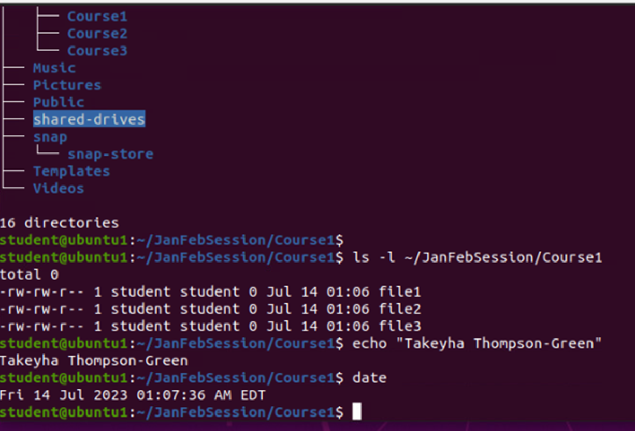
CREATE DIRECTORIES AND FILES
Take a screenshot of the output in Steps 5 and 6.

Slide 6
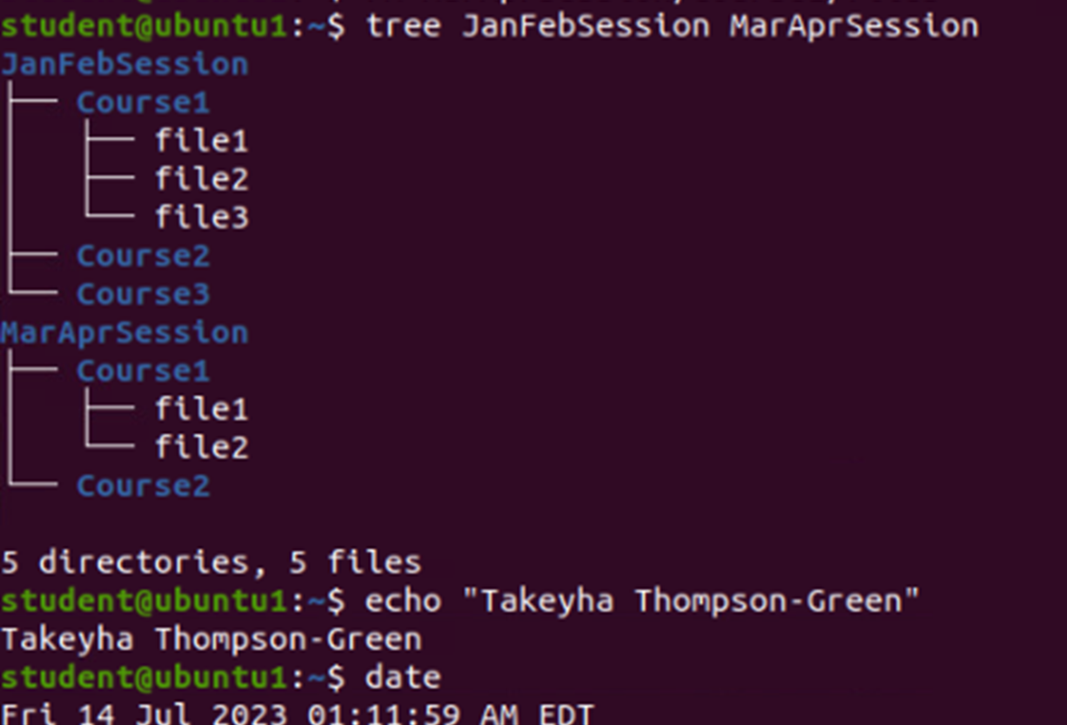
COPY AND REMOVE DIRECTORIES AND FILES
Take a screenshot of the output in Step 3

Slide 7
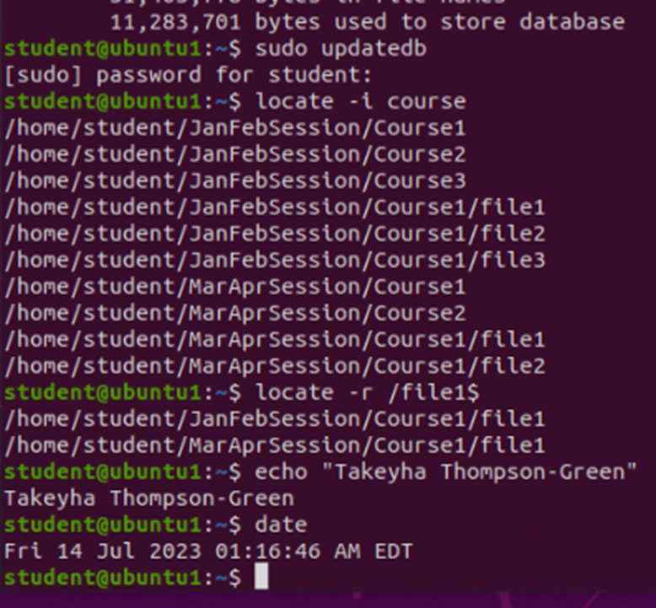
LOCATE DIRECTORIES AND FILES
Take a screenshot of the output in Steps 5 and 6.

Slide 8
LINUX SHELL SCRIPTS

Slide 9
CREATE A SHELL SCRIPT
1. What are the file permissions of the script?
Answer here:
rw-rw-r-- --read/write for the owner, read/write for the group , read only for everyone
2. What’s the name of the user-defined variable in the script?
Answer here:
Text
3. Which redirection meta-character is used in the script? What does it do?
Answer here:
>> -- redirection to the file and appends to the end of the file

Slide 10
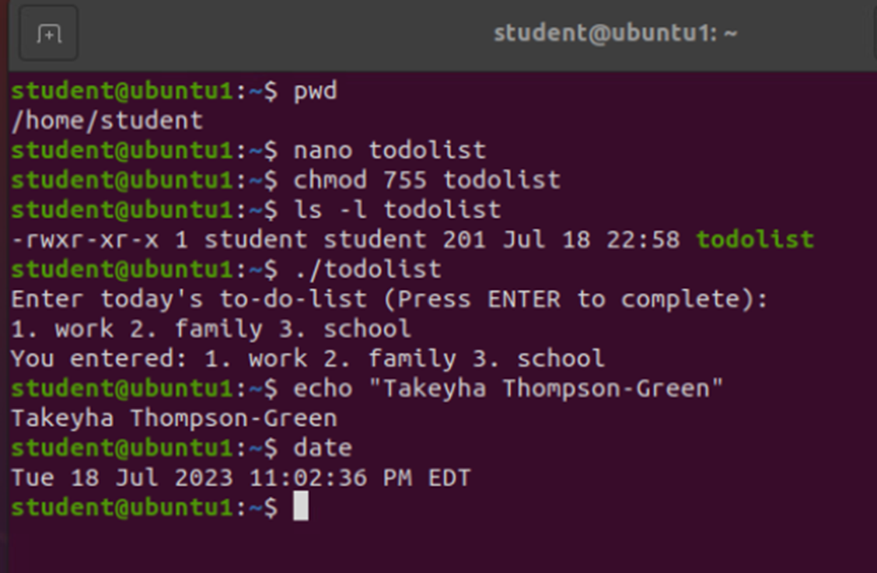
CHANGE SCRIPT FILE PERMISSIONS
Take a screenshot of the output in Step 5.

Slide 11
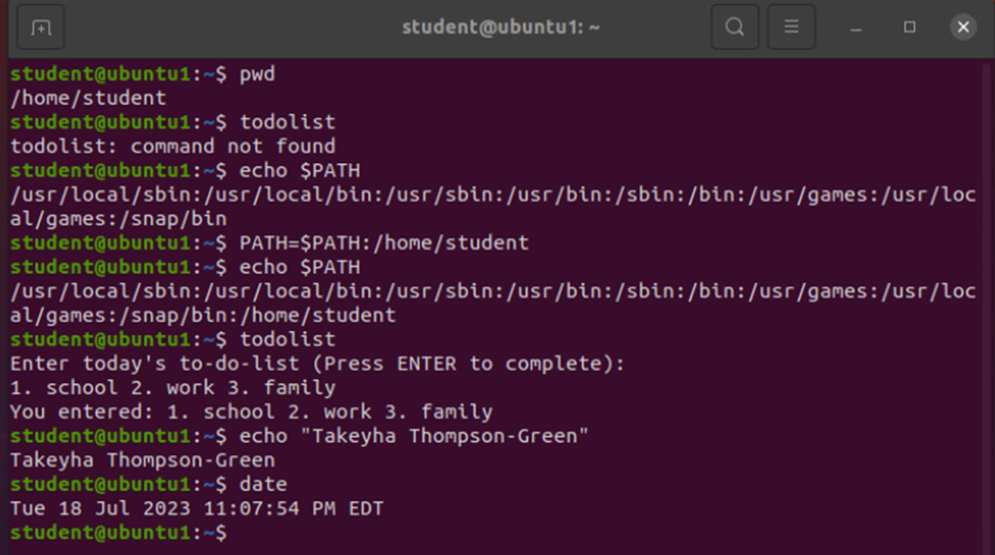
SET THE PATH VARIABLE
Take a screenshot of the output in Step 6.

Slide 12
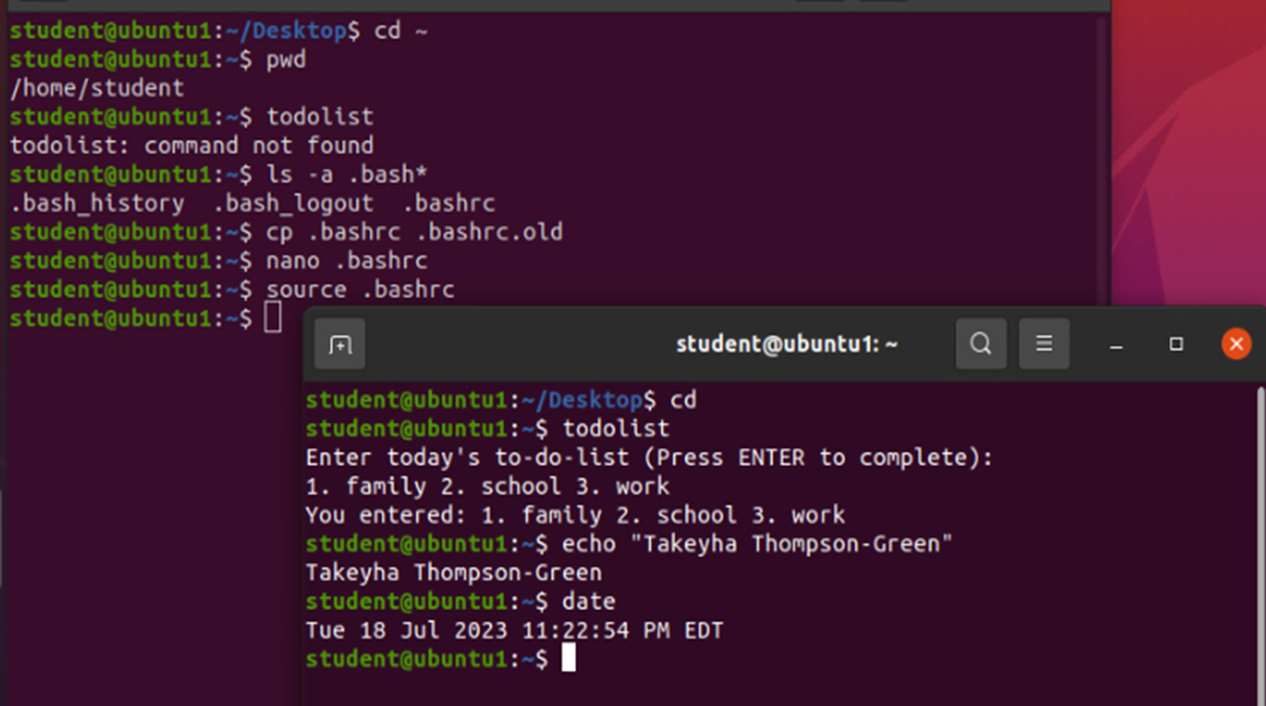
MAKE THE PATH VARIABLE PERMANENT
Run the todolist script before and after making the PATH variable permanent. Take a screenshot of both Terminal windows.

Slide 13
USER AND GROUP MANAGEMENT

Slide 14
ADD USERS AND GROUPS IN CLI
1. What does the –m option in the useradd command do?
Answer here:
The –m option tells the useradd command to create a home directory for the new user
2. What does the -3 option in the tail command do?
Answer here:
The -3 option tells the tail command how many lines to show from the end of the file
3. Which line of the /etc/group file lists members of the “students” group? Copy it here.
Answer here:

Slide 15
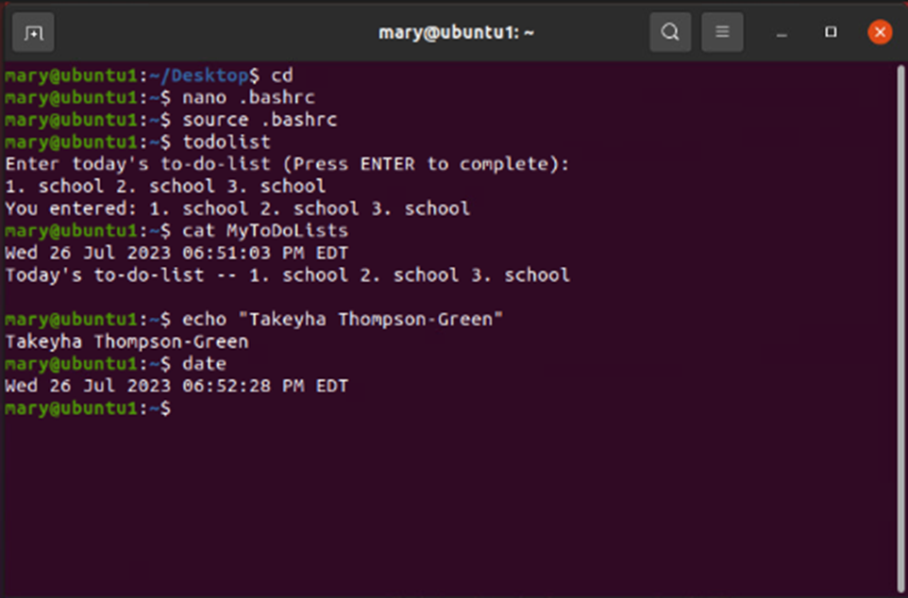
TEST USER AND GROUP SETTINGS
Take a screenshot of the output in Step 6.

Slide 16
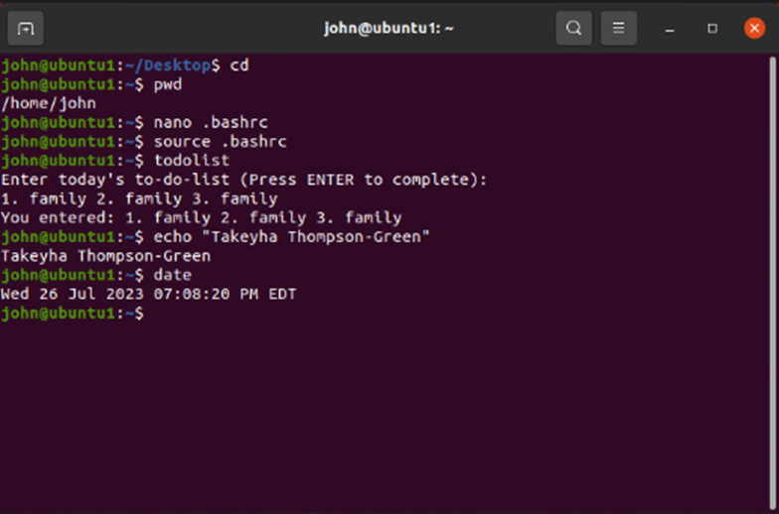
ADD USERS IN GUI
Take a screenshot of the output in Step 9.

Slide 17
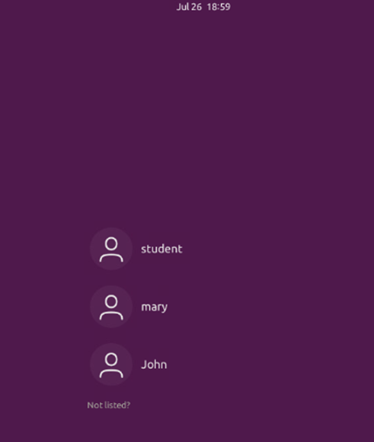
REMOVE USERS AND GROUPS
Take a screenshot of the log on page with three user accounts.
Take a screenshot of the log on page with only your user account (i.e., student).

Slide 18
NETWORK CONFIGURATION

Slide 19
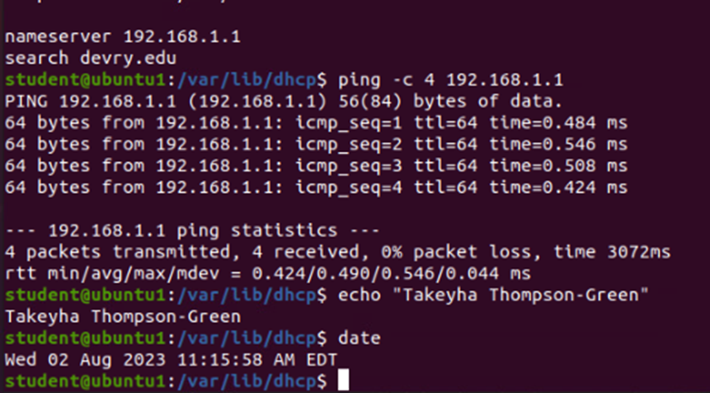
DISCOVER HOST IP CONFIGURATIONS
Take a screen capture of the output in Step 12.
1. What is the IP address of your Ubuntu machine?
Answer here:
192.168.1.108
2. What is the IP address of its default gateway?
Answer here:
192.168.1.1
3. What is the IP address of its DHCP server?
Answer here:
192.168.1.1
4. What is the IP address of its DNS server?
Answer here:
192.168.1.1

Slide 20
MANAGE NETWORK INTERFACES
1. Which DHCP message is shown in the output of the sudo dhclient –v –r ens33 command?
Answer here:
DHCPRELEASE
2. Which four DHCP messages are shown in the output of the sudo dhclient –v ens33 command?
Answer here:
DHCPDISCOVER
DHCPOFFER
DHCPREQUEST
DHCPACK

Slide 21
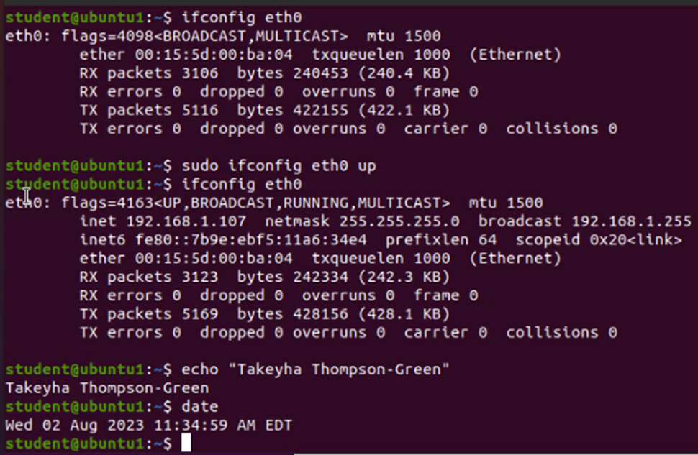
USE NETWORK UTILITIES
Take a screen capture of the output in Step 7 and Step 8.

Slide 22
SYSTEM PERFORMANCE MONITORING

Slide 23
MONITOR LINUX PROCESSES
1. What is the default action of the 15 SIGTERM kill signal?
Answer here: Kill the highlighted process
2. In the System Monitor window, click on % CPU to sort the processes by CPU load. Which process shows the highest percentage of CPU usage?
Answer here:
The gnome-shell(GUI) shows the highest percentage of CPU usage

Slide 24
MONITIOR USER ACTIVICTIES
Issue the sudo accton on command to turn on GNC accounting. Run the sudo updatedb command. Enter lastcomm updatedb to check if the updatedb command was executed before. Remember to turn off GNC accounting (sudo accton off) after answering the questions.
1. What flag value is displayed in the output?
Answer here: S ---”super user”
2. Why is the name of the user who ran the processes shown as root, not student?
Answer here: Super user ran the process because I typed in sudo in front of the command

Slide 25
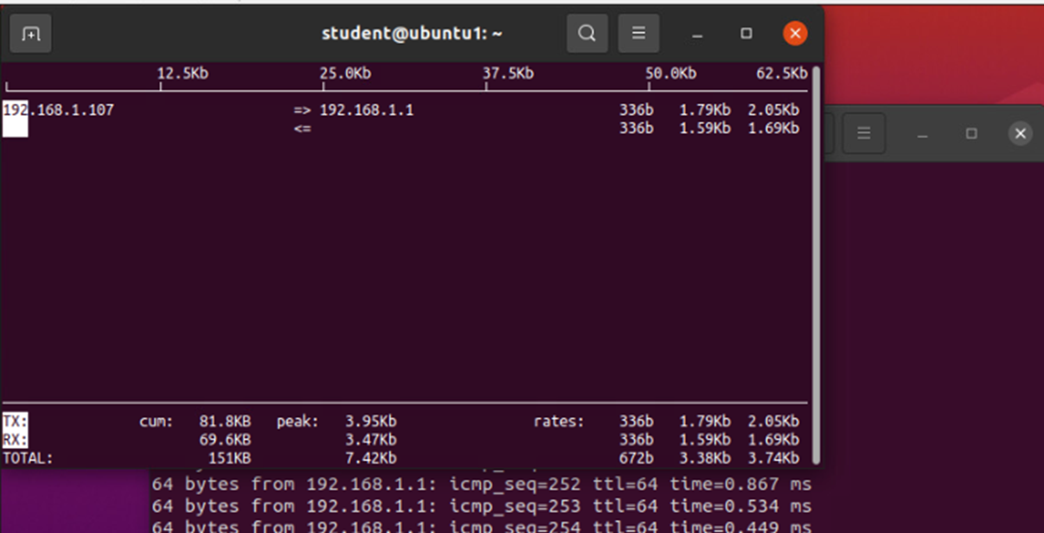
MONITIOR NETWORK BANDWIDTH USAGE
Take a screenshot of the output in Step 4.

Slide 26
CHALLENGES
Some of the challenges that I faced during this project were :
Forgetting that Linux is case sensitive
Comparing this programming language to Python
Ubuntu crashed a few times, which caused me to start from the beginning
Starting all over, based on misspelled commands
Time usage in my learning environment when I used Ubuntu for the first time

Slide 27
CAREER SKILLS
WRITING SCRIPTS TO AUTOMATE TASK
LEARNING LINUX COMMANDS
MANAGING USER AND GROUPS
MONITORING SYSTEM PERFORMANCE
UNDERSTANDING OF IP CONFIGURATIONS
FUNDAMENTAL KNOWLEDGE OF LINUX OPERATING SYSTEMS IN A VIRTUALIZATION ENVIRONMENT

Slide 28
conclusion
This course project was very fun and one of my favorites so far. Despite facing a few obstacles , especially with remembering that Linux is case sensitive. I quickly overcame this obstacle by practicing double checking my commands before executing them. I enjoyed working in a virtualized environment, which was great hands-on experience . After a while, I got familiarized with remembering some of Linux's commands, due to repetitive usage . This course project also gave me an idea of one of the certifications I will purse in the near future .

