Slide 1
CEIS110 PROGRAMMING WITH DATA
PROFESSOR Jeevan D'Souza
May Session 2023
Takeyha Thompson-Green

Slide 2
Introduction
Data is steadily generated and yet growing from many sources.
In this project I used a cloud-based system to gather temperature and humidity data in my locality.
The data that was gathered was then analyzed using programming and data analytics.
This project also gave me a taste of the software development process which was quite interesting .

Slide 3
INVENTORY
The first step in my programming with data project was making sure I had all the tools needed. Which included making sure I had downloaded and installed the required software that was necessary for this project which were:
Microsoft Excel
Python (Anaconda)

Slide 4
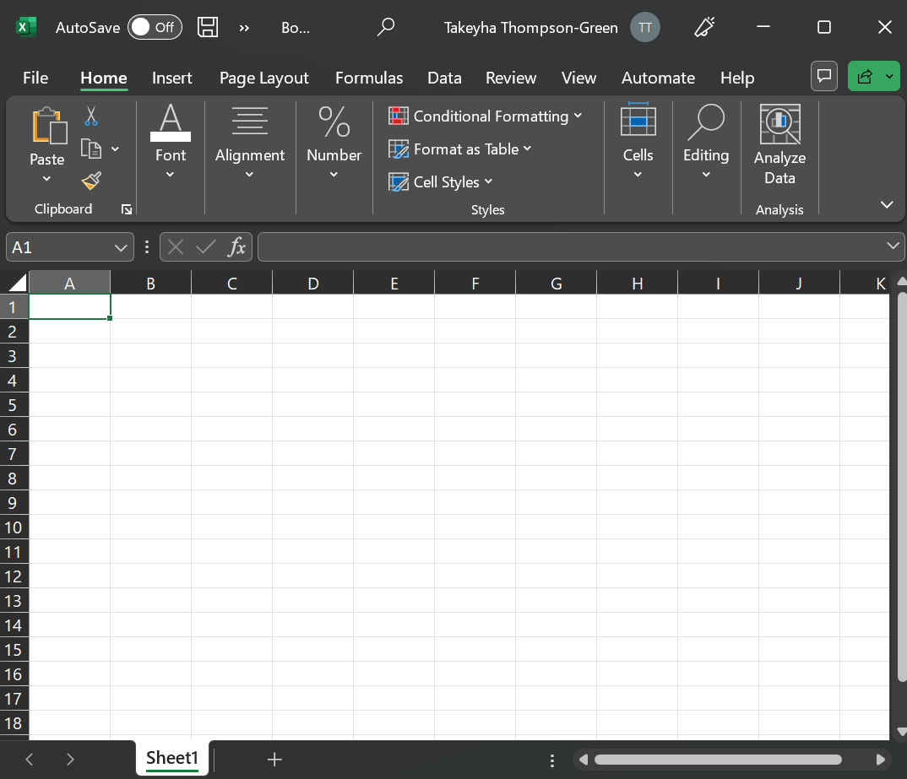
SOFTWARE
The programs that I used in this project were :
Microsoft Excel and Anaconda Navigator . Within Anaconda Navigator I used Spyder IDE.

Slide 5
Planning And DESIGN
After downloading the required software such as Anaconda Navigator and Microsoft excel. I started my planning and design process which included me creating a flow chart . The flowchart was used to explain the approach that I was taking from start to finish. This helped me to understand the developmental process.

Slide 6
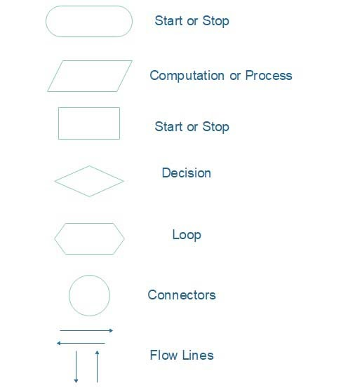
What are flowcharts?
Flowcharts are graphical representational charts that give you a visual explanation of a workflow or process. Flowcharts can be hand drawn or created, in my case. Flow charts consist of different shapes like ovals, circles, boxes, and arrows. Creating this flowchart was very beneficial, which helped me to illustrate the input, process, and output of this weather data analysis program.

Slide 7
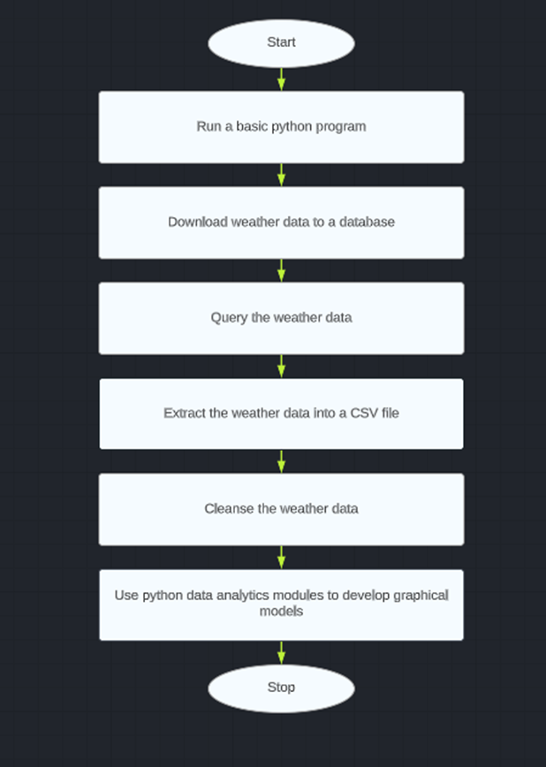
FLOWCHART
Install Python
Download weather data to database
Query the weather data
Extract the weather data into CSV file
Cleanse weather data
Use Python data analytics modules to develop
Graphical models.

Slide 8
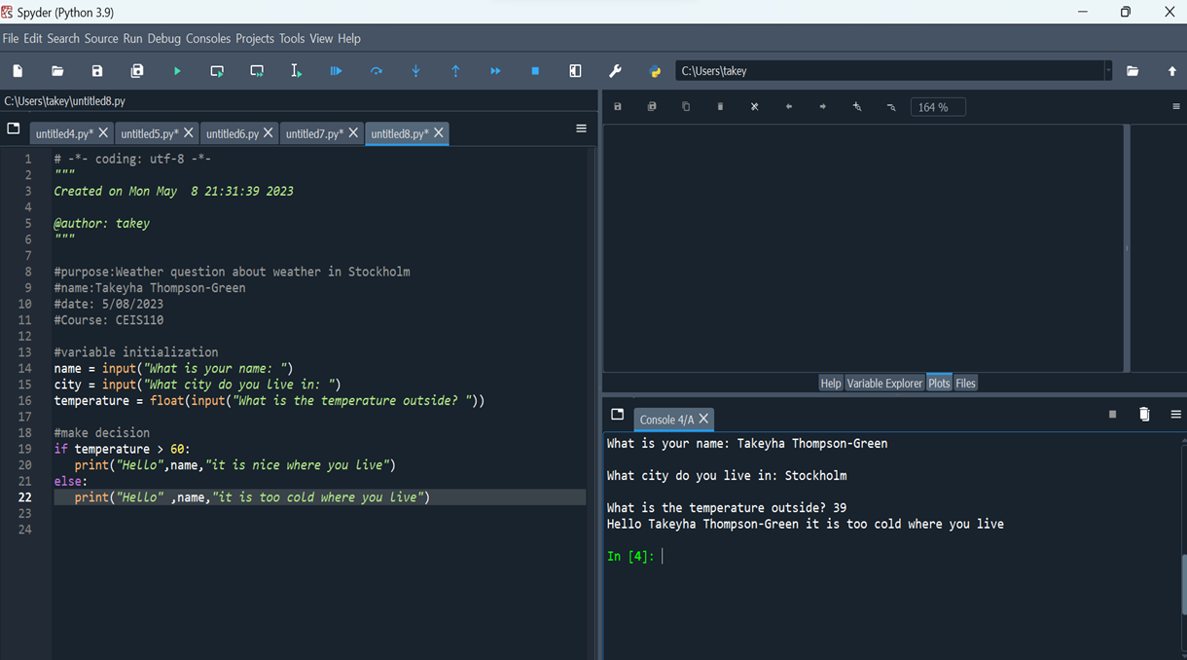
INTRODUCTION TO Python
Python is an open-source, popular computer programming language. The program Python is used for data analytics, data visualization, scientific analytics, web development, and much more.
The program demonstrates a control structure in Python . As you can see in my screen shoot if the temperature was greater than 60. Python would have printed it is nice where you live. Instead, it printed, it is too cold where you live .

Slide 9
Gathering TEMPERATURE AND HUMIDITY DATA
After completing my planning and design process . I ran my code which was developed to download a set of weather observation
This same data was stored on a local database in a table which I used later for weather data analysis

Slide 10
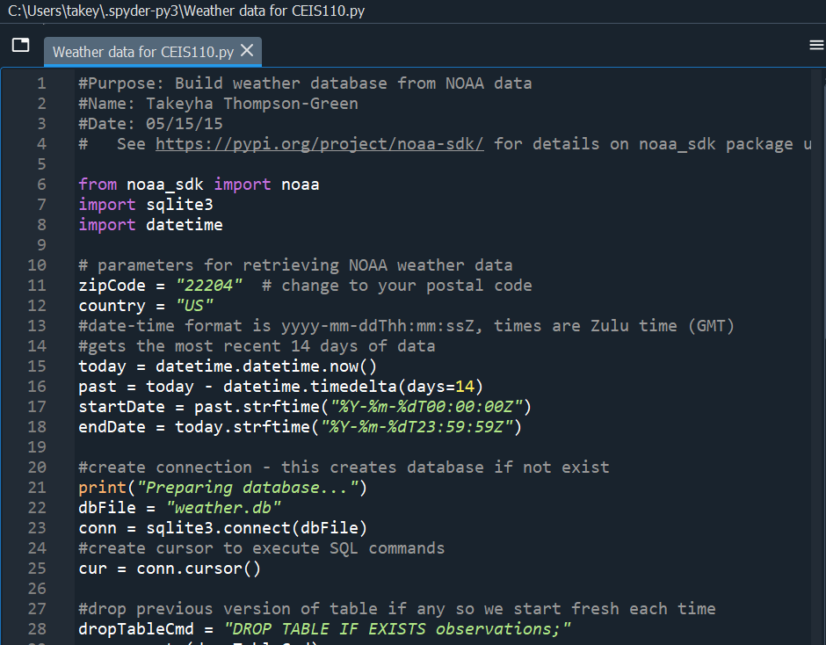
BuildWeatherDb.py Code (Screenshot)
This code created a table name observations table with the fields:
timestamp
windSpeed
temperature
relativeHumidity
windDirection
barometric Pressure
visibility, and text Description.
This weather database file was named weather.db and saved in the same directory as the Python code.
(Screen shot of code in Spyder)

Slide 11
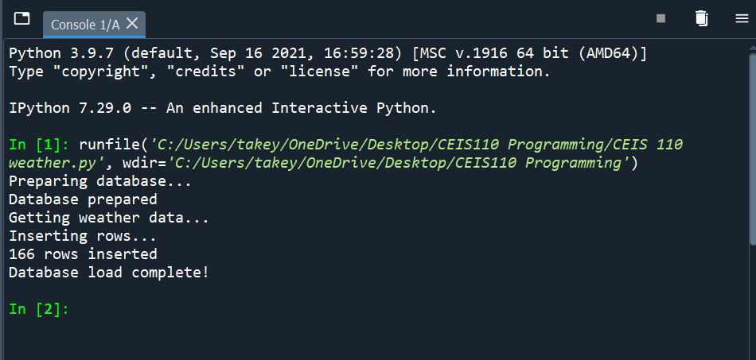
Python Console (Screenshot)
Screenshot of program output in Python console showing program executed successfully .Which also included that 166 rows were inserted into the database.

Slide 12
Weather. dB File (Screenshot)
Screenshot of created Weather database file saved in my class folder.

Slide 13
Querying and manipulating data with SQL and Python
Structured Query Language (SQL) is a programming language that is specialized for working with a relational database.
I was able to issue SQL query commands to my database and view the results when using Python .

Slide 14
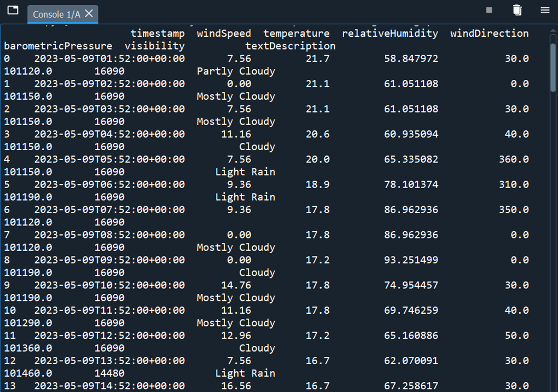
Query to retrieve all columns and all rows
In this part of my process , I executed a SQL Select Query. I was able to view weather data from the database using a query from all columns and rows. Screenshot of SQL query command and results
Weather data from my output window

Slide 15
Query to retrieve lowest and highest temperatures (Screenshot)
SQL query command and results which were in Celsius instead of Fahrenheit .In the screenshot you’ll be able to see the min and max

Slide 16
Query to retrieve all clear days (Screenshot)
This query was performed to retrieve all clear days , which is seen in the text description column . Along with the temperature and windspeed.

Slide 17
Querying and manipulating data with SQL and Python
In this step, I started cleansing my data due to data output from machines having irrelevant data or data errors. The next step was to save my data into a CSV file so it could be read by Microsoft Excel. Which later I used further in the project.

Slide 18
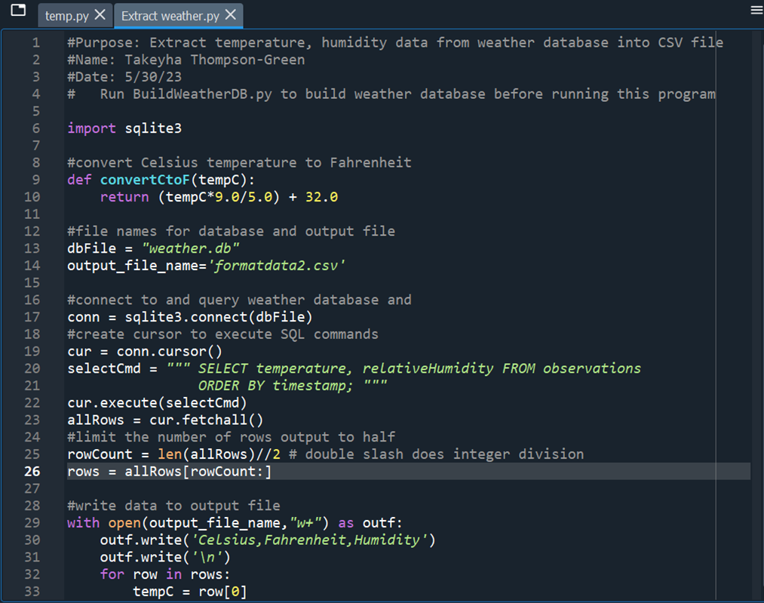
EXTRACTING TEMPERATURE and HUMIDITY DATA
This code was used to extract only temperature and humidity data . This code created 2 CSV files , formatdata1.csv and formantdata2.csv.
ExtractTempHumidity.py Python code

Slide 19
Retrieve and Convert Data to CSV Format (Screenshot)
Format data file open in Excel showing 3 columns of data which are :
Celsius
Fahrenheit
Humidity

Slide 20
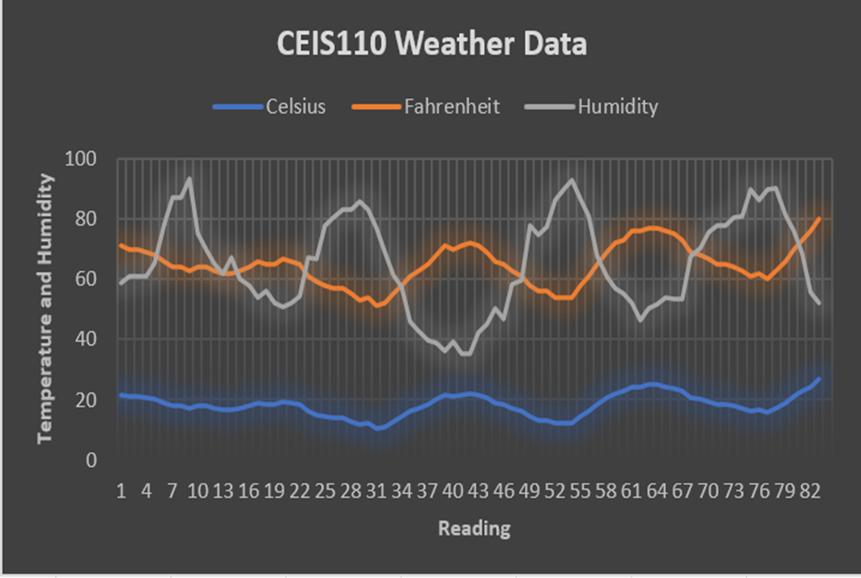
Temperature and Humidity Chart (Graph)
Excel line chart based on temperature and humidity data from Period 1.

Slide 21
Develop Graphical Models and Interpret Results/Data analytics

Slide 22
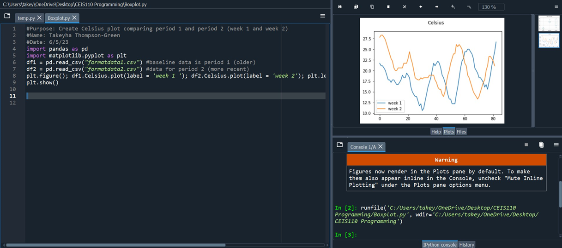
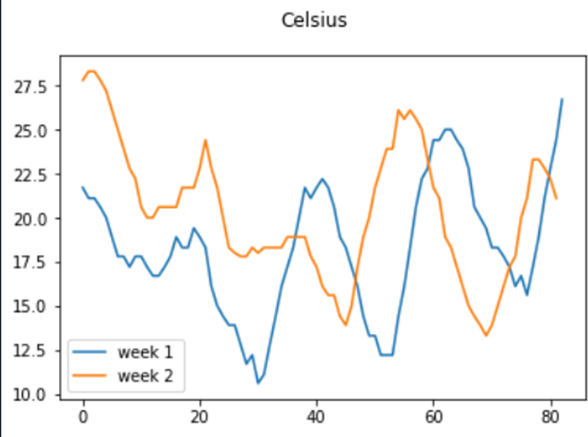
CELSUIS PLOT COMPARING PERIOD 1&2

Slide 23
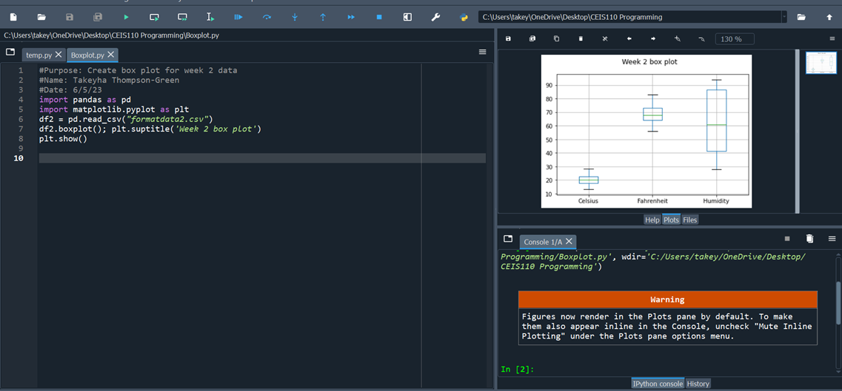
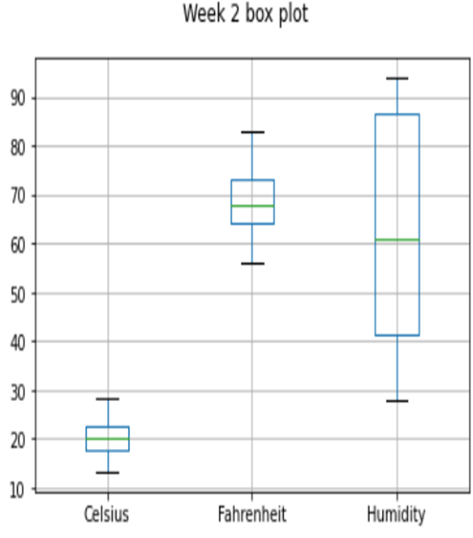
Period 2 box plot

Slide 24
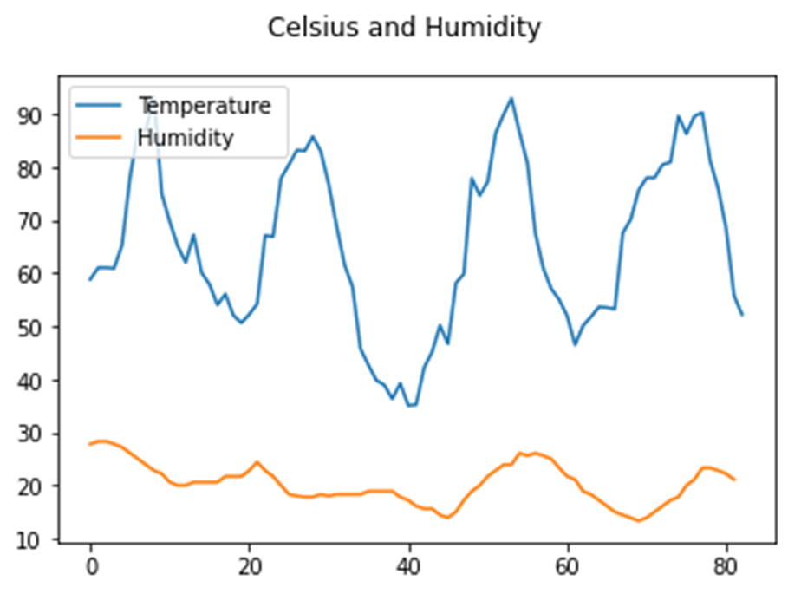
ANALYSIs
In this step I had to think of my own question and create a chart/graph to answer the question . Which was :
What is the relationship between temperature and humidity ?Is it less humid on cooler days vs hotter days ?
Answer supported by Chart:
I’ve noticed as the temperature rises the humidity also rises upwards. Also, as the temperature drops so does the humidity . I also notice that as the temperature drops its is less humid as the temperature has dropped and starts to rise. The weather doesn’t become less humid on cooler days it seems as if once the temperature drops the humidity decrease slower than the temperature .

Slide 25
Predictions
Based on the data provided, I predict that the temperature will continue to rise and drop over the next few days. I would expect the humidity to follow that same trend based on the weather from my personal observation, it seems as if the hot weather brought in the humidity. I noticed stays humid for a bit until the weather cools down. If the weather rises, the humidity will slowly rise. If the temperature lowers the humidity would stay for a bit and eventually decrease over time.

Slide 26
Challenges
Some of the challenges that I faced were :
Python crashing randomly
Python and taking forever just to load

Slide 27
Career Skills
Skills that I've gained during this project were :
Programming using Python
( Anaconda Navigator)
Creating Flowcharts in Microsoft Excel
Data Cleansing
Data Analysis – formulation my own question and making predictions based of graphs.
Communication and gathering data

Slide 28
CONCLUSION
This project was very intriguing, even though I experienced very few issues with Python crashing. The project was hands-on and visual. I got the chance to create a flowchart and a few graphs of data. I also got to formulate my questions and analysis. This project also gave me an introduction to Python .

